Slide 1
Autoimmune disorders
Hypersensitivities win which the body fails to recognize its own antigens or self antigens. An individuals body cells have specific antigen on the cells surfaces.
Failure of the body to recognize the self antigen, leads to the body attacking and destroying its own tissues.
Cause for autoimmune disease is currently unknown and studied.
Some autoimmune disorders include Rheumatoid arthritis, Rheumatic fever, Myasthenia Gravis, Type 1 Diabetes, Lupus erythematosus, and scleroderma.

Slide 2
Rheumatic Fever
Description: Rheumatic Fever is an inflammatory disease, that can affect the heart, joints and skin.
Etiology: Occurs following a group of streptococcal infection, usually strep throat. In some individuals, the proteins in their hearts and other connective tissues are similar to the protein in strep bacteria. Exposure to strep bacteria causes the immune system to make antibodies to fight the bacteria.
These antibodies also attack the tissues of the heart and joints because they cannot distinguish the difference in the proteins. Rheumatic fever is characterized by myocarditis. (myo=muscle, cardi=heart, itis= inflammation)

Slide 3
Rheumatic fever
Symptoms: Rheumatic fever usually occurs 1 to 4 weeks after a streptococcal infection. Children and adolescents are most commonly affected. Onset of the disease can be sudden or gradual and includes symptoms of fever , malaise, and joint pain.
The first occurrence of rheumatic fever might be mild and resolve without any permanent damage. Further episodes are usually more severe and might lead to permanent scarring and deformity of the heart valves. Deformity of the mitral and aortic valve can eventually lead to heart failure.

Slide 4
Rheumatic fever
Diagnosis: There is no definitive test for diagnosing rheumatic fever. Blood testing along with electrocardiogram to determine heart muscle damage, that is part of the diagnostic workup, as well as a positive culture for Streptococcus bacteria being a indicative of the diagnosis.
Treatment: Culturing strep infections and prolonged treatment (at least 10 days) with antibiotics is most effective. Prophylactic antibiotics can be given to susceptible individuals. Surgical replacement of the heart valves might be necessary for individuals with severe valve deformity.

Slide 5
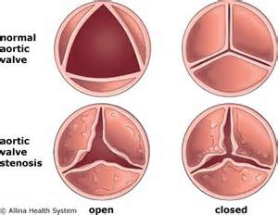
Rheumatic fever
Prevention: Prompt and accurate diagnosis and treatment of group A streptococcal infections are the best preventative measures against rheumatic fever.

Slide 6
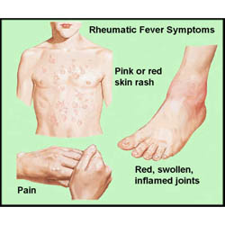
Rheumatic Fever
https://www.youtube.com/watch?v=NSJwthP7c9s
https://www.youtube.com/watch?v=PNMP-GLWsoU
Very rare, only occurs in severe cases.
(Erythema Marginatum)
More common symptoms include Sydennams Chorea (rapid irregular jerking).
(Arthritis)

