Slide 1
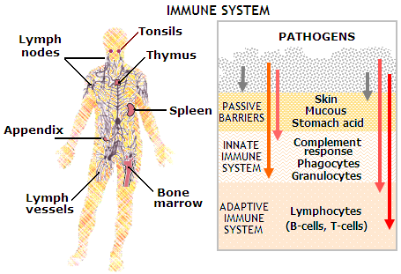
Impaired immunity
1st line of defense of the body’s normal structure and function, including intact skin, mucous membranes, tears, and secretion.
2 additional ways are: inflammatory response in which leukocytes kill foreign invaders, and specific antibody-antigen in which the body responds to antigens by producing antibodies.
Antibodies: also called immune bodies, are proteins the body produces to react to antigen and render it harmless.
Antigen: substances that cause the body some type of harm, thus setting up a specific reaction.

Slide 2
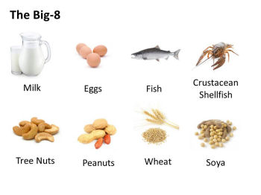
Allergy
Immune response is too hypersensitive to environmental substances.
The allergen in an allergy can be anything like house dust, grass, pets, perfumes, or insect bites.
Allergens only cause a reaction to the persons that are sensitive to the allergen.

Slide 3
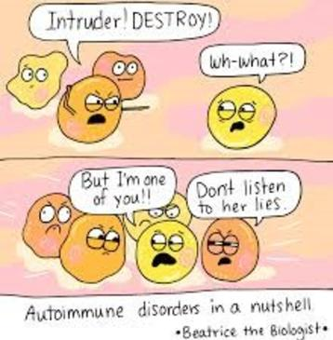
Autoimmunity
When the immune response attacks itself. (auto=self)
The body’s lymphocytes (white blood cells producing antibody’s) cannot identify the body’s own self antigens, which are harmless.
In response, lymphocytes form antibodies then attack the body’s own cells.
Ex: Rheumatoid arthritis and rheumatic fever.

Slide 4
Immunodeficiency
Inability to defend the body due to a decrease or absence of leukocytes, primarily lymphocytes.
Immunodeficiency in people are usually asymptomatic (without symptoms) except for recurrent infections that lead to death.
Acquired Immunodeficiency syndrome (AIDS) is an example.
Immunodeficiency can also be caused by medications like chemotherapy and radiation.

Slide 5
Immunodeficiency
Organ recipients are intentionally immunosuppressed or immunodeficient to save their transplant organ.
Without immunosuppressant medications, the body’s immune system would recognize the organ as foreign and attack it, leading to organ death. (Organ rejection)

Slide 6
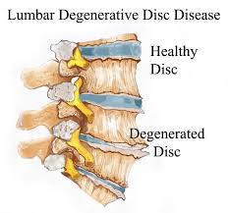
Aging
Diseases related to aging are often called degenerative diseases.
Tissue degeneration is a change in functional activity to a lower or lesser level.
Aging mechanisms are complex and thought to include factors as heredity, lifestyle, stress, diet, and environment.

Slide 7
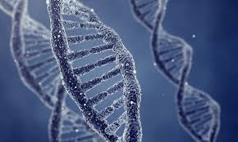
Aging
Heredity factors can include increased life span related to the inherited ability to resist disease.
Hereditary factors cannot be controlled, longevity can be increased and disease decreased by controlling lifestyle behaviors that increase risk of chronic disease.
Body repairs and replaces itself throughout its lifetime, but with aging, this process slows.

Slide 8
Aging
Age as early as 40, causes changes to skin, endocrine function, vision and muscle strength.
Bone loss is also common causing osteoporosis, decreased melanin pigment production, leading to the graying of the hair.
Decreased immunity, leading to increase in infections, and possible development of cancer.
Loss of brain and nerve cells that might lead to senile dementia, as well as intestinal motility, causing constipation.

