Slide 1
Immune system disease and Disorders
Chapter 5

Slide 2
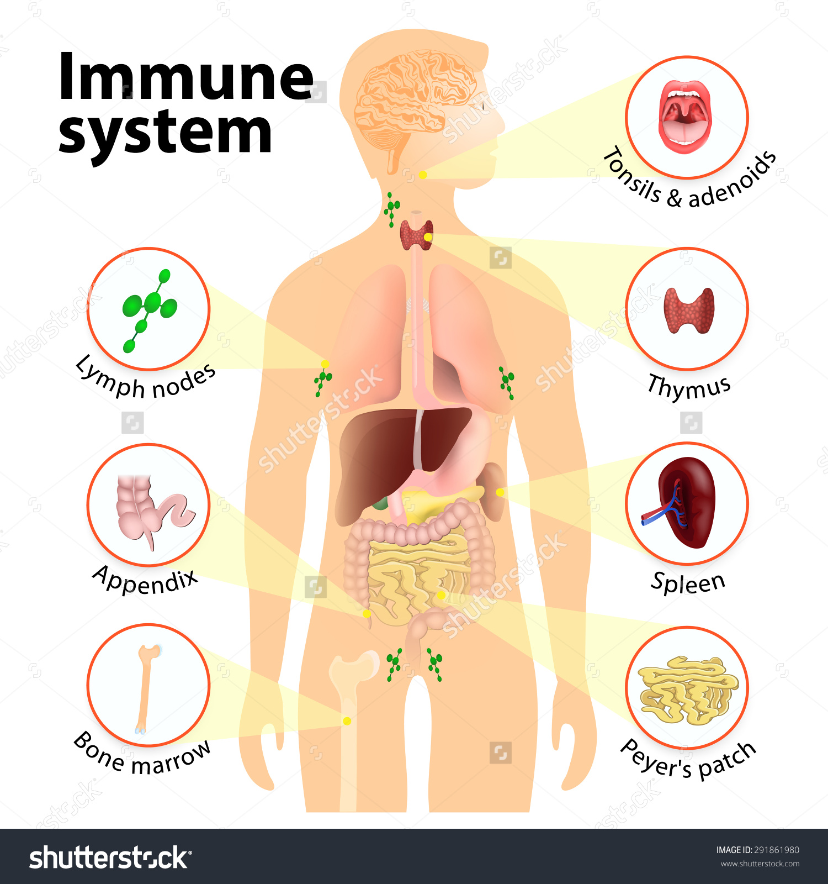
Immune System Anatomy and Physiology
Immune system includes primary organs such as the thymus gland, and the bone marrow. And secondary organs such as the lymph nodes, spleen, liver, and tonsils.
Lymphocytes are the major cells of the immune system, arise and develop in the primary organs.
Secondary organs are responsible for filtering foreign substances and providing the space for antigen reactions.

Slide 3
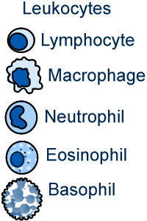
Immune System Anatomy and Physiology
The immune system includes four types of leukocytes: Polymorphonuclear lymphocytes, monocytes, macrophages , and lymphocytes.
Polymorphonuclear lymphocytes (PMN’s) aka granulocytes, are active in inflammatory process. Some activate when infection threatens body, others prevent damage to tissues and cells from allergic reactions.
Monocytes and macrophages become phagocytic in presence of pathogens and foreign substances.

Slide 4
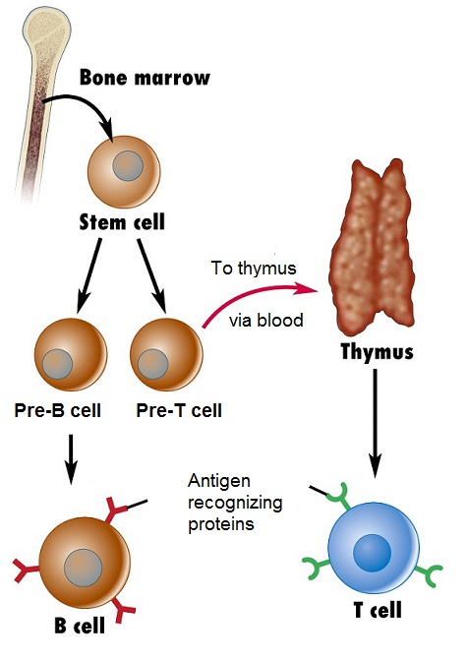
Immune System Anatomy and Physiology
Lymphocytes are in charge of the Immune response being formed in the bone marrow. Remaining and maturing cells become B lymphocytes while others migrate and mature in the thymus and become T lymphocytes.
When B&T lymphocytes mature, they enter the blood and circulate and colonize lymphatic organs, predominantly the spleen and lymph nodes.
T lymphocytes (T cells) destroy microorganisms that invade the body and are responsible for the cell mediated response.

Slide 5
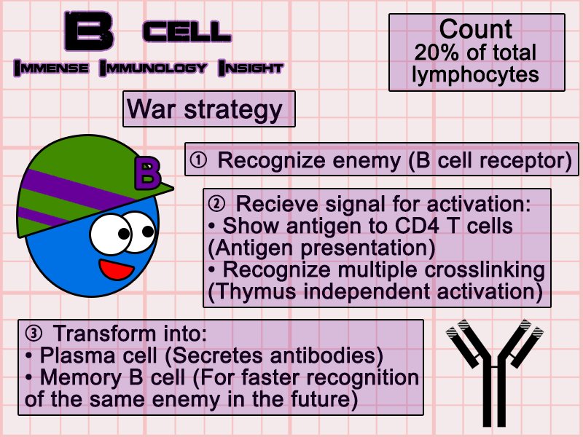
Immune System Anatomy and Physiology
B lymphocytes are responsible for humoral immunity, which is associated with circulating antibodies by enlarging and dividing to make mature plasma cells.
The plasma cells secrete antibodies into the blood and lymph to protect the body against infections and toxins produced by microorganisms.

Slide 6
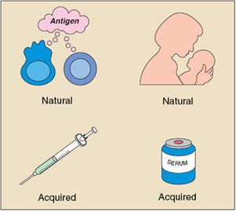
Immune System Anatomy and Physiology
There are two types of immune responses in the body:
Specific and non-specific.
Specific immunity is associated with antigens and antibody reaction.
Antibodies respond to the exposure to antigens. Antibodies may neutralize, kill, or cause clumping of the foreign microorganism.
A group of proteins are produced in the liver and combined with serum in the liver to enhance the work for the antibodies to destroy the invader.

Slide 7
Organs of the immune system

Slide 8
Immune System Anatomy and Physiology
The nonspecific immune response includes, inflammation, phagocytosis, physical barriers (skin and mucous membranes, etc..) and chemical barriers (acids and other secretions)
Nonspecific immunity is part of the first line of defense against foreign invaders.

Slide 9
Immune System Anatomy and Physiology
The best way to classify immunity is by dividing it into passive and active, then further divide it into natural and artificial.
Natural resistance is the inherited immunity the individual may possess due to race, species, or ethnic background. Some races, species, or particular groups of populations are naturally resistant to certain diseases. Such as some are susceptible to certain diseases.

Slide 10
Immune System Anatomy and Physiology

Slide 11
Common signs and symptoms
A patients concern can be considered as both a symptom and a sign. Some references consider this an objective or observable symptom. For example, a patient complaining of a runny nose. It’s the patients symptom, but for the doctor it is an observable sign.
Common signs and symptoms related to the various immune system disease are varied, depending on the organ or organ system affected.
For example: Allergies, symptoms include the inflammatory response (redness, heat, swelling, and itching), and respiratory symptoms (runny nose, cough, sneezing, and nasal congestion).

Slide 12
Common signs and symptoms
A classical problem with immune deficiency disorders is the development of unusual and severe infections such as pneumonia, meningitis, or septicemia.
The development of infections by microorganisms that are usually not pathogenic (opportunistic infections), might indicate of an immunodeficiency disorder (lack of immunity).
Common sign and symptoms related to various autoimmune(immune against self) and isoimmune (immunity against other humans) vary depending on organ and organ system, as well as the pathogen.

