Slide 1
CH 34
Section 1:
Circulatory System

Slide 2
Essential Questions
What are the main functions of the circulatory system?
How does the blood flow through the heart and body?
Circulatory System
Copyright © McGraw-Hill Education

Slide 3
Vocabulary
New
artery
capillary
vein
valve
heart
pacemaker
plasma
red blood cell
platelet
white blood cell
atherosclerosis
Circulatory System
Copyright © McGraw-Hill Education

Slide 4
Functions of the Circulatory System
Transports oxygen and nutrients
Carries disease-fighting materials produced by the immune system
Contains cell fragments and proteins for blood clotting
Distributes heat throughout the body to help regulate body temperature
Circulatory System
Copyright © McGraw-Hill Education

Slide 5
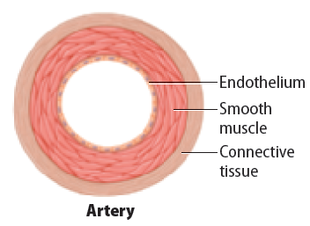
Blood Vessels
Arteries
Oxygen-rich blood is carried away from the heart in large blood vessels called arteries.
Arteries are composed of three layers:
Outer layer of connective tissue
Middle layer of smooth muscle
Inner layer of endothelial tissue
Circulatory System
Copyright © McGraw-Hill Education

Slide 6
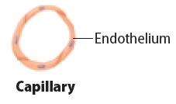
Blood Vessels
Capillaries
Microscopic blood vessels where the exchange of important substances and wastes occur are capillaries.
The walls are only one cell thick.
Circulatory System
Copyright © McGraw-Hill Education

Slide 7
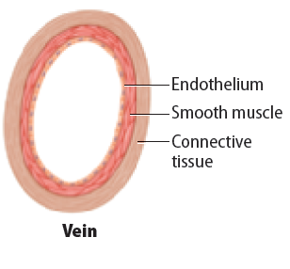
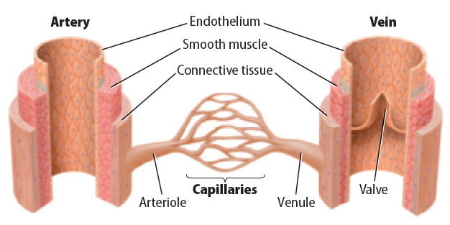
Blood Vessels
Veins
The largest blood vessels are veins.
Carry oxygen-poor blood back to the heart
Contraction of skeletal muscles helps keep the blood moving.
Valves are flaps of tissue that prevent blood from flowing backward.
Circulatory System
Copyright © McGraw-Hill Education

Slide 8
The Heart
A hollow, muscular organ that pumps blood throughout the body
Pumps oxygenated blood to the body
Pumps deoxygenated blood to the lungs
Circulatory System
Copyright © McGraw-Hill Education

Slide 9
The Heart
Structure of the heart
Divided into four compartments called chambers
The right atrium and the left atrium receive blood returning to the heart.
The right and left ventricles pump blood away from the heart.
Valves separate the atria from the ventricles and keep blood flowing in one direction.
Circulatory System
Copyright © McGraw-Hill Education

Slide 10
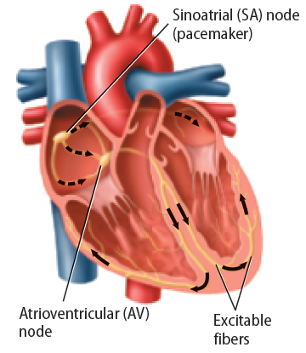
The Heart
How the heart beats
The atria fill with blood.
The atria contract, filling the ventricles with blood.
The sinoatrial (SA) node sends out signals that cause both atria to contract.
The signal travels to another area in the heart called the atrioventricular node, causing both ventricles to contract.
Circulatory System
Copyright © McGraw-Hill Education

Slide 12
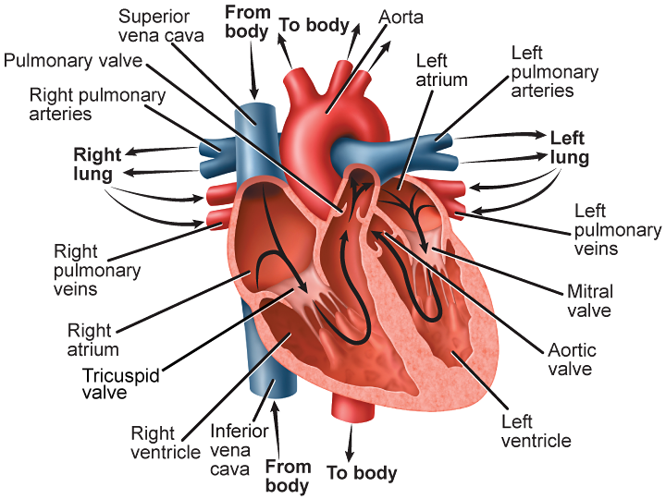
Circulatory System
Copyright © McGraw-Hill Education

Slide 13
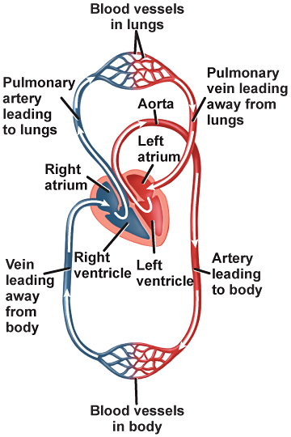
Circulatory System
Copyright © McGraw-Hill Education

Slide 14
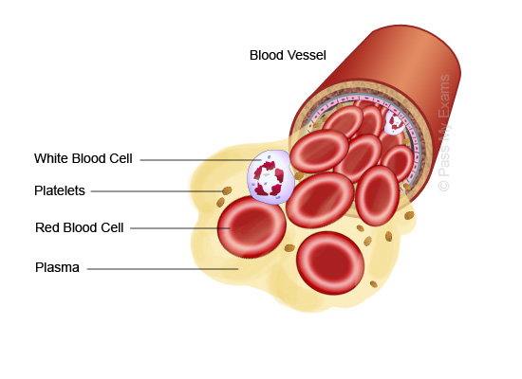
Blood Components
Plasma
The clear, yellowish portion of blood is the plasma.
Carries glucose, fats, vitamins, minerals, hormones, and waste products from the cells
Circulatory System
Copyright © McGraw-Hill Education

Slide 15
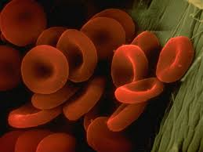
Blood Components
Red Blood Cells
Red blood cells carry oxygen to all of the body’s cells
Consist of an iron-containing protein called hemoglobin
Hemoglobin chemically binds with oxygen molecules and carries oxygen to the body’s cells.
Circulatory System
Copyright © McGraw-Hill Education

Slide 16
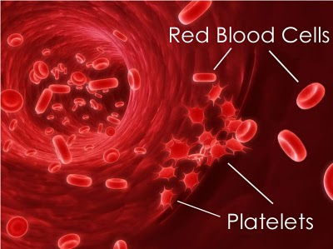
Blood Components
Platelets
Cell fragments that are important in forming blood clots are platelets.
Collect and stick to the vessel at the site of the wound
Release chemicals that produce a protein called fibrin
Fibrin is a protein that weaves a network of fibers across the cut that traps blood platelets and red blood cells.
Circulatory System
Copyright © McGraw-Hill Education

Slide 17
Blood Components
White Blood Cells
The body’s disease fighters are the white blood cells, which are produced in bone marrow.
Recognize disease-causing organisms
Produce chemicals to fight the invaders
Surround and kill the invaders
Circulatory System
Copyright © McGraw-Hill Education

Slide 18
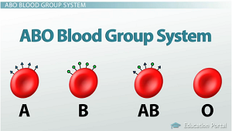
Blood Groups
ABO blood group
There are four types of blood—A, B, AB, and O.
Rh Factor
Another marker found on the surface of red blood cells
Circulatory System
Copyright © McGraw-Hill Education

Slide 19
Circulatory System

Slide 20
CH 34
Section 2:
Respiratory System

Slide 21
Essential Questions
What is the difference between internal and external respiration?
What is the path of the air through the respiratory system?
What changes occur in the body during breathing?
Respiratory System
Copyright © McGraw-Hill Education

Slide 22
Vocabulary
New
breathing
external respiration
internal respiration
trachea
bronchus
lung
alveolus
Respiratory System
Copyright © McGraw-Hill Education

Slide 23
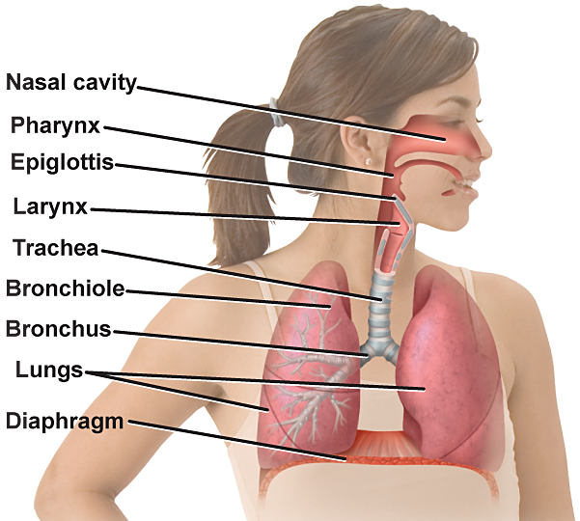
The Path of Air
The respiratory system is made up of the nasal passages, pharynx, larynx, epiglottis, trachea, lungs, bronchi, bronchioles, alveoli (al VEE uh li), and the diaphragm.
Tim Fuller
Respiratory System
Copyright © McGraw-Hill Education

Slide 24
Breathing and Respiration
The respiratory system sustains cellular respiration by supplying oxygen to body cells and removing carbon dioxide waste from cells.
Breathing is the mechanical movement of air into and out of your lungs.
External respiration is the exchange of gases between the atmosphere and the blood.
Internal respiration is the exchange of gases between the blood and the body’s cells.
Respiratory System
Copyright © McGraw-Hill Education

Slide 25
The Path of Air
Air enters your mouth or nose.
Hair like structures called cilia trap foreign particles from the air and sweep them toward the throat.
Filtered air then passes through the upper throat called the pharynx.
The epiglottis allows air to pass from the larynx to a long tube in the chest cavity called the trachea.
The trachea branches into two large tubes, called bronchi, which lead to the lungs.
Respiratory System
Copyright © McGraw-Hill Education

Slide 26
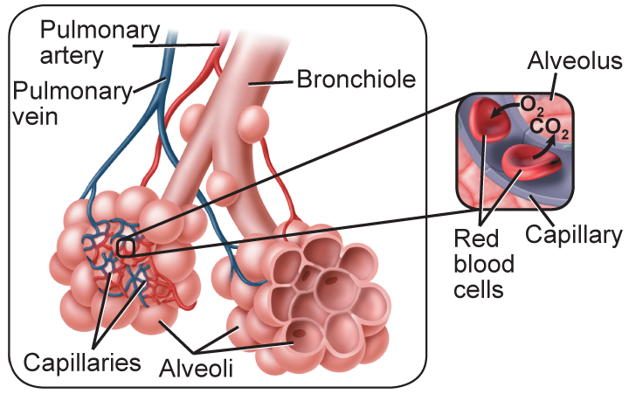
The Path of Air
Each bronchus branches into smaller tubes called bronchioles.
Each of these small tubes continues to branch into even smaller passageways, which end in individual air sacs called alveoli.
Respiratory System
Copyright © McGraw-Hill Education

Slide 27
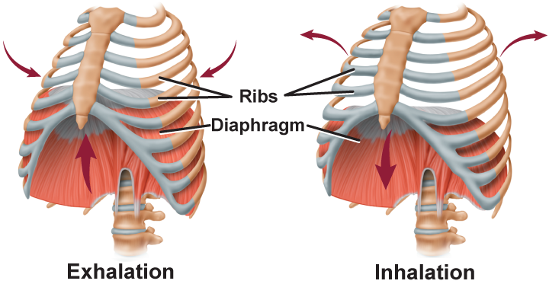
Breathing
Inhalation is the act of taking air into the lungs.
The diaphragm contracts, causing the chest cavity to expand as the diaphragm moves down.
Respiratory System
Copyright © McGraw-Hill Education

Slide 28
Breathing
During exhalation, the diaphragm relaxes and returns to its normal resting position.
This reduces the size of the chest cavity as the diaphragm moves up.
Respiratory System
Copyright © McGraw-Hill Education

Slide 29
Respiratory System

