Slide 1
Chapter 4
Inflammation and infection

Slide 2
Defense Mechanisms
Defense to infections can be non-specific, protecting the body from any and all invaders prior to killing it.
The system uses three basic lines of defense to accomplish its protective goals.
Physical or surface barriers (nonspecific)
Inflammation (nonspecific)
Immune response (specific)

Slide 3
Physical or surface barriers
Intact skin is the first line of defense, as a physical barrier and an acidic, antimicrobial surface that is an effective barrier against infection most of the time.
Skin has more than 650,000 microorganisms per square inch on its surface, adding more than 100 trillion microorganisms per person.
Normal bacterial flora of skin prevents habitation by other bacteria, sebaceous glands secrete antibacterial acids and enzymes.
Mucous membranes serve to trap invaders

Slide 4
inflammation
If physical barriers are broken the foreign invader penetrates the cell and tissue, triggering the second line of defense, inflammatory response.
Primary goals of inflammatory response are to isolate the invader, destroy it, and clean up the debris, thereby promoting healing.

Slide 5
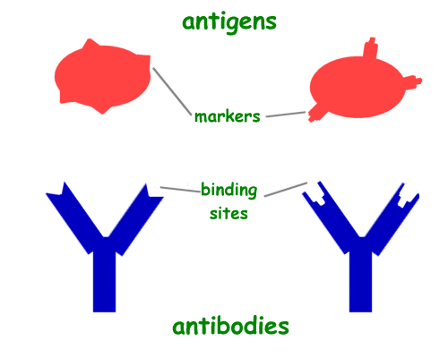
Immune response
The last line of defense reacts to invasion slower than inflammation, but with specific killing ability.
All cells even human body cells, have protein or saccharide markers called antigens on their surfaces that identify the cell.
During immune response, the body identifies the invader by the antigen.
Once antigen is identified, lymphocytes produce antibodies that link to the cells antigen, killing or disabling it.

Slide 6
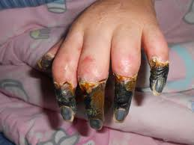
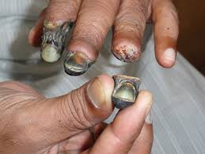
Inflammation
Non specific cellular and vascular reaction to any tissue trauma or injury.
Limiting factor of skin is that if there is no blood supply, there will be no inflammation.
If tissue is destroyed by injury, inflammation will only occur in the borders of the injury where blood is maintained.
In gangrenous tissue (dead tissue due to no blood supply) no inflammation will occur but will have an obvious reaction at its borders.

Slide 7
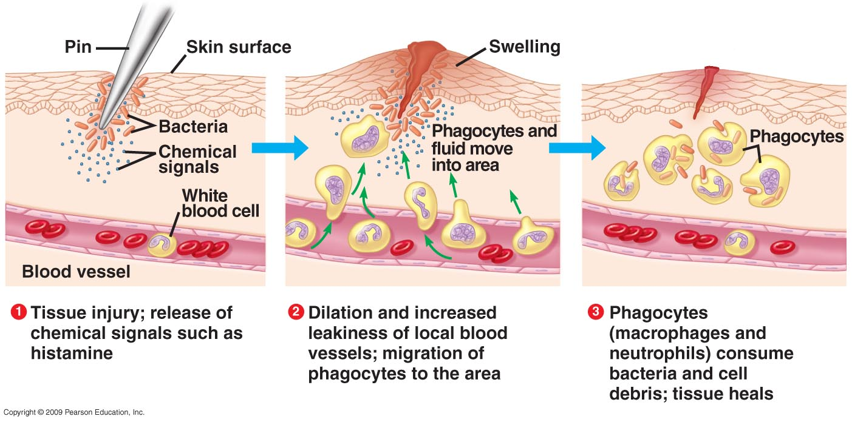
inflammation
Inflammations only occur in vascularized (supplied with blood). This is important in forensic evidence.
Evidence of inflammation in tissue shows person was injured while alive, and no inflammation shows injury was done after death.
Inflammation is designed to be a beneficial protective defense mechanism.

Slide 8
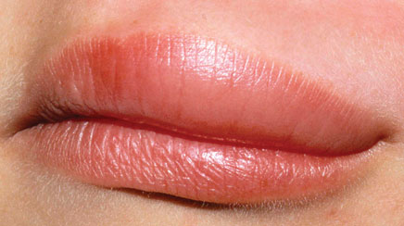
Inflammation
If infection becomes too intense, it may become harmful to the tissue, such as acute hypersensitive reaction leads local tissue damage or anaphylactic shock and death of the individual
If process goes awry, autoimmune response will occur, causing body to basically begin to destroy itself, and anti-inflammatory medication will be needed to stop the process if it becomes injurious.

Slide 9
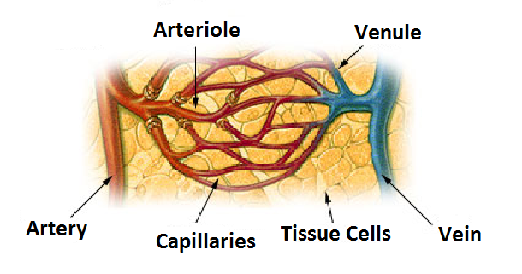
Inflammation Process
When we undergo any trauma, inflammation will occur every time.
Mast cells (tissue histiocytes) exit in all tissues of the body plating a major role in inflammatory process.
When injured or irritated, the cells release histamine, causing local arterioles, venules, and capillaries to dilate, increasing blood flow to the area, called Hyperemia (hyper=increased, emia= blood) causing redness and heat to the area.

Slide 10
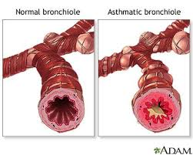
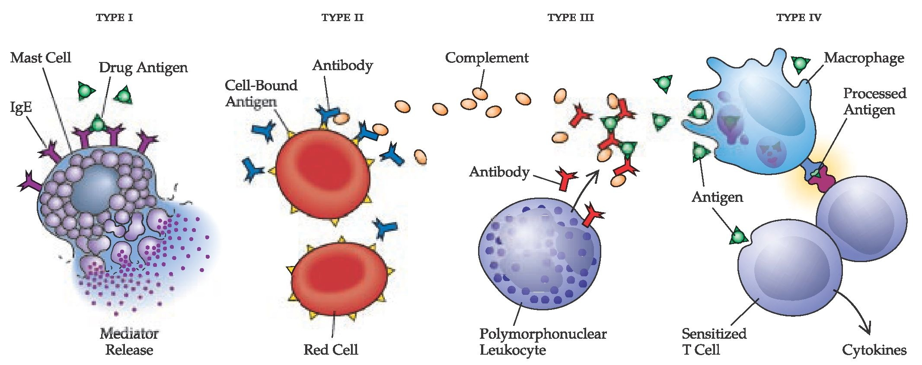
Inflammation process
Hyperemia also causes leukocytes(white blood cells) to the area as well as neutrophils, also called polymorphonuclear cells (Pmn’s) (poly=many, morphic=shaped nucleus).
These cells line the endothelium of the vessels waiting to move into tissues.
As capillaries dilate due to histamine, vascular permeability occurs. Allowing substances to enter that typically wouldn’t.

Slide 11
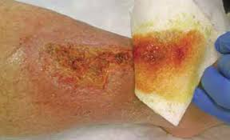
Inflammatory process
The permeability that occurs allows blood fluid called exudate to leak into tissue causing swelling and edema observed with inflammation.
As edema increases, more pressure is exerted on nerve endings leading to increase pain and tenderness, as well as possible loss of function.
Vascular and cellular responses produce five cardinal signs of inflammation: heat, redness, swelling, pain, and loss of function.

Slide 12
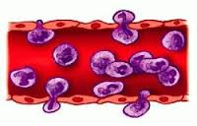
Inflammatory process
Diapedesis is the process of neutrophils extending part of their bodies between epithelial cells and squeeze through the capillary wall.
The process of diapedesis delivers millions of neutrophils within a few hours, making them the first cells to arrive and in large numbers directing the cells to the injured area by a process called Chemotaxis.
There are chemicals detected through chemoreceptors on the neutrophils outer membrane that are released by a variety of elements like bacteria, dead skin, and plasma proteins.

Slide 14
*Inflammation process*
When the neutrophil arrives at the scene of the trauma, it begins phagocytosis, eating and destroying microorganisms, foreign material and dead cells.
Life of a neutrophil is short, so the death of many neutrophils mixed with exudate or blood fluid, make up the white fluid identified as pus.
after about 3 to 4 days after inflammatory process begins, large numbers of another white cells, Monocytes begin to arrive.
As monocytes leave the bloodstream and move to tissue, it will also become phagocytic and is called a macrophage.

