Slide 1
CH 17
Taxonomy and Classification
& 18
Bacteria and Viruses

Slide 2
Essential Questions 17-1
Using binomial nomenclature, how are scientific names written?
What are the categories used in biological classification?
The History of Classification

Slide 3
Vocabulary
Review
morphology
New
classification
taxonomy
binomial nomenclature
taxon
genus
family
order
class
phylum
division
kingdom
domain
The History of Classification

Slide 4
Early Systems of Classification
Classification is the grouping of objects or organisms based on a set of criteria.
Biologists use a system of classification to organize information about the diversity of living things.
The History of Classification

Slide 5
Early Systems of Classification
Linnaeus’s system
Linnaeus’s system of classification was based on observations of morphology and habitat.
The Linnaean system was the first formal system of taxonomy – the discipline of identifying, naming, and classifying organisms.
The History of Classification

Slide 6
Early Systems of Classification
Binomial nomenclature
Linnaeus’s method of naming organisms, called binomial nomenclature, gives each species a scientific name with two parts.
The first part is the genus name, and the second part is the specific epithet, or specific name, that identifies the species.
Biologists use scientific names for species because common names vary in their use.
The History of Classification

Slide 7
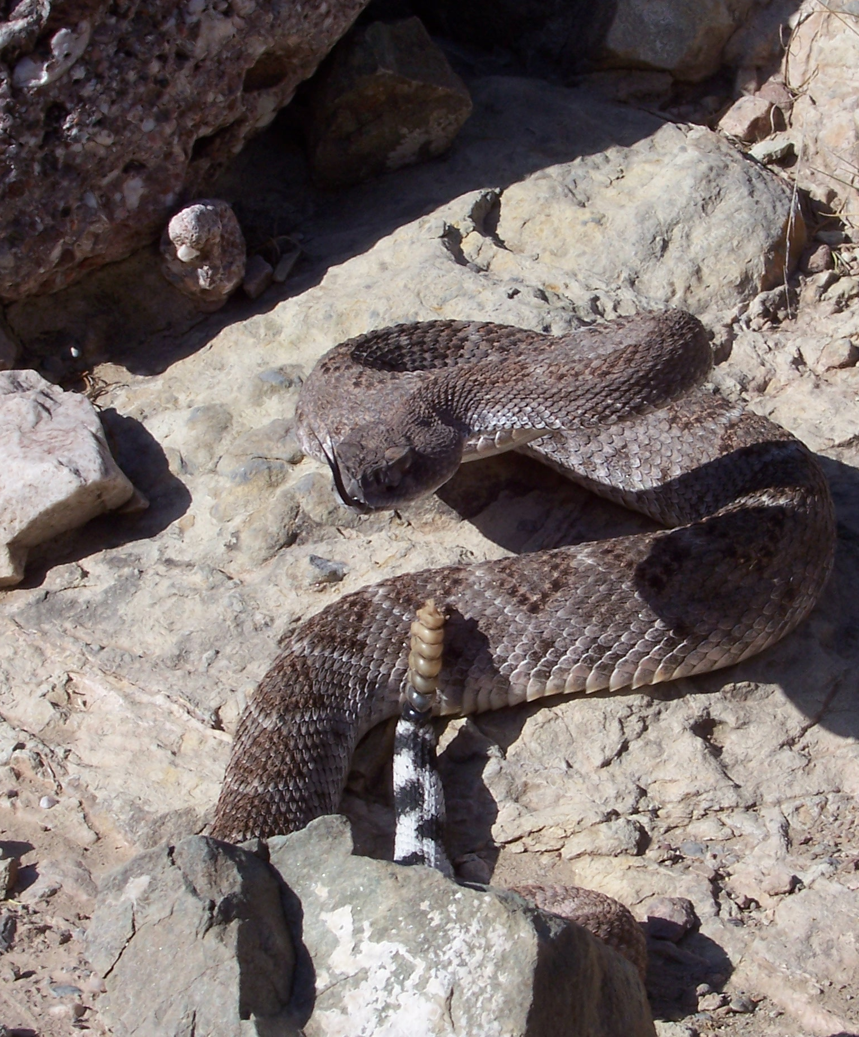
Early Systems of Classification
Binomial nomenclature
When writing a scientific name, scientists use these rules:
The first letter of the genus name always is capitalized, but the rest of the genus name and all letters of the specific epithet are lowercase.
For example Crotalus atrox

Slide 8
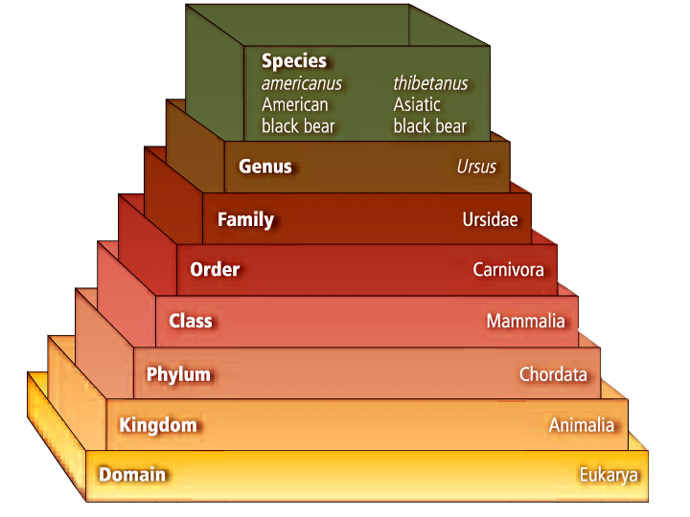
Taxonomic Categories
The taxonomic categories used by scientists are part of a nested-hierarchal system.
Each category is contained within another, and they are arranged from broadest to most specific.
The History of Classification

Slide 9
Taxonomic Categories
Higher taxa
An order contains related families.
A class contains related orders.
A phylum or division contains related classes.
A kingdom contains related phyla.
The domain is the broadest of all the taxa and contains one or more kingdoms.
The History of Classification

Slide 10
Taxonomic Categories
Species and genus
A named group of organisms is called a taxon.
A genus is a group of species that are closely related and share a common ancestor.
Family
A family is the next higher taxon, consisting of similar, related genera
The History of Classification

Slide 12
Systematics applications
Taxonomy is part of a larger branch of biology called systematics.
Systematics is the study of biological diversity with an emphasis on evolutionary history.
Taxonomists can produce detailed guides to identify different organisms.
Through the use of dichotomous keys, which provide a series of choices between alternate characteristics, users can identify organisms they encounter.
The History of Classification

Slide 13
Essential Questions 17-2
What are the similarities and differences between species concepts?
What are the methods used to reveal phylogeny?
How is a cladogram constructed?
Modern Classification

Slide 14
Vocabulary
Review
evolution
New
phylogeny
character
molecular clock
cladistics
cladogram
Modern Classification

Slide 15
Determining Species
Typological species concept
The concept of what determines a species has changed through time.
Aristotle and Linnaeus used the typological species concept – each species a distinctly different group of organisms based on physical similarities.
Based on the idea that species are unchanging, distinct, and natural types.
Modern Classification

Slide 16
Determining Species
Biological species concept
The biological species concept defines a species as a group of organisms that is able to interbreed and produce fertile offspring in a natural setting.
Does not account for extinct species or species that reproduce asexually.
Modern Classification

Slide 17
Determining Species
**Phylogenic species concept**
Phylogeny is the evolutionary history of a species.
The phylogenic species concept defines a species as a cluster of organisms that is distinct from other clusters and shows evidence of a pattern of ancestry and descent.
Characters
To classify a species, scientists construct patterns of descent by using characters – inherited features that vary among species.
Characters can be morphological or biochemical.
Modern Classification

Slide 18
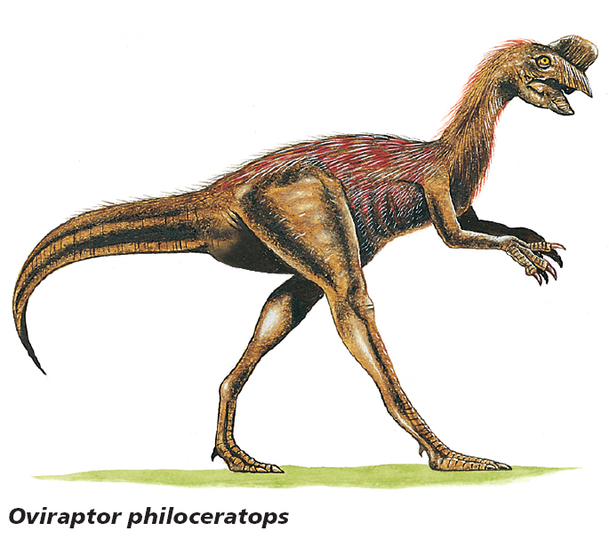
Characters
**Morphological characters of species concept**
Shared morphological characters suggest that species are related closely and evolved from a recent common ancestor.
Birds and dinosaurs:
Modern birds may not look closely related to dinosaurs.
Both birds and dinosaurs have hollow bones
Theropods have hip, leg, wrist, and shoulder structures more similar to birds than living reptiles.
Modern Classification

Slide 19
Characters
**Biochemical characters of Species Concept**
Scientists use biochemical characters, such as amino acids and nucleotides, to help them determine evolutionary relationships among species.
DNA and RNA analyses are powerful tools for reconstructing phylogenies.
Chimpanzee
Gorilla
Orangutan

Slide 20
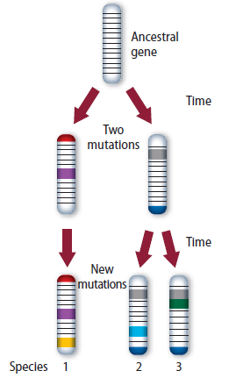
Characters
Biochemical characters
A molecular clock is a model that is used to estimate the amount of time it has taken to species to evolve from a common ancestor.
Scientists use molecular clocks to compare DNA sequences between species – the more mutations present, the more time has passed.
The rate of mutation is affected by many factors, making molecular clocks difficult to read.
Modern Classification

Slide 21
Phylogenetic Reconstruction
Character types
Cladistics classifies organisms based on the order that they diverged from a common ancestor.
Scientists consider two main types of characters when doing cladistic analyses:
Ancestral characters are found within the entire line of descent of a group of organisms.
Derived characters are only found after a split from the descendent line.
Modern Classification

Slide 22
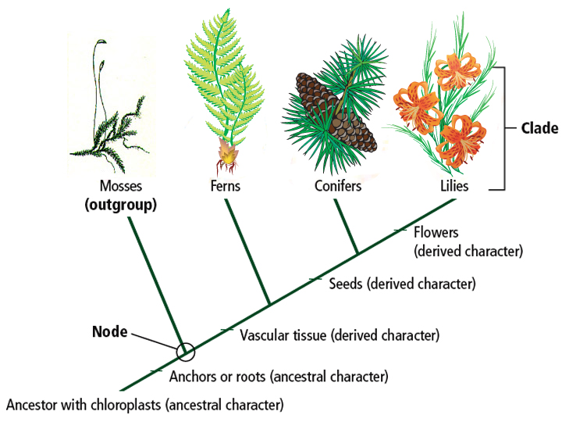
Phylogenetic Reconstruction
Cladograms
A cladogram is a branching diagram that represents a proposed phylogeny of a species or group.
One branch of a cladogram is called a clade.
Bozeman Cladograms
Modern Classification

Slide 23
Essential Questions 17-3
What are the major characteristics of the three domains?
What are the differences among the six kingdoms?
How are organisms classified at the kingdom level?
Domains and Kingdoms

Slide 24
Vocabulary
Review
eukaryote
New
archaea
protist
fungus
Domains and Kingdoms

Slide 25
Grouping Species
The broadest category in the classification used by most biologists is the domain.
Three domains: Bacteria, Archaea, Eukarya
Six kingdoms: Bacteria, Archaea, Protists, Fungi, Plantae, and Animalia
Organisms are classified into domains based on cell type and structure
Organisms are classified into kingdoms based on cell type, structure, and nutrition
Domains and Kingdoms

Slide 26
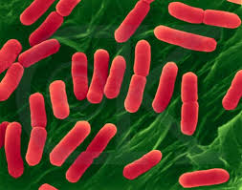
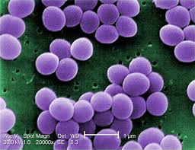
Domain Bacteria
Bacteria are members of both Domain and Kingdom Bacteria
Prokaryotes
Cell walls contain peptidoglycan
Diverse group that can survive many different environments
Most bacteria are heterotrophs that get their energy from other organisms
Most abundant organism on the planet
Copyright © McGraw-Hill Education

Slide 27
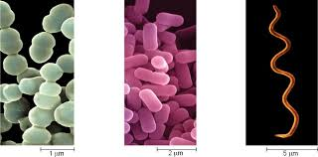
Prokaryote Characteristics
Shapes
Cocci (spherical or round)
Bacilli (rod-shaped)
Spirilli (spiral-shaped)
Movement
Some prokaryotes are stationary, others move with flagella.
Flagella help prokaryotes to move toward materials that they need to survive – light, oxygen, chemicals.
Other prokaryotes move by gliding over a layer of secreted slime
Bacteria

Slide 28
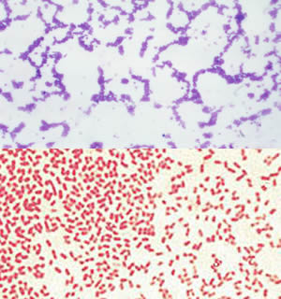
Scientists classify bacteria based on the composition of their cell walls.
All bacterial cells have peptidoglycan in their cell walls.
Gram staining is a common procedure for identifying main kinds of bacteria.
Bacteria with large amounts of peptidoglycan appear purple when stained; Gram-positive.
Bacteria with lipid layers have less peptidoglycan and appear pink when stained; Gram-negative.
Important for antibiotic treatment

Slide 29
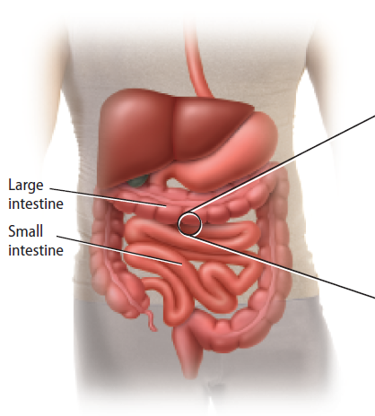
Ecology of Bacteria
Normal flora
Your body is covered in bacteria inside and out.
Normal flora have a symbiotic relationship with humans – prevent disease, aid with digestion, make vitamins
Normal gut flora:
E. coli provide the body nutrients in exchange for a place to live
Bacteria

Slide 30
Ecology of Bacteria
Disease-causing bacteria
A small percentage of bacteria cause disease.
Cause disease in two ways:
Multiply quickly at site of infection before immune system responds
Secrete a toxin or harmful substance
Bacteria

Slide 31
Bacteria and Replication

Slide 32
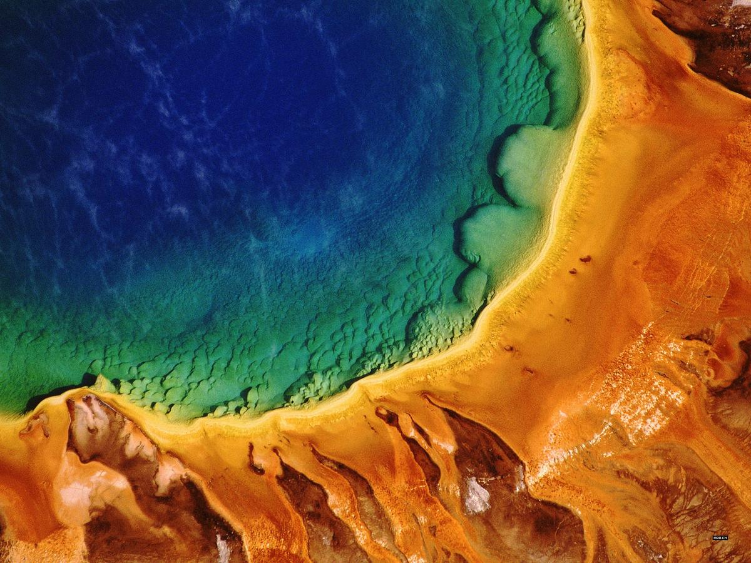
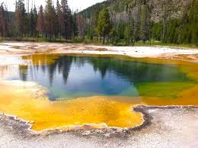
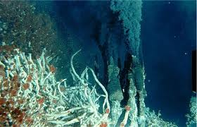
Domain Archaea
Archaea are thought to be more ancient than bacteria and yet more closely related to our eukaryote ancestors.
Lack peptidoglycan in their cell walls, and have some of the same proteins as eukaryotes.
Archaea are diverse in shape and nutrition requirements.
Most are heterotrophs, some are extremophiles that can survive extreme conditions (e.g. high temperature, salinity)
Domains and Kingdoms
Copyright © McGraw-Hill Education

Slide 33
Domain Eukarya
All eukaryotes have a membrane-bound nucleus and other membrane-bound organelles.
Domain Eukarya contains Kingdoms Protista, Fungi, Plantae, and Animalia.
Domains and Kingdoms

Slide 34
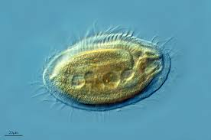
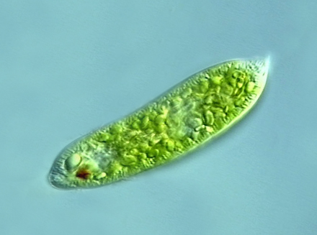
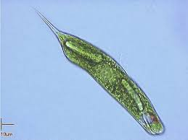
Domain Eukarya
Kingdom Protista
Protists are eukaryotic organisms that can be unicellular, colonial, or multicellular.
Protists are classified into three different groups – plantlike, animal-like, and fungus-like.
Domains and Kingdoms

Slide 35
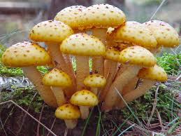
Domain Eukarya
Kingdom Fungi
A fungus is a unicellular or multicellular eukaryote that absorbs nutrients from organic materials in its environment.
Heterotrophic, lack motility, have cell walls containing chitin.
Have threadlike structures called hyphae for feeding, growth, and reproduction
Domains and Kingdoms

Slide 36
Domain Eukarya
Kingdom Animalia
All animals are heterotrophic, multicellular eukaryotes.
Have cells organized into tissues and organs as well as complex organ systems.
Most animals are motile for at least a portion of their life cycle.
Domains and Kingdoms

Slide 37
Domain Eukarya
Kingdom Plantae
Mostly multicellular, have cell walls composed of cellulose.
Most contain chloroplasts for photosynthesis, but a few plants are heterotrophs
Many plants possess organs such as roots, stems, and leaves.
Domains and Kingdoms

Slide 39
Viruses – an exception
A virus is a nucleic acid surrounded by a protein coat.
Viruses do not possess cells, nor are they cells, and are not considered to be living.
Because they are nonliving, they usually are not placed in the biological classification system.
Viruses
Viral Replication
Domains and Kingdoms

Slide 40
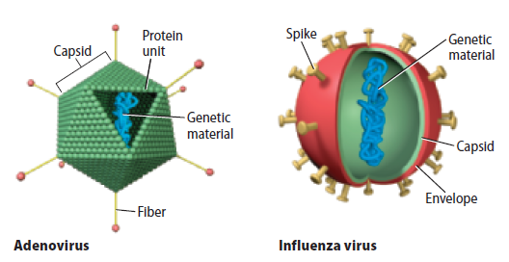
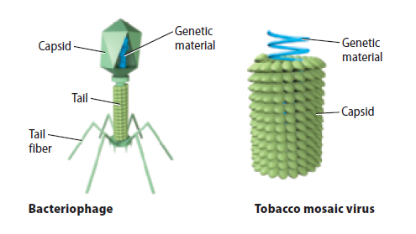
Viruses
Virus structure
The outside layer of all viruses is made of proteins and called the capsid.
Inside the capsid is the genetic material, either DNA or RNA (never both).
Viruses and Prions

Slide 41
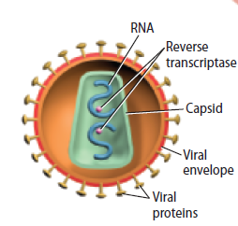
Retroviruses
Retroviruses have RNA instead of DNA for their genetic material.
Have a lipid envelope surrounding the capsid obtained from the plasma membrane of a host cell
In the host cytoplasm, Reverse transcriptase synthesizes DNA from RNA template, DNA integrates into host chromosome until activated
Viruses and Prions

Slide 42
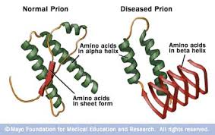
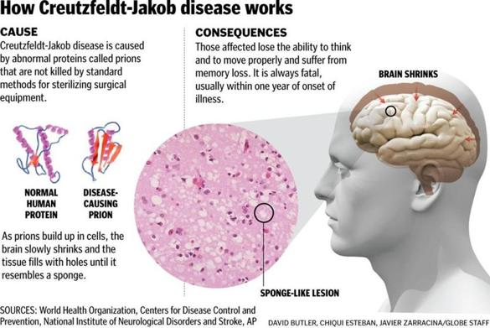
Prions
A proteins that can cause infection or disease is called a proteinaceous infectious particle, or prion.
Prions normally exist in cells, but their function is poorly understood.
Normally spiral shaped
Mutations cause incorrect folding, mutated prions cause diseases
Viruses and Prions

Slide 43
Prions
Prion infection
Prions can cause normal proteins to mutate.
Cause nerve cells to burst, creating space in the brain
Prions may be communicated between species, but scientists are not unified on this thought.
Prion infection
Prions can cause normal proteins to mutate.
Cause nerve cells to burst, creating space in the brain
Prions may be communicated between species, but scientists are not unified on this thought.
Viruses and Prions

