Slide 1
CH 15
Section 3:
Shaping Evolutionary Theory

Slide 2
Mechanisms of Evolution
Natural selection is not the only mechanism of evolution.
Evolution occurs at the population level, with genes as the raw material.
Shaping Evolutionary Theory

Slide 3
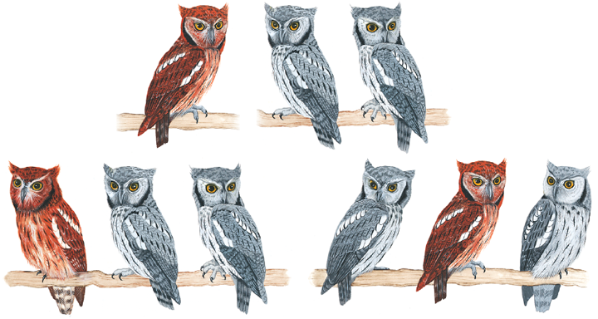
Mechanisms of Evolution
Population genetics
Hardy and Weinberg showed that evolution will not occur in a population unless allelic frequencies are acted upon by forces that cause change.
Hardy-Weinberg principle states that when allelic frequencies remain constant, a population is in genetic equilibrium.

Slide 4
Mechanisms of Evolution
Population genetics
The Hardy-Weinberg principle can be numerically represented as:
Where:
p² is the proportion of homozygous dominant
2pq is the proportion of heterzygous
q² is the proportion of homozygous recessive
Hardy-Weinberg-Equation

Slide 5
Mechanisms of Evolution
Population genetics
For a population to be in genetic equilibrium according to the Hardy-Weinberg principle, it must meet five conditions:
No genetic drift
No gene flow
No mutation
Mating must be random
No natural selection
These five conditions are the mechanisms of evolutionary change.

Slide 6
Mechanisms of Evolution
Genetic drift
Any change in the allelic frequencies in a population that results from chance is called genetic drift.
In smaller populations, the effects of genetic drift become more pronounced, and the chance of losing an allele becomes greater.
Genetic Drift
Shaping Evolutionary Theory

Slide 7
Mechanisms of Evolution
Genetic drift
The founder effect results when a group of individuals with a different allele frequency than the original population becomes isolated.
Alleles that were infrequent in the original population may be common in the new population.
Happens when a subset of organisms settles in an area separated from their original population
Can result in large genetic variations in the separated population
Shaping Evolutionary Theory

Slide 8
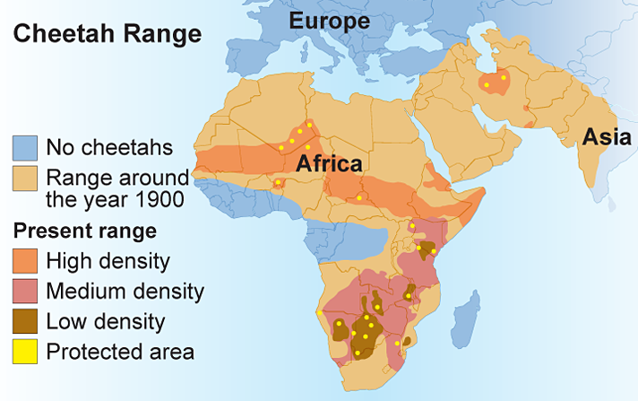
Mechanisms of Evolution
Genetic drift
A bottleneck results when population declines to a very low level and then rebounds.
The gene pool of the rebound population is similar to the low-level population, which may have reduced diversity.

Slide 9
Mechanisms of Evolution
Gene flow
A population in genetic equilibrium experiences no gene flow – it is a closed system.
Uncommon in natural populations – organisms migrate/move between populations
Random movement increases genetic variation within a population and decreases the genetic variation between populations.

Slide 10
Mechanisms of Evolution
Nonrandom mating
A population in genetic equilibrium must exhibit random mating.
This rarely occurs in populations – mating occurs between individuals in close proximity
Promotes inbreeding
Changes allelic frequencies, favoring individuals that are homozygous
Shaping Evolutionary Theory

Slide 11
Mechanisms of Evolution
Mutation
A mutation is a random change in genetic material.
The cumulative effect of mutations in a population might shift allelic frequencies.
Most mutations are harmful, but some may be beneficial and become more common.
Shaping Evolutionary Theory

Slide 12
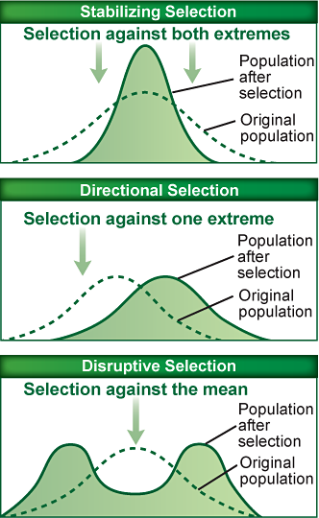
Mechanisms of Evolution
Natural selection
Natural selection acts to select the individuals that are best adapted for survival and reproduction.
Three types of natural selection:
Stabilizing
Directional
Disruptive

Slide 13
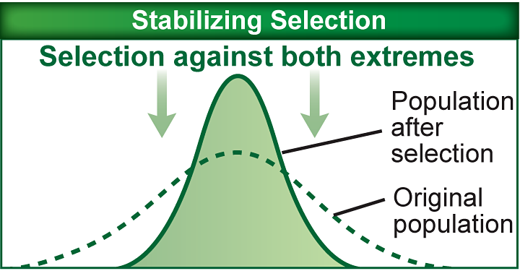
Mechanisms of Evolution
Natural selection
Stabilizing selection operates to eliminate extreme expressions of a trait when the average expression leads to higher fitness.

Slide 14
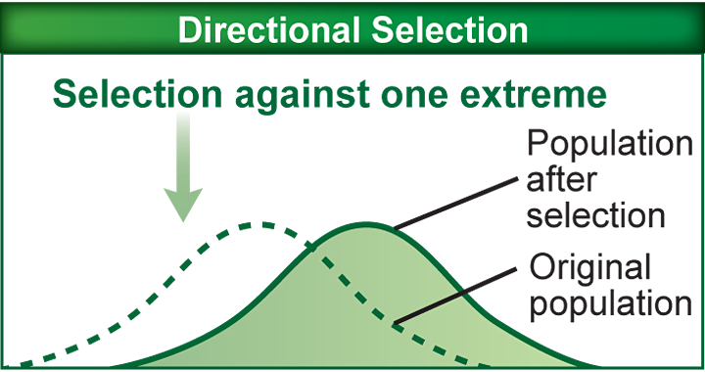
Natural selection
Directional selection increases the expression of an extreme version of a trait in a when it increases fitness.

Slide 15
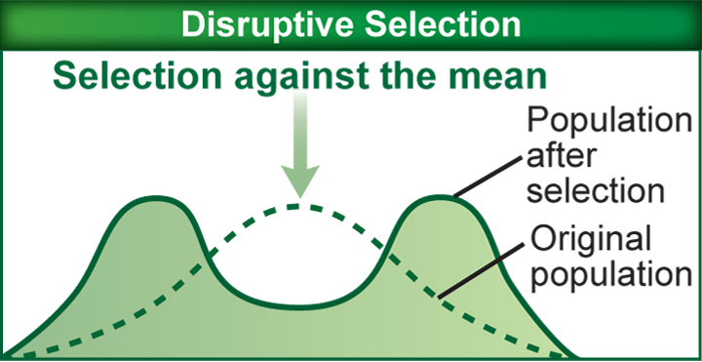
Natural selection
Disruptive selection removes individuals with average traits, but retains individuals expressing extreme traits .

Slide 16
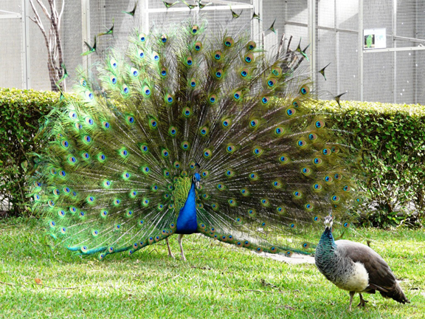
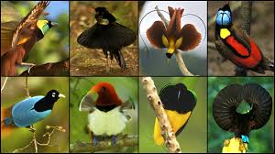
Sexual selection drives change in the frequency of a trait based on the ability to attract a mate.
Common in populations where males and females look significantly different
Some qualities that enhance mating success reduce odds of survival.

Slide 17
Reproductive Isolation
Most scientists define speciation as the process whereby a population of sexually reproducing organisms changes so much that it can no longer produce fertile offspring with other populations.
Two types of reproductive isolation mechanisms prevent gene flow:
Prezygotic
Postzygotic
Shaping Evolutionary Theory

Slide 18
Reproductive Isolation
Postzygotic isolation
Postzygotic isolating mechanisms operate after fertilization and ensure that the resulting hybrid remains infertile.
Hybrid offspring either cannot develop or cannot reproduce.
Shaping Evolutionary Theory

Slide 19
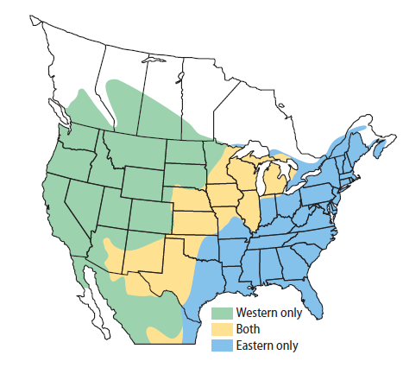
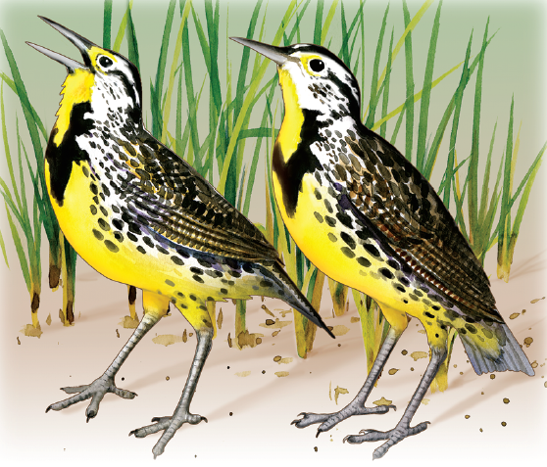
Reproductive Isolation
Prezygotic isolation
Prezygotic isolating mechanisms operate before fertilization occurs.
Prevent reproduction by making fertilization unlikely
Often occur through geographic, ecological, or behavioral differences. (i.e. Mechanical, Temporal)

Slide 20
Speciation
For speciation to occur, populations must diverge and become reproductively isolated.
Two types of speciation: allopatric and sympatric.
Shaping Evolutionary Theory

Slide 21
Speciation
Allopatric speciation
Allopatric speciation occurs when populations are divided by a physical barrier.
Most scientist think allopatric speciation is the most common type of speciation.

Slide 22
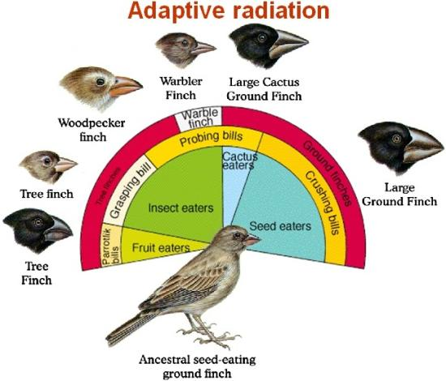
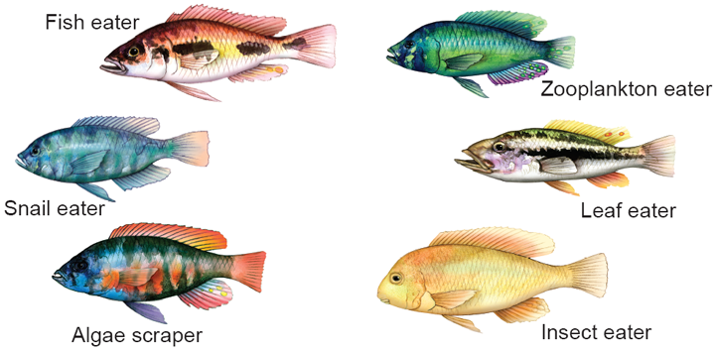
Patterns of Evolution
Adaptive radiation
Adaptive radiation takes place when a large number of species arise from a single common ancestor in response to an ecological opportunity.
Often follows large-scale extinction events or creation of new habitat
Shaping Evolutionary Theory

Slide 23
Patterns of Evolution
Coevolution
Coevolution occurs when relationships between species are so close that they influence each other’s evolution.
Mutualism – both species benefit
Coevolutionary arms race – parasitic or predatory relationship
Two (or more) species reciprocally affect each other's evolution.
So for example, an evolutionary change in the morphology of a plant, might affect the morphology of an herbivore that eats the plant, which in turn might affect the evolution of the plant, which might affect the evolution of the herbivore…and so on!!

Slide 24
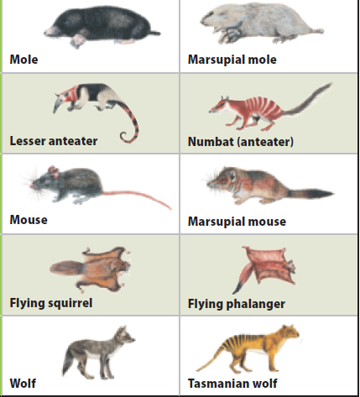
Patterns of Evolution
Convergent evolution
Unrelated species evolve similar traits even thought they live in different parts of the world.
Occurs in environments that are geographically distinct but ecologically similar
Shaping Evolutionary Theory

Slide 26
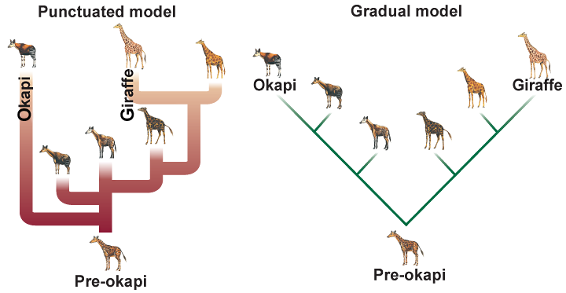
Patterns of Evolution
Rate of speciation
Evolution proceeds in small, gradual steps according to a theory called gradualism.
Punctuated equilibrium states rapid spurts of genetic change causing rapid speciation punctuate long periods of little change.

