Slide 1
CH 15-2
Section 2:
Evidence of Evolution

Slide 2
Support for Evolution
The theory of evolution states that all organisms on Earth have descended from a single ancestor.
Recall that theories provide explanations for natural phenomena based on observation.
Evidence of Evolution
Copyright © McGraw-Hill Education

Slide 3
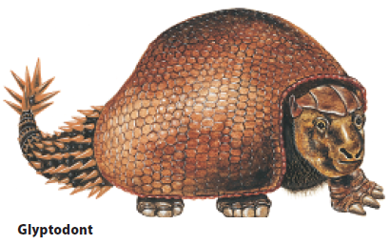
Support for Evolution
The fossil record
Fossils show modern species resemble ancient species.
They also reveal that some species have changed very little.
The fossil record is an important source of information for determining the ancestry of organisms and the patterns of evolution.
The glyptodont was an ancient ancestor of the modern armadillo

Slide 4
Support for Evolution
The fossil record
Researchers consider two major classes of traits when studying transitional fossils:
Derived traits are newly evolved features, such as feathers, that do not appear in the fossils of common ancestors.
Ancestral traits are more primitive features, such as teeth and tails, that do appear in ancestral forms.
Copyright © McGraw-Hill Education

Slide 5
Support for Evolution
Comparative anatomy (Homologous Structures)
Anatomically similar structures inherited from a common ancestor are called homologous structures.
Evolution predicts that an organism’s body parts are more likely to be modifications of ancestral body parts than entirely new structures.

Slide 6
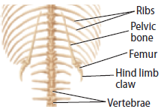
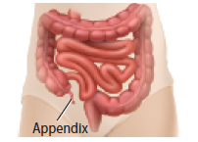
Support for Evolution
Comparative anatomy
Vestigial structures are structures that are the reduced forms of functional structures in other organisms.
Evolutionary theory predicts that features of ancestors that no longer have a function for that species will become smaller over time until they are lost.
snake pelvis
human appendix

Slide 7
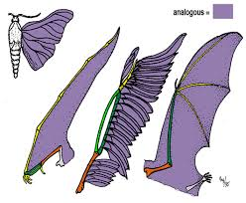
Support for Evolution
Comparative anatomy
Analogous structures can be used for the same purpose and be superficially similar in construction, but are not inherited from a common ancestor.
Analogous structures show that functionally similar features can evolve independently under similar conditions.
Evidence of Evolution
Copyright © McGraw-Hill Education

Slide 8
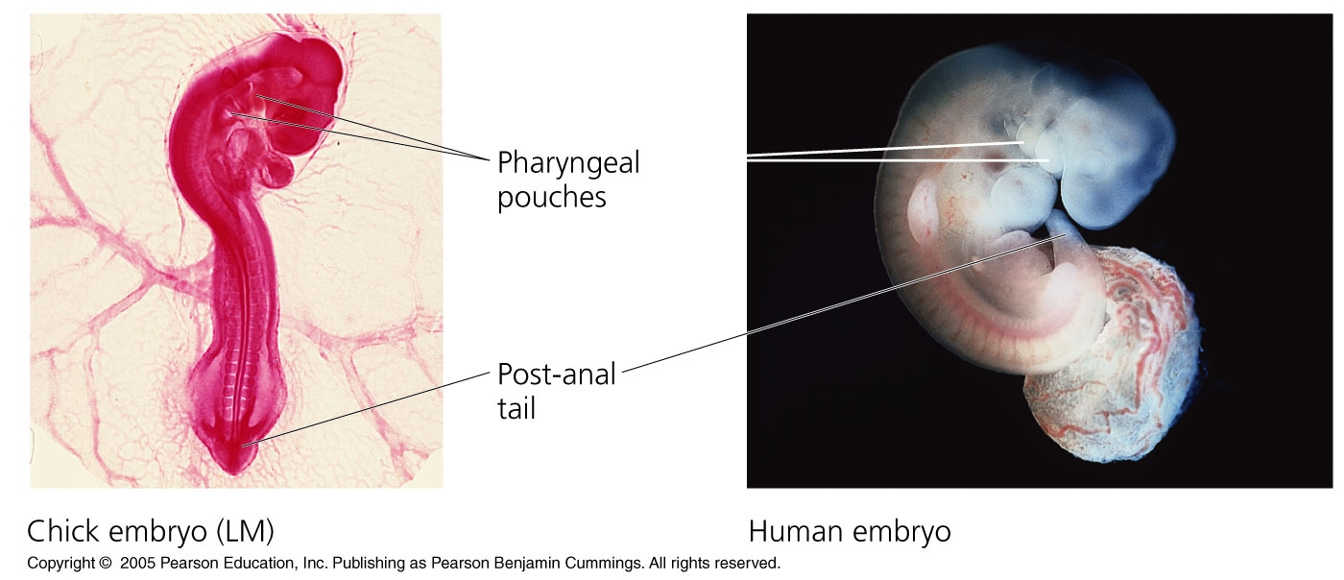
Support for Evolution
Comparative embryology
An embryo is an early, pre-birth stage of an organism’s development.
Vertebrate embryos exhibit homologous structures during phases of development that become totally different structures in the adult forms.

Slide 10
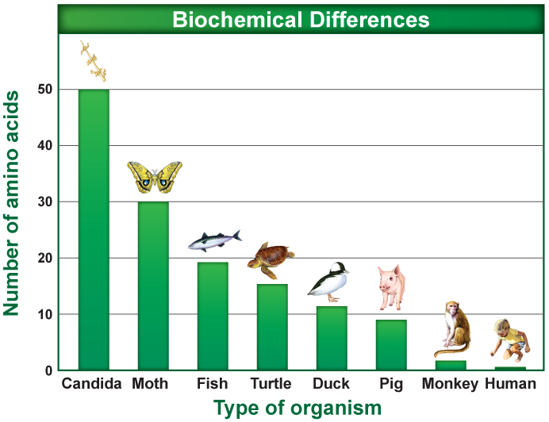
Support for Evolution
Comparative biochemistry
Common ancestry can be seen in the complex metabolic molecules that many different organisms share.
The more closely related species are to each other, the greater the biochemical similarity.

Slide 11
Support for Evolution
Geographic distribution
The distribution of plants and animals that Darwin were what first suggested evolution to him.
The distribution of plants and animals around the world is studied in the field of biogeography.
Evolution is linked to migration patterns, climate, and geological forces (such as plate tectonics).

Slide 13
Adaptation
Types of adaptations
An adaptation is a trait shaped by natural selection that increases an organism’s reproductive success.
Fitness is a measure of the relative contribution an individual trait makes to the next generation.
The better an organism is adapted to its environment, the greater its chances of survival and reproductive success.

Slide 14
Adaptation
Types of adaptations
Camouflage is a suite of morphological adaptations that allow an organism to blend into its environment.
Mimicry is a type of morphological adaptation where a species evolves to resemble another species.
Antimicrobial resistance develops in some bacteria in response to sub-lethal exposure to antibiotics.
Physical:
Speed, Camouflage, Claws, Quills, etc.
Behavioral:
Solitary, Herds, Packs, Activity, etc.
Evidence of Evolution
Copyright © McGraw-Hill Education

Slide 15
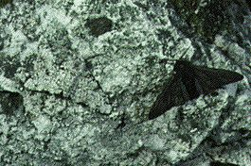

Slide 16
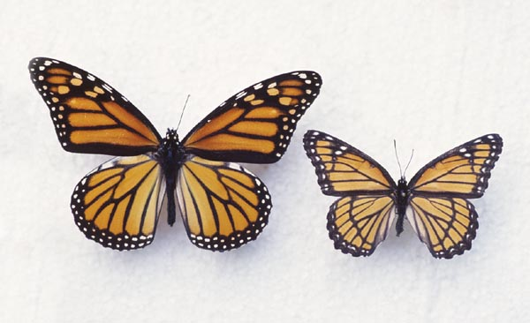
Mimicry
Another way animals adapt to their environments to survive. (Batesian)

Slide 18
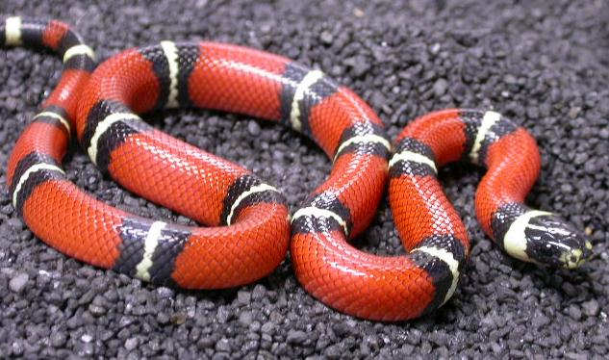
Milksnake Coral Snake
Milk Snake Coral Snake

Slide 19
Adaptation
Consequences of adaptations
Not all features of an organism are necessarily adaptive.
Some features are consequences of other evolved characteristics.
Helplessness of human babies: humans give birth at a much early developmental stage than other primates.
May be a consequence of larger brain size and upright posture

