Slide 1
CH 11
Section 2:
Complex Patterns of Inheritance

Slide 2
Essential Questions
What are the differences between various complex inheritance patterns?
How can sex-linked inheritance patterns be analyzed?
How can the environment influence the phenotype of an organism?
Complex Patterns of Inheritance
Copyright © McGraw-Hill Education

Slide 3
Vocabulary
incomplete dominance
codominance
multiple alleles
epistasis
sex chromosome
autosome
sex-linked trait
polygenic trait

Slide 4
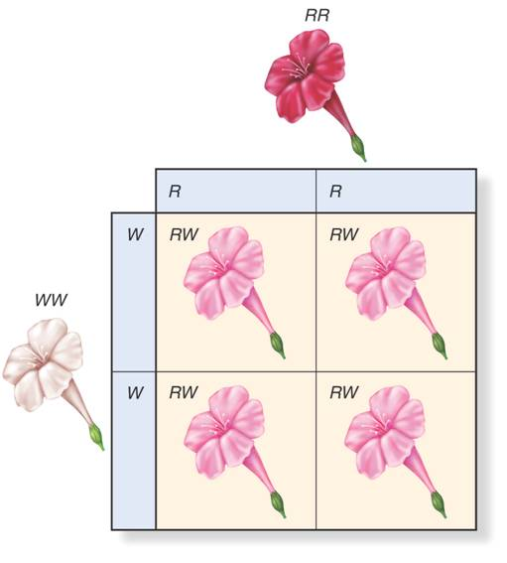
Incomplete Dominance
In some organisms, heterozygous individuals will display the dominant phenotype.
With incomplete dominance, the heterozygous phenotype is an intermediate phenotype between the two homozygous phenotypes.

Slide 5
Codominance
In codominance, both the dominant and recessive allele are expressed in heterozygous individuals.
In certain varieties of chicken, the allele for black feathers is codominant with the allele for white feathers.
Heterozygous Pandas are showing with both black and white fur. The black and white colors do not blend to form a new color, but appear separately.

Slide 6
Codominance
Sickle-cell disease
Changes in hemoglobin cause red blood cells to become sickle shaped.
People who are heterozygous for the trait have both normal and sickle-shaped cells.
Sickle-cell disease and malaria
Those who are heterozygous for the sickle cell trait also have a higher resistance to malaria.
The death rate due to malaria is lower where sickle-cell trait is higher, meaning more people live to pass it on to their offspring.

Slide 7
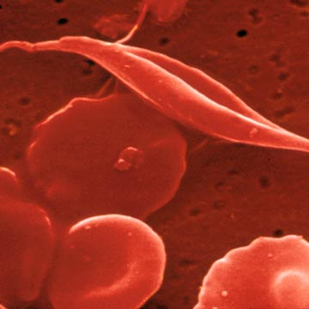
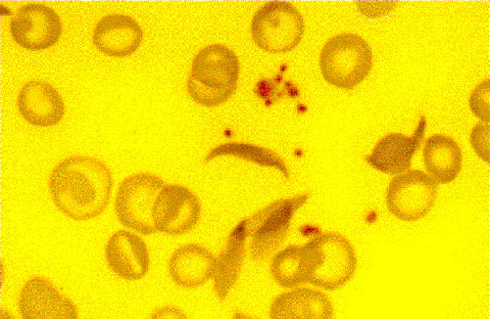

Slide 8
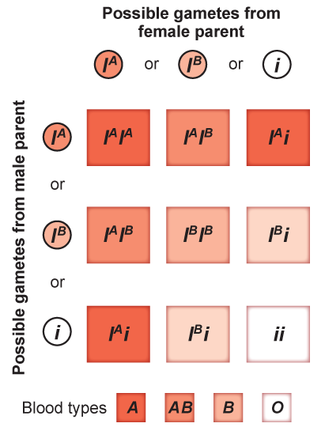
Multiple Alleles
Blood groups in humans
Some forms of inheritance are determined by more than two alleles, referred to as multiple alleles.
The ABO blood group has three forms of alleles, sometimes called AB markers.
Some are homozygous ii producing no antigen or blood type O

Slide 9
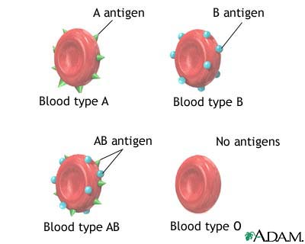

Slide 10
Multiple Alleles
Coat color of rabbits
Multiple alleles can demonstrate a hierarchy of dominance.
In rabbits, four alleles code for coat color: C, c^{ch}, c^{h}, and c.
  The hierarchy of dominance is C > c^{ch} > c^{h} >c.
  The presence of multiple alleles increases the possible number of genotypes and phenotypes.

Slide 11
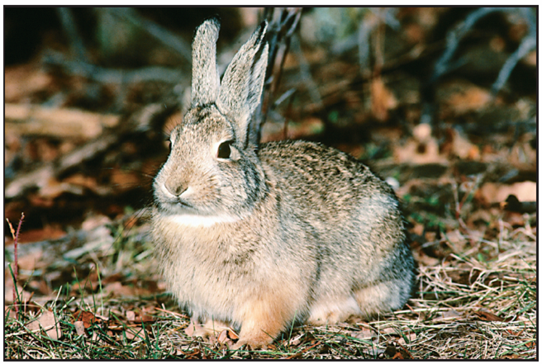
Different combinations of alleles result in the colors shown here.
KEY
C = full color; dominant
to all other alleles
c^{ch} = chinchilla; partial
defect in pigmentation;
dominant to
c^{h} and c alleles
c^{h} = Himalayan; color in
certain parts of the
body; dominant to
c allele
c = albino; no color;
recessive to all other
alleles
Full color: CC, Cc^{ch}, Cc^{h}, or Cc
Chinchilla: c^{ch}c^{h}, c^{ch}c^{ch}, or c^{ch}c
Himalayan: c^{h}c, or c^{h}c^{h}
AIbino: cc
Notes:
Coat color in rabbits is determined by a single gene that has at least four different alleles. Different combinations of alleles result in the four colors you see here. photo credits: 1. ©John Gerlach/Visuals Unlimited 2.Animals Animals/©Richard Kolar 3. ©Jane Burton/Bruce Coleman, Inc. 4. ©Hans Reinhard/Bruce Coleman, Inc.

Slide 12
Epistasis
Epistasis is an interaction where of one allele hiding the effects of another allele or phenotypic expression of one gene is influenced by another gene
Seen in the coat color of Labrador retrievers
  Dominant allele E determines whether the coat will have dark pigment.
  Allele B determines how dark the coat will be.
  When a dog has recessive ee alleles, the coat will be yellow, because the e allele masks the effects of the B allele.

Slide 13
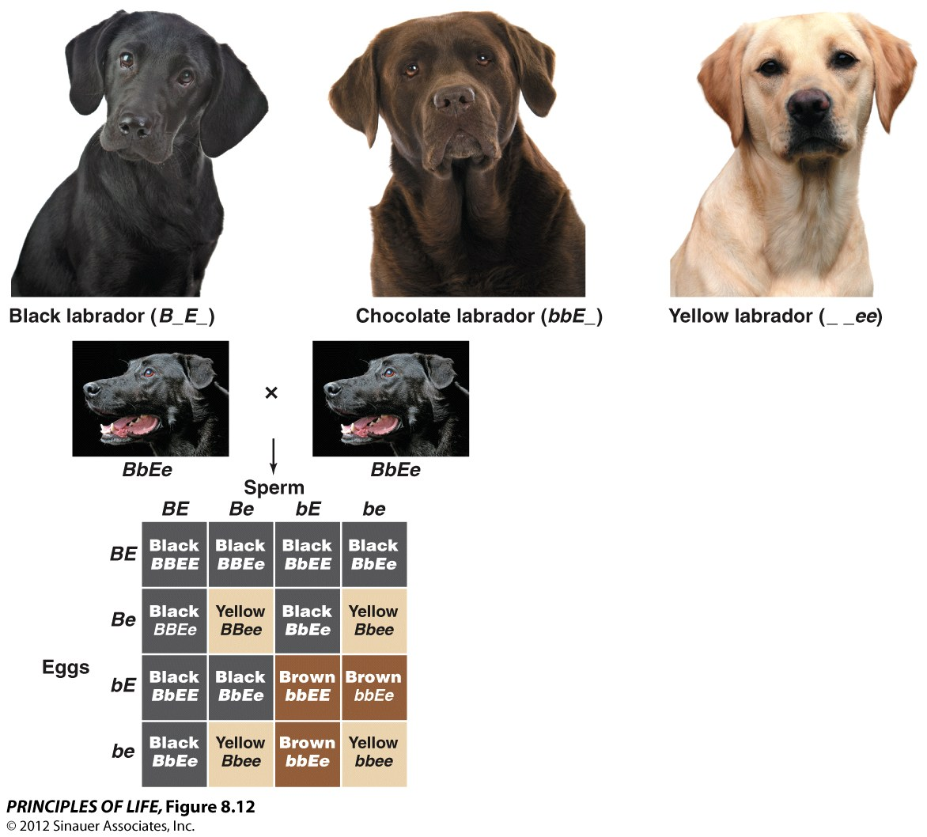

Slide 14
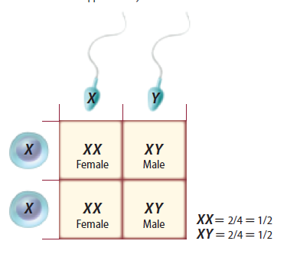
Sex Determination
One pair of chromosomes, sex chromosomes, determine an individual’s gender.
  XX: female
  XY: male
The other 22 pairs of chromosomes are called autosomes.

Slide 15
Sex-Linked Traits
Traits controlled by genes located on the X chromosome are sex-linked traits.
Because males have only one copy of the X chromosome, they are more affected by recessive X-linked traits

Slide 16
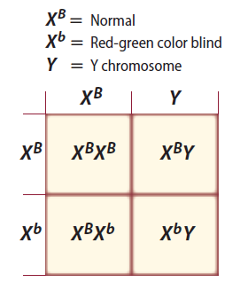
Sex-Linked Traits
Red-green color blindness
Recessive, X-linked trait
Mothers are carriers.

Slide 17
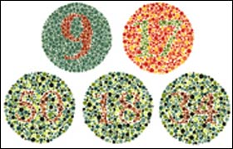

Slide 18
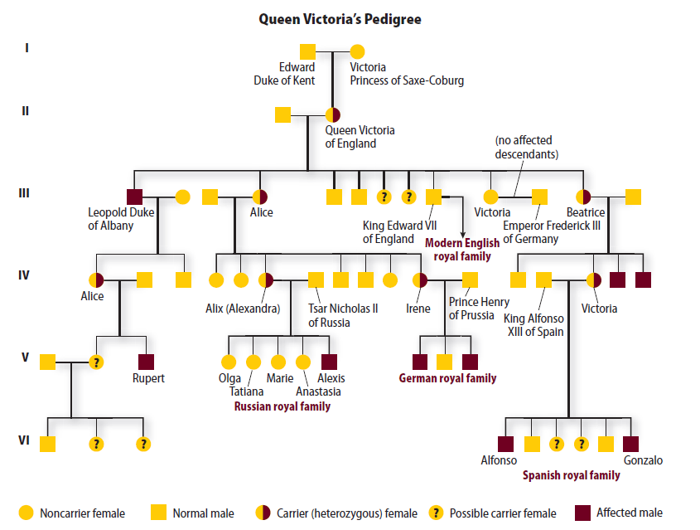
Sex-Linked Traits
Hemophilia
Recessive, X-linked trait that causes delayed clotting of blood

Slide 19
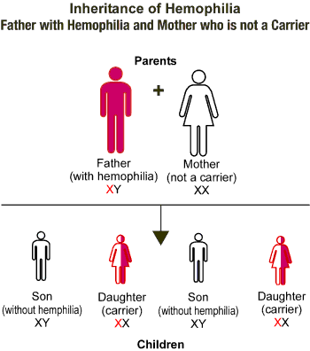

Slide 20
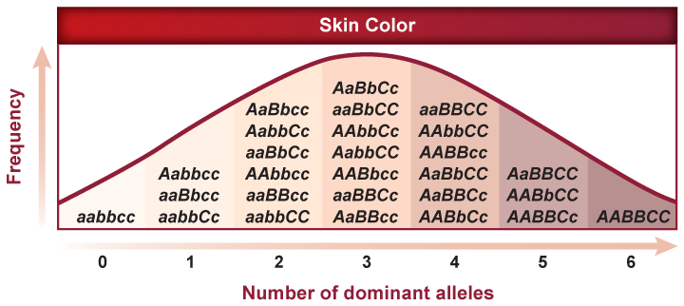
Polygenic Traits
Polygenic traits arise from the interaction of multiple pairs of genes.
Include such traits as skin color(A,a), height(B,b), and eye color (C,c).

