Slide 1
Sports Injuries
Chapter 6

Slide 2
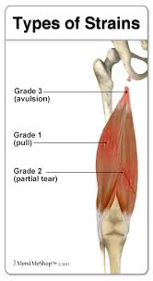
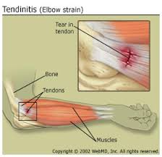
Strains
Description: A strain is a stretching or tearing of muscle or tendon. A tendon is a fibrous cord of tissue that connects muscles to bones. Strains often occur in the lower back and in the hamstring muscle in the back of your thigh.
Signs and symptoms will vary, depending on the severity of the injury:
Pain
Swelling
Muscle spasms
Limited ability to move the affected muscle

Slide 3
Strains
Etiology:
There are two types of strains: acute and chronic.
An acute strain occurs when a muscle becomes strained or pulled — or may even tear — when it stretches unusually far or abruptly.
Acute strains often occur in the following ways:
Slipping on ice, Running, jumping or throwing, Lifting a heavy object or lifting in an awkward position
A chronic strain results from prolonged, repetitive movement of a muscle. This may occur on the job or during sports, such as:
Gymnastics, Tennis, Rowing, Golf

Slide 4
Strains
Treatment:
1. Control Swelling and Prevent Further Injury With PRICE
Protect by applying an elastic bandage, sling, or splint.
Rest the muscle for at least a day.
Ice immediately, and continue to ice for 10 to 15 minutes every hour, for 2-3 days.
Compress by gently wrapping with an Ace or other elastic bandage. (Don't wrap tightly.)
Elevate injured area above the person's heart level, if possible, for at least 24 hours, and start physical therapy to help restore strength and flexibility.
2. Manage Pain and Inflammation
Take an over-the-counter pain medication(analgesics) like aspirin or ibuprofen (Advil, Motrin).
3. Follow Up
Elevate and ice the area ( above the heart) every 3 to 4 hours after the first day.

Slide 5
Strains
https://www.youtube.com/watch?v=EPYQgwA15Aw
https://www.youtube.com/watch?v=TWTO4uIrPws
Prevention:
Poor conditioning: Lack of conditioning can leave your muscles weak and more likely to sustain injury.
Fatigue: Tired muscles are less likely to provide good support for your joints. When you're tired, you're also more likely to succumb to forces that could stress a joint or overextend a muscle.
Improper warm-up: Properly warming up before vigorous physical activity loosens your muscles and increases joint range of motion, making the muscles less tight and less prone to trauma and tears.
Environmental conditions: Slippery or uneven surfaces can make you more prone to injury.
Poor equipment: Ill-fitting or poorly maintained footwear or other sporting equipment can contribute to your risk of a sprain or strain.

Slide 6
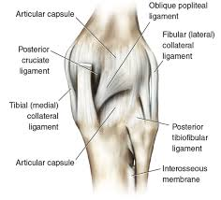
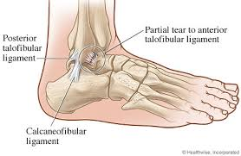
Sprain
Description: Is traumatic Injury to a JOINT with partial or complete tearing if the ligament (tissue connecting joints together bone to bone).
Etiology: Sports activities usually lead to sprains. The ankle joint is a common example and can be so painful, the joint cannot be used. The degree of ligament tearing, involvement of of associated tendons, muscles, and blood vessels determines the degree of injury.
Severe sprains can exhibit complete tearing of the ligaments
.

Slide 7
Sprains
Symptoms: Varying degrees of swelling, pain, heat, redness to purple or dark blue discoloration from blood vessel hemorrhage.
Limited ability to move the affected joint
At the time of injury, you may hear or feel a "pop" in your joint.
A sprain occurs when you overextend or tear a ligament while severely stressing a joint. Sprains often occur in the following circumstances:
Ankle — Walking or exercising on an uneven surface
Knee — Pivoting during an athletic activity
Wrist — Landing on an outstretched hand during a fall
Thumb — Skiing injury or overextension when playing racquet sports, such as tennis

Slide 8
Sprains
https://www.youtube.com/watch?v=xIplNs4754Q
Diagnosis: Physical examinations is often all that is needed for diagnosis although X-rays might be taken to rule out a fracture. In extreme cases, MRI and arthroscopy (minimally invasive surgery that can be an examination as well) can be used.
Treatment: Depends on the severity of the sprain. Mild sprains can be implemented by the concept of RICE, rest, ice, compression, and elevation. As the sprain heals, and pain resolves, light exercise and gradual walking is recommended to strengthen the ligaments.
Prevention: Regular exercise, stretching, and strengthening the joints to maintain good physical condition are the best preventions for sprains.

