Slide 1
Causes of cancer
Actual cause of cancer is unknown, and is usually due to a variety of circumstances, suggesting that there is more than one factor involved in its development.
One thing that stays consistent is the development of cancer: genetic alterations allowing the cells to grow independently and uncontrollably.
It is theorized that that the human immune system catches and destroys abnormal cells as soon as they occur.

Slide 2
Causes of cancer
In some respects, cancer might be present on some failure of the immune system in the individual.
Prevention and cure of cancer will depend on finding the initiating agents causing genetic alterations in the cell or the event that causes the altered cells to become malignant.
We currently have hundreds of carcinogenic compounds that have been identified.

Slide 3
Causes of cancer
Carcinogenisis (cancer development) might take several years to develop, start and stop, or even reverse.
Usually there is continued progression of cellular changes from hyperplasia, to dysplasia to metaplasia, to neoplasia.
http://www.youtube.com/watch?v=46Xh7OFkkCE

Slide 4
Chemical carcinogens
The frequency of exposure, strength, and potency of a chemical are important factors in the development of cancer.
Chemicals that do not cause cancer by themselves might enhance cancer development when used in combination with other chemicals.
Ex: Napthylamine found in certain dyes causes bladder cancer, asbestos: previously used in roofing and insulation is identified as a carcinogen leading to lung cancer, and insecticides lead to skin and lung cancer.

Slide 5
hormones
Can increase the incidence of cancer, and at times hormones can be used as a form of cancer treatment.
Action of hormones related to cancer is unknown, Ex: benign moles don’t become malignant until sex hormones increase in puberty.
Negativity of hormones: diethylstilbestrol, a synthetic estrogen compound given to pregnant women during the 1940’s and 50’s lead to rare vaginal adenocarcinoma in female children and testicular abnormalities in male children.

Slide 6
hormones
Excessive production of estrogen in the female can lead to cancer of their breast and uterus. Estrogen medication used to treat menopausal symptoms has shown to cause an increase in endometrial cancer.
Ovaries are sometimes removed after breast cancer in effort to decrease stimulation of other possible tumors.
The connection to birth control and cancer have been inconclusive. Birth control combine estrogen with progestin( synthetic progesterone: hormone released by ovaries to regulate menstrual cycle and maintain pregnancy) may decrease risk of ovarian and endometrial cancer.

Slide 7
Hysterectomy
In a supracervial or subtotal hysterectomy, a surgeon removes only the upper part of the uterus, keeping the cervix in place.
A total hysterectomy removes the whole uterus and cervix.
In a radical hysterectomy, a surgeon removes the whole uterus, tissue on the sides of the uterus, the cervix, and the top part of the vagina. Radical hysterectomy is generally only done when cancer is present.
The ovaries may also be removed -- a procedure called oophorectomy -- or may be left in place.
https://www.youtube.com/watch?v=t7GwsiXbevk

Slide 8
Hormones
Prostate cancer is stimulated by the male hormone testosterone but slowed or inhibited by estrogen treatment.
Estrogen medication will counteract the effects of testosterone. Decreasing testosterone production might also include orchiectomy- the removal of the testes, in effort to decrease or slow the growth of prostatic tumor or decrease stimulation of other tumors.
. Animation video of Orchiectomy:
https://www.youtube.com/watch?v=6inEXNsZOKI&t=4s
https://www.youtube.com/watch?v=27PATuCznI8
Graphic/ Actual Orchiectomy video:
https://www.youtube.com/watch?v=dYokNSAnbOY&oref=https%3A%2F%2Fwww.youtube.com%2F&has_verified=1

Slide 9
Orchiectomy
Orchiectomy causes sudden hormone changes in the body. Side effects from hormone changes may include:
Sterility.
Loss of sexual interest.
Erection problems.
Hot flashes.
Larger breasts (gynecomastia).
Weight gain.
Loss of muscle mass.
Thin or brittle bones (osteoporosis).

Slide 10
radiation
Ultraviolet (UV) radiation, X- radiation, radioactive materials, are all known carcinogens.
Over 2 million cases of skin cancer are diagnosed each year from farmers, sun bathers, fisherman, construction workers, mariners, and anyone with exposure to UV rays.
Melanomas occur more frequently due to extreme, blistering burns at a young age. Fair skinned people are at greater risk due to low amounts of melanin. (black people don’t get skin cancer) ;D

Slide 11
Radiation
High dosage of radiation may be used as treatment for some cancers, but has a risk of developing secondary tumors.
These tumors take between 20 to 25 years to actually develop so the benefits of radiation therapy outweigh its risk.
Radioactive materials release Alpha, Beta, and Gamma rays making them potential carcinogens.
Wearing protective clothing when exposed to these materials can decrease the risk of cancer.

Slide 12
viruses
Have been proven to cause cancer in laboratory animals, but no clear cut views in humans. For example:
The Epstein-Barr virus causes infectious Mononucleosis.
Hepatitis B virus has been linked to liver cancer.
Individuals with cervical cancer also tend to have the herpes simplex virus.

Slide 13
Genetic predisposition
Discoveries of certain cancer suppressor genes, and most recently a breast cancer gene, has aided research efforts, but has not given us a complete understanding of correlation to genetics and cancer.
It is known that breast and colon cancer have a higher incidence in certain families.
Relatives that have these genes can pass them to other family members.

Slide 14
Personal risk behavior
Smoking and tobacco products
Diet
Alcohol use
Sexual Behavior

Slide 15
Smoking and tobacco products
Cigarette smoke is a carcinogen. It kills approximately 443,000 people yearly according to the ACS (American Cancer Society, 2011)
According to ACS, cigarettes kill more people than car accidents, alcohol, AIDS, murders, illegal drugs, and suicides combined.
Smoking also doubles the incidence of cancer in the bladder and pancreas.

Slide 16
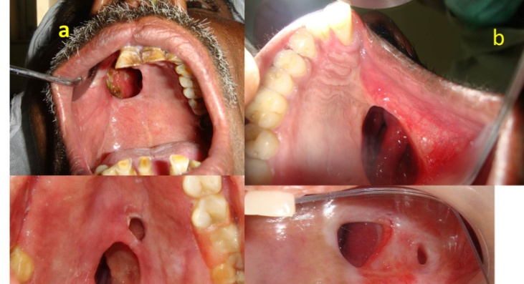
Lung and oral Cancer from tobacco

Slide 17
Smoking and tobacco products
Chemicals in cigarette smoke affect all organs in the body because the chemical are absorbed from the lungs to the bloodstream circulating to all the organs.
These chemicals are found in increased concentrations in the urine of smokers.
Secondhand smoke is also detrimental, leading to 46,000 heart disease deaths, and 3,400 lung cancer deaths. Cigarette smoking currently costs the U.S. $139 billion per year in health care costs and related losses.
Oral cancer occurs in tobacco chewers than non tobacco users. (Common in baseball)

Slide 18
Diet
There is a consistent relationship in the increase in weight in women and the risk of cancer, but no relationship between the two in men.
Obesity and high consumption of dietary fat is a consistent risk factor for endometrial, breast, and colon cancer.
Food additives like saccharin (Artificial sugar) have been found to cause cancer in the bladder in rats but no correlation has been found in humans.
Nitrates are preservatives used in meats and have shown to produce stomach cancer in animals. (Japan- high rates of gastric cancer)

Slide 19
Diet
Colon cancer rates are lower in countries that have lower consumption in dietary fat, and higher consumption in fiber and the U.S.
The Western plains area of the U.S. is high in Selenium (mineral) found in meats has the lowest colon cancer rates, supporting concepts of correlation between selenium level and colon cancer.

Slide 20
Alcohol use
Cancer of the mouth, throat, and esophagus, occurs more often in people who smoke and drink alcohol excessively.
Alcohol is not a proven carcinogen at the moment but, recent studies have shown higher incidence of breast cancer in women who drink even in moderate amounts (3 drinks a week)

Slide 21
Sexual behavior
The risk of cervical cancer is related to the age of first sexual intercourse and the number of sexual partners.
The younger the female, and larger the amount of sex partners, the greater the risk. (Amount of sex partners from both sexes causes the risk)
Medical studies confirm that Human Papilloma Virus (HPV) is associated with most cervical cancers and it is easily transmitted between partners.

Slide 22
Sexual behavior
Incidence of cervical cancer is two times greater In black women than white, and is found more commonly in lower socioeconomic groups.
Women who marry men that have had relations with a woman that has cervical cancer, are at greater risk of developing cervical cancer.
Pregnancy and childbirth appear to be protective mechanisms for cancer of the ovaries, endometrium, and breast for women.

Slide 23
Sexual behavior
Females that start menstrual cycles at a later age, have early menopause, bear first child at an early age, or experience all or some of these behaviors are at decreased risk for breast cancer.
Stop here for quiz #3

