Slide 2
Mechanisms of disease
Chapter 2

Slide 3
There are 6 causes of diseases:
1. Heredity
2. Trauma
3. Inflammation and infection
4. Hyperplasias and neoplasms
5. Nutritional imbalance
6. Impaired immunity

Slide 4
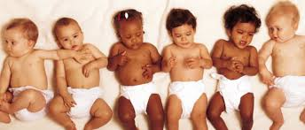
Heredity
Caused by an abnormality in individuals genetic or chromosomal makeup.
May not be apparent during birth
Congenital disorders are present at birth and can be apparent or not
Not always genetic (fetal alcohol syndrome or difficult with delivery)

Slide 5
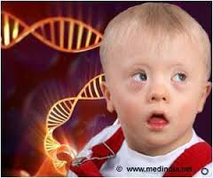
Heredity
Classified in 3 basic ways:
Single gene abnormalities
Abnormality of several genes
Abnormality of chromosomes
Not all chromosomal and genetic abnormalities will present or cause an effect on the individual.
Others lead to death and spontaneous abortion of unborn child.

Slide 6
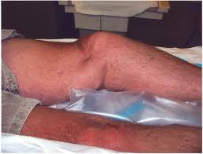
Trauma
Caused by a physical injury from an external force.
Leading cause of death in children and young adults.
Individuals most commonly affected have to do with age, race and residence.
(Ex: falls in elderly, gunshots-urban areas, and MVA’s –most common cause of traumatic disease.

Slide 7
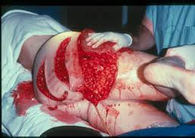
Trauma
Triage is the prioritization of care according to severity of an injury.
It incorporates an ABC prioritizing method, with A for airway, B for breathing, c for cardiac function.
After these areas are assessed, bleeding, and fractures are addressed.
(ex. Help non-breathing patient or bleeding patient)

Slide 8
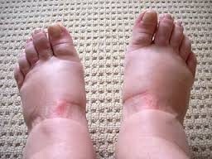
Inflammation and Infection
Inflammation is a protective immune response triggered by any type of injury or irritant.
Signs of inflammation: redness, heat, swelling, pain, and loss of motion.
Body causes loss of motion during inflammation to prevent further movement. Allowing area to heal.

Slide 9
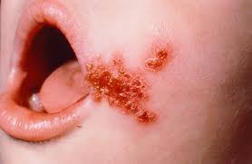
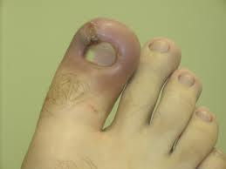
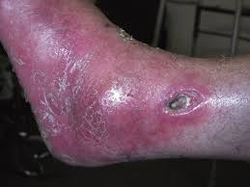
Inflammation and Infection
Infection refers to the invasion of microorganisms into tissues that causes cell or tissue injury.
Infections will cause inflammation, Ex: Bacterial infection of skin
Inflammation does not always mean you have an infection. Ex: Sunburn

Slide 10
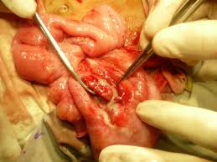
Inflammation and Infection
Diseases related to inflammation are identifies with suffix “itis”
Ex: Appendicitis (Inflammation of the appendix)
Gastritis (inflammation of stomach)
Colitis (Inflammation of the colon)
Encephalitis (inflammation of the brain)
Inflammation will progress to an infection due to the presence of bacteria in the region.

Slide 11
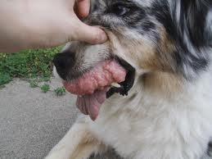
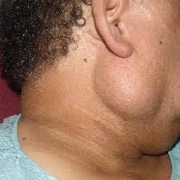
Hyperplasias and Neoplasms
Hyperplasia: Hyper = Excessive, plasia = growth
Neoplasia: Neo = New, Plasia = growth
Both are similar because in both, you will se an increase in tissue size.

Slide 12
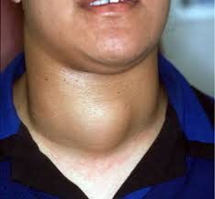
Hyperplasias
Are an overgrowth in response to some type of stimulus.
Ex: Enlargement of thyroid gland in response to hormone deficiency. (not having enough thyroid hormone needed
for metabolism, causing enlarged thyroid)

Slide 13
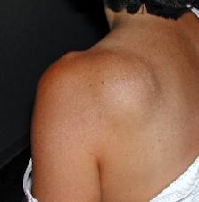
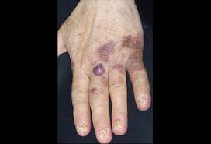
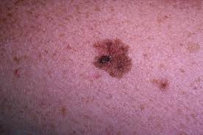
Neoplasms
Commonly called “Tumors” – Latin for “swelling”, and originally used in description of swelling related to inflammation.
Greek term for swelling is “onkos” used now to construct word “oncology” : onco – tumor, ology – study of, or study of cancer.
Diseases with tumor involvement usually end with the suffix “oma”.
Ex: Lipoma, carcinoma, melanoma, and sarcoma)

Slide 14
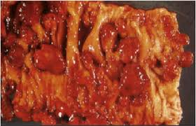
Neoplasms
May be classified as benign or malignant.
Generally neoplasms are benign tumors with limited growth and are encapsulated, easily removed, and are not deadly.
Malignant tumors grow uncontrollably; have finger – like projections into surrounding tissue making removal very difficult, and making it deadly.
Malignant means deadly or progressing to death.

Slide 15
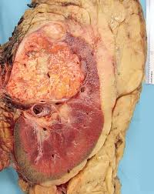
Neoplasms.
Tumor diseases are usually called cancer, defined as a malignant tumor.
Fingerlike or crablike projections give cancer the name from the Greek karkinos, meaning “crab”
This characteristic makes surgical removal of cancer difficult.
Neoplasms metastasize, meaning they move. Metastatic cancers move from site of origin to a secondary site in the body. Ex: Lung cancer commonly metastasizes to bone.

Slide 16
Nutritional Imbalance
Nutritional disorders can cause problems with physical growth, mental and intellectual retardation, and even death in extreme cases.
Most nutritional diseases are related to overconsumption or underconsumption of nutrients.
Problems: Malnutrition, obesity, and excessive or deficient vitamins, minerals, or both.

Slide 17
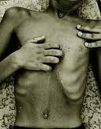
Malnutrition
Inadequate nutrient intake or disease causing a problem with absorption of nutrients.
Children and elderly are the most affected by malnutrition.
Persons suffering with cancer experience problems with malnutrition, causing cachexia. (having ill, thin, wasted appearance.

Slide 18
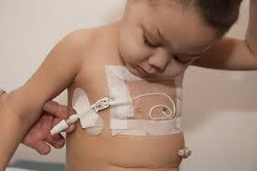
Malnutrition
People unable to maintain body weight can receive nutritional supplements through liquid drinks.
Provide complete nutritional intake through parenteral(to administer through injection)
Parenteral injections can include subcutaneous( sub-under; cutaneous-skin), intramuscular( intra-within, muscular-muscle) or intravenous( intra-within, venous- vein)

Slide 19
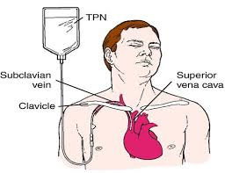
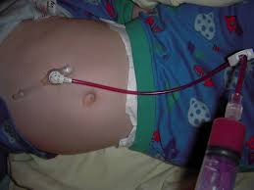
Malnutrition
Intravenous nutrition is the most common parenteral route due to providing total nutrition trough the vein. Also called total parenteral nutrition (TPN)
Nutrition can also be provided through eternal(small intestine) route, nasogastric(naso-nose, gastric-stomach) for short term supplement.
For long term feeding, gastrostomy(gastro-stomach, ostomy-opening) the placing of a tube through abdominal and stomach wall. Called “Tube feeding”

Slide 20
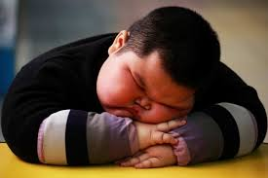
Obesity
Overconsumption of nutrients and lack of exercise cause obesity.
According to American Heart Association, obesity is a national health concern. 1 in 3 (31.7%) U.S. children ages 2-19 are obese and over 1/3 of adults (33.7%) are obese.
Obesity shortens lifespan and increases the chance of getting arteriosclerosis, leading to cardiovascular disease.

Slide 21
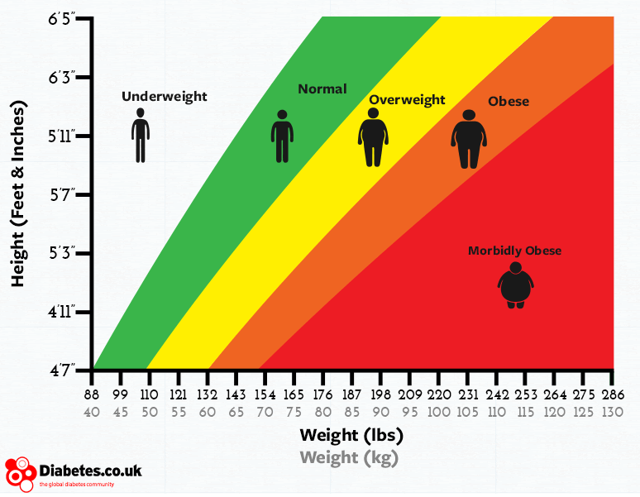
Obesity
It is medically determined when an individual has a body mass index (BMI) greater than 29.9.
BMI is obtained by dividing the individuals weight in pounds, by the square of height, multiplied by 703.
BMI scale: <18.5: underweight, 18.5-24.9: normal, 25-29:overweight, 30-35: obese, 36-40: moderately obese, >40: extremely obese.

Slide 22
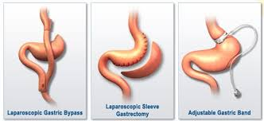
Obesity
Bariatrics –branch of medicine that deals with prevention and treatment of obesity.
1st line of treatment: diet, exercise, anti-obesity medication, and behavior modifications.
In severely obese populations they often have poor success, causing the need of bariatric or weight loss surgery. (Gastric binding or gastric bypass surgery).

