Slide 1
Causes of disease
Chapter 2

Slide 2
There are 6 causes of diseases:
1. Heredity
2. Trauma
3. Inflammation and infection
4. Hyperplasias and neoplasms
5. Nutritional imbalance
6. Impaired immunity

Slide 3
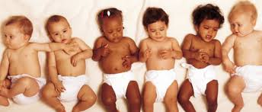
Heredity
Caused by an abnormality in individuals genetic or chromosomal makeup.
May not be apparent during birth
Congenital disorders are present at birth and can be apparent or not
Not always genetic (fetal alcohol syndrome or difficult with delivery)

Slide 4
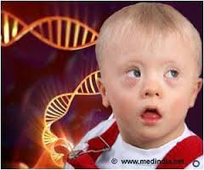
Heredity
Classified in 3 basic ways:
Single gene abnormalities
Abnormality of several genes
Abnormality of chromosomes
Not all chromosomal and genetic abnormalities will present or cause an effect on the individual.
Others lead to death and spontaneous abortion of unborn child.

Slide 5
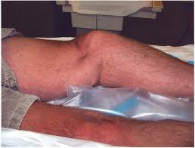
Trauma
Caused by a physical injury from an external force.
Leading cause of death in children and young adults.
Individuals most commonly affected have to do with age, race and residence.
(Ex: falls in elderly, gunshots-urban areas, and MVA’s –most common cause of traumatic disease.

Slide 6
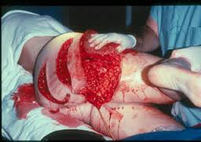
Trauma
Triage is the prioritization of care according to severity of an injury.
It incorporates an ABC prioritizing method, with A for airway, B for breathing, c for cardiac function.
After these areas are assessed, bleeding, and fractures are addressed.
(ex. Help non-breathing patient or bleeding patient)

Slide 7
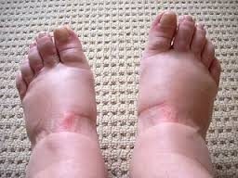
Inflammation and Infection
Inflammation is a protective immune response triggered by any type of injury or irritant.
Signs of inflammation: redness, heat, swelling, pain, and loss of motion.
Body causes loss of motion during inflammation to prevent further movement. Allowing area to heal.

Slide 8
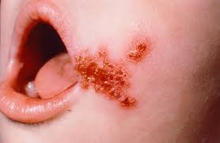
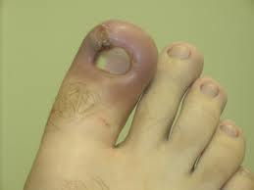
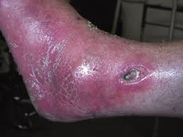
Inflammation and Infection
Infection refers to the invasion of microorganisms into tissues that causes cell or tissue injury.
Infections will cause inflammation, Ex: Bacterial infection of skin
Inflammation does not always mean you have an infection. Ex: Sunburn

Slide 9
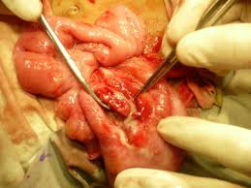
Inflammation and Infection
Diseases related to inflammation are identifies with suffix “itis”
Ex: Appendicitis (Inflammation of the appendix)
Gastritis (inflammation of stomach)
Colitis (Inflammation of the colon)
Encephalitis (inflammation of the brain)
Inflammation will progress to an infection due to the presence of bacteria in the region.

Slide 10
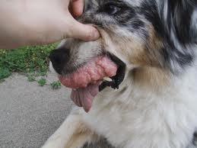
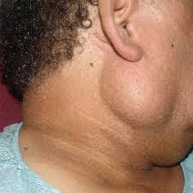
Hyperplasias and Neoplasms
Hyperplasia: Hyper = Excessive, plasia = growth
Neoplasia: Neo = New, Plasia = growth
Both are similar because in both, you will se an increase in tissue size.

Slide 11
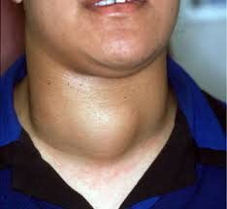
Hyperplasias
Are an overgrowth in response to some type of stimulus.
Ex: Enlargement of thyroid gland in response to hormone deficiency. (not having enough thyroid hormone needed
for metabolism, causing enlarged thyroid)

Slide 12
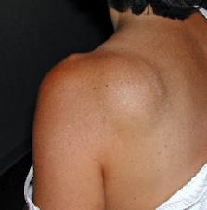
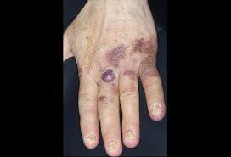
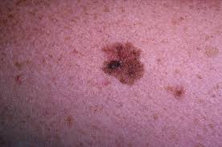
Neoplasms
Commonly called “Tumors” – Latin for “swelling”, and originally used in description of swelling related to inflammation.
Greek term for swelling is “onkos” used now to construct word “oncology” : onco – tumor, ology – study of, or study of cancer.
Diseases with tumor involvement usually end with the suffix “oma”.
Ex: Lipoma, carcinoma, melanoma, and sarcoma)

Slide 13
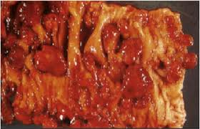
Neoplasms
May be classified as benign or malignant.
Generally neoplasms are benign tumors with limited growth and are encapsulated, easily removed, and are not deadly.
Malignant tumors grow uncontrollably; have finger – like projections into surrounding tissue making removal very difficult, and making it deadly.
Malignant means deadly or progressing to death.

Slide 14
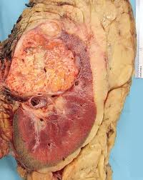
Neoplasms.
Tumor diseases are usually called cancer, defined as a malignant tumor.
Fingerlike or crablike projections give cancer the name from the Greek karkinos, meaning “crab”
This characteristic makes surgical removal of cancer difficult.
Neoplasms metastasize, meaning they move. Metastatic cancers move from site of origin to a secondary site in the body. Ex: Lung cancer commonly metastasizes to bone.

Slide 15
Nutritional Imbalance
Nutritional disorders can cause problems with physical growth, mental and intellectual retardation, and even death in extreme cases.
Most nutritional diseases are related to overconsumption or underconsumption of nutrients.
Problems: Malnutrition, obesity, and excessive or deficient vitamins, minerals, or both.

Slide 16
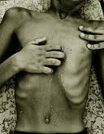
Malnutrition
Inadequate nutrient intake or disease causing a problem with absorption of nutrients.
Children and elderly are the most affected by malnutrition.
Persons suffering with cancer experience problems with malnutrition, causing cachexia. (having ill, thin, wasted appearance.

Slide 17
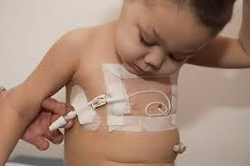
Malnutrition
People unable to maintain body weight can receive nutritional supplements through liquid drinks.
Provide complete nutritional intake through parenteral(to administer through injection)
Parenteral injections can include subcutaneous( sub-under; cutaneous-skin), intramuscular( intra-within, muscular-muscle) or intravenous( intra-within, venous- vein)

Slide 18
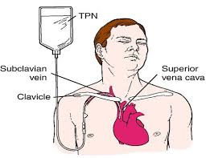
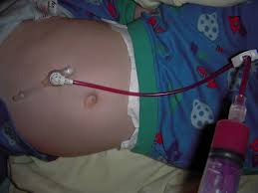
Malnutrition
Intravenous nutrition is the most common parenteral route due to providing total nutrition trough the vein. Also called total parenteral nutrition (TPN)
Nutrition can also be provided through eternal(small intestine) route, nasogastric(naso-nose, gastric-stomach) for short term supplement.
For long term feeding, gastrostomy(gastro-stomach, ostomy-opening) the placing of a tube through abdominal and stomach wall. Called “Tube feeding”

Slide 19
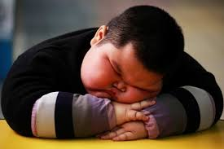
Obesity
Overconsumption of nutrients and lack of exercise cause obesity.
According to American Heart Association, obesity is a national health concern. 1 in 3 (31.7%) U.S. children ages 2-19 are obese and over 1/3 of adults (33.7%) are obese.
Obesity shortens lifespan and increases the chance of getting arteriosclerosis, leading to cardiovascular disease.

Slide 20
Obesity
It is medically determined when an individual has a body mass index (BMI) greater than 29.9.
BMI is obtained by dividing the individuals weight in pounds, by the square of height, multiplied by 703.
BMI scale: <18.5: underweight, 18.5-24.9: normal, 25-29:overweight, 30-35: obese, 36-40: moderately obese, >40: extremely obese.

Slide 21
Obesity
Bariatrics –branch of medicine that deals with prevention and treatment of obesity.
1st line of treatment: diet, exercise, antiobesity medication, and behavior modifications.
In severely obese populations they often have poor success, causing the need of bariatric or weight loss surgery. (Gastric binding or gastric bypass surgery).

Slide 22
Impaired immunity
1st line of defense of the body’s normal structure and function, including intact skin, mucous membranes, tears, and secretion.
2 additional ways are: inflammatory response in which leukocytes kill foreign invaders, and specific antibody-antigen in which the body responds to antigens by producing antibodies.
Antibodies: also called immune bodies, are proteins the body produces to react to antigen and render it harmless.
Antigen: substances that cause the body some type of harm, thus setting up a specific reaction.

Slide 23
Allergy
Immune response is too hypersensitive to environmental substances.
The allergen in an allergy can be anything like house dust, grass, pets, perfumes, or insect bites.
Allergens only cause a reaction to the persons that are sensitive to the allergen.

Slide 24
Autoimmunity
When the immune response attacks itself. (auto=self)
The body’s lymphocytes (white blood cells producing antibody’s) cannot identify the body’s own self antigens, which are harmless.
In response, lymphocytes form antibodies then attack the body’s own cells.
Ex: Rheumatiod arthritis and rheumatic fever.

Slide 25
Immunodeficiency
Inability to defend the body due to a decrease or absence of leukocytes, primarily lymphocytes.
Immunodeficiency in people are usually asymptomatic( without symptoms) except for recurrent infections that lead to death.
Acquired Immunodeficiency syndrome(AIDS) is an example.
Immunodeficiency can also be caused by medications like chemotherapy and radiation.

Slide 26
Immunodeficiency
Organ recipients are intentionally immunosuppressed or immunodeficient to save their transplant organ.
Without immunosuppressant medications, the body’s immune system would recognize the organ as foreign and attack it, leading to organ death. (Organ rejection)

Slide 27
Aging
Diseases related to aging are often called degenerative diseases.
Tissue degeneration is a change in functional activity to a lower or lesser level.
Aging mechanisms are complex and thought to include factors as heredity, lifestyle, stress, diet, and environment.

Slide 28
Aging
Heredity factors can include increased life span related to the inherited ability to resist disease.
Hereditary factors cannot be controlled, longevity can be increased and disease decreased by controlling lifestyle behaviors that increase risk of chronic disease.
Body repairs and replaces itself throughout its lifetime, but with aging, this process slows.

Slide 29
Aging
Age as early as 40, causes changes to skin, endocrine function, vision and muscle strength.
Bone loss is also common causing osteoporosis, decreased melanin pigment production, leading to the graying of the hair.
Decreased immunity, leading to increase in infections, and possible development of cancer.
Loss of brain and nerve cells that might lead to senile dementia, as well as intestinal motility, causing constipation.

Slide 30
Cellular injury
Cellular injury and death can lead to hypoxia(not enough oxygen), anoxia (no oxygen), drug or bacterial toxins or viruses.
Ability of cell to survive depend on factors as, time cell suffers, and type of cell injury.
Short term injury causes cell to have a greater chance of survival.
Heart, brain, and nerve cells are easily injured and die, while connective and epithelial cells, recuperate and replace themselves by mitosis.

Slide 31
Cellular Adaptation
There are 5 types of adaptations: Atrophy, hypertrophy, dysplasia, metaplasia, and neoplasia.
Atrophy (a=without, trophy=growth) causes decrease in cell size leading to decrease In tissue and organ. Due to aging process or disease.
Ex: decrease of muscle and bone in elderly, and breast and reproductive organs atrophy.
No use of muscle causes cell decrease in size.

Slide 32
Atrophy of a cell

Slide 33
Hypertrophy
Hyper=excessive, trophy=growth, leading to growth in tissue and organ size.
Ex: muscle growth from exercising. Muscles need to adapt to the amount of exercise and must grow.
Increase workload in skeletal muscle cause cellular hypertrophy and increase in muscle size.

Slide 34
Hypertrophied cell

Slide 35
Hyperplasia
Hyper=increase, plasia=growth increase in cell number due to hormonal stimulation. (any stimulation causing growth.

Slide 36
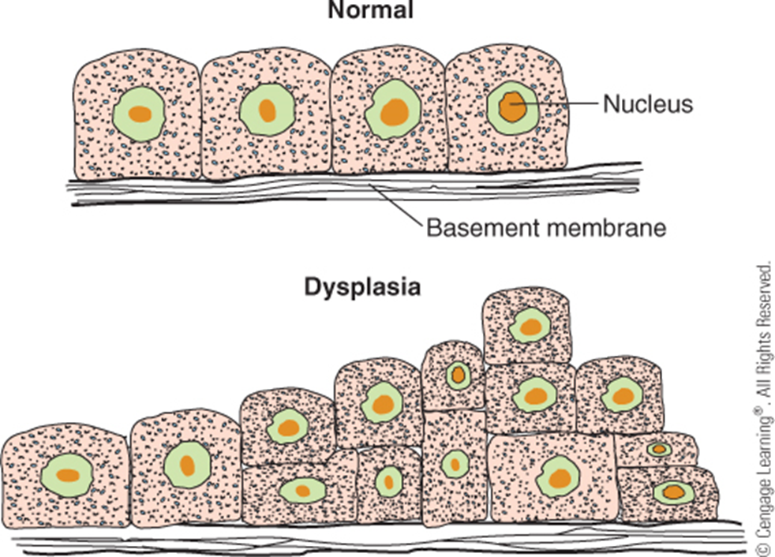
Dysplasia
Dys=bad or difficult, plasia=growth.
Usually follows hyperplasia by alteration of size, shape, and organization of cells.if irritation or stimulus causing growth stops, cells can change back to normal, but usually progresses to neoplasia.

Slide 37
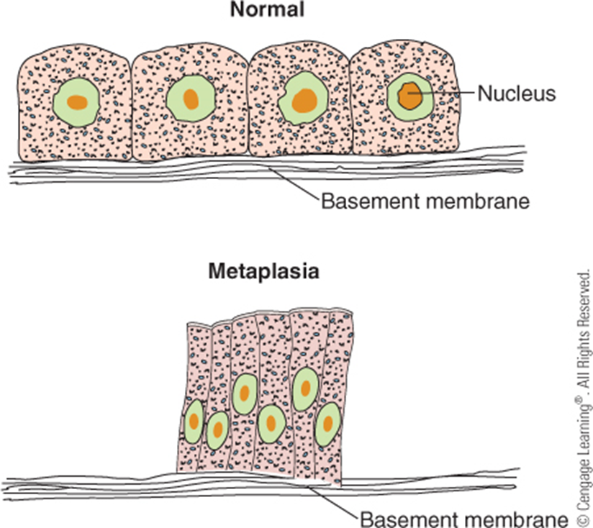
Metaplasia
Meta=changed, plasia=growth.
Cellular adaptation where cell changes to different type of cell.
Ex: columnar epithelial cell in respiratory tree changing to stratified squamous epithelial cells, when exposed to cigarette smoke.

Slide 38
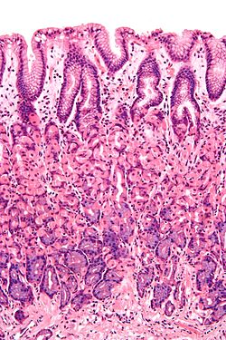
Metaplasia
Epithelial cells
Stratified squamous epithelial cells.
Helps move mucus and other substances out of the body
Forms outermost layer of the skin, like mouth. Areas of constant abrasion.

Slide 39
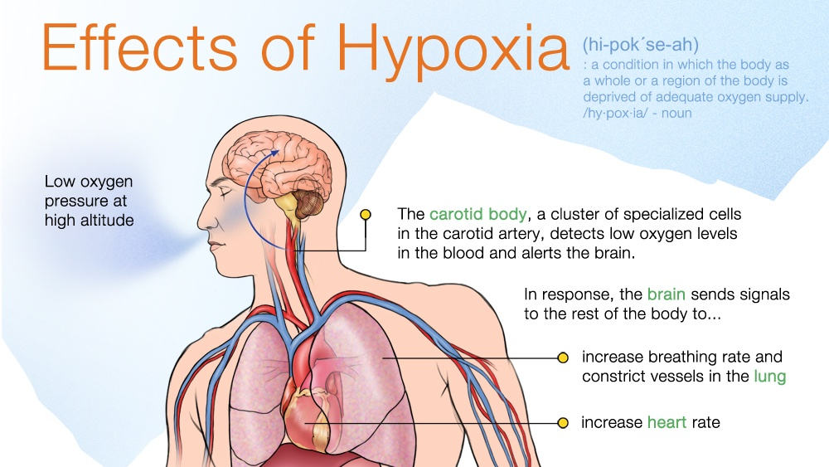
Cell and Tissue death
Cell death can be caused by trauma, hypoxia, anoxia, drugs, bacterial toxins, or viruses.
Hypoxia caused by decrease of blood is called ischemia (isch=hold back, emia=blood) no oxygen gets to blood causing cell death (necrosis)
Dead cells or tissues are described as necrotic. Ischemic necrosis is cell death due to no oxygen in cells also called an infarct.
Most common infract affect heart tissue, leading to myocardial infraction, or heart attack.

Slide 40
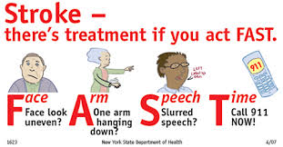
Organism death
Diseases that would not be lethal in our younger years, such as respiratory infections, can cause death in an older individual.
According to Center for Disease Control and Prevention (CDC), most common cause of death is heart disease, followed by cancer and strokes.
Strokes are the leading cause of serious long-term disability in the U.S.

Slide 41
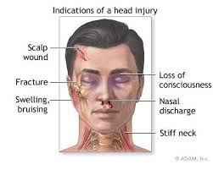
Organism death
Disability is called Morbidity (state of being diseased).
Severe injury's like brain injury can cause person to live a limited quality of life.
Prior to death, major organs like heart, brain, and lungs stop functioning. Loss of brain function in a person is considered brain dead.

Slide 42
Organism death
The criteria for determining brain death include:
Lack of response to stimuli
Loss of all reflexes
Absence of respiration or breathing effort.
Lack of brain activity as shown by electroencephalogram (EEG)
Defining death is controversial in the medical profession.

