Slide 1
Section 3: Plant Hormones and Responses
Hormones can affect a plant’s responses to its environment.
K What I Know | W What I Want to Find Out | L What I Learned

Slide 2
Plant Hormones
Hormones are organic compounds that are made in one part of an organism and affect another part of the organism.
Plant hormones can affect cell division, growth, or differentiation.
Plant hormones work by chemically binding to the plasma membrane and activating receptor proteins, which affect the expression of a gene, enzymes, or membrane permeability.
Plant Hormones and Responses
Copyright © McGraw-Hill Education

Slide 3
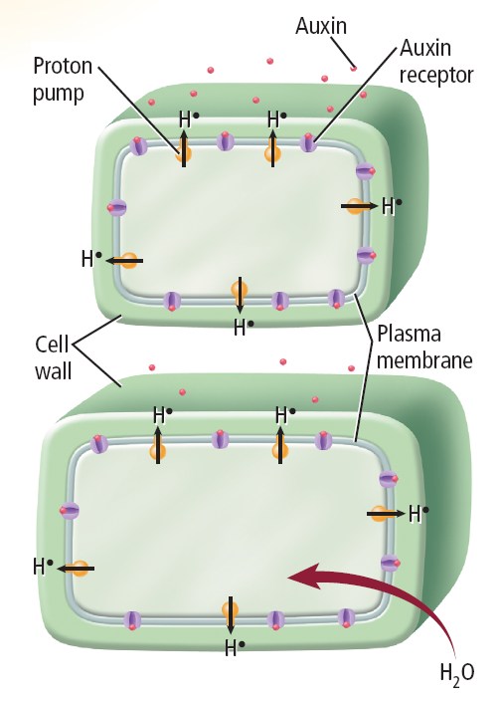
Plant Hormones
Auxin
Auxin is produced in the apical meristems, buds, young leaves, and other rapidly growing tissues.
Stimulates lengthening or elongation of cells
Results in apical dominance, where plants grow mostly upwards with few side branches
Plant Hormones and Responses
Copyright © McGraw-Hill Education

Slide 4
Plant Hormones
Gibberellins
Gibberellins causes cell elongation, stimulate cell division, and affect seed growth.
Dwarf plants often lack the genes for gibberellins production or gibberellins receptor proteins.
Plant Hormones and Responses
Copyright © McGraw-Hill Education

Slide 5
Plant Hormones
Ethylene
Ethylene is the only known gaseous hormone.
Affects the ripening of fruit, senescence of leaves
Travels through the phloem as well as the space between cells
Plant Hormones and Responses
Copyright © McGraw-Hill Education

Slide 6
Plant Hormones
Cytokinins
Cytokinins induce growth in rapidly dividing cells.
Promote cell division by stimulating the production of the proteins needed for mitosis and cytokinesis
Plant Hormones and Responses
Copyright © McGraw-Hill Education

Slide 7
Plant Responses
Nastic responses
A plant response that causes movement independent of the direction of the stimulus is called a nastic response.
Not a growth response, is reversible, and can be repeated
Opening of leaves during the day, closing of leaves at night
Closing of a Venus flytrap’s leaves
Once the stimulus ends, the leaves return to their original position.
Plant Hormones and Responses
Copyright © McGraw-Hill Education

Slide 8
Plant responses
Tropic responses
A tropism is a plant’s growth response to an external stimulus.
If a plant grows towards the stimulus, it is a positive tropism
If a plant grows away from the stimulus, it is a negative tropism
Phototropism: growth in response to light
Gravitropism: growth in response to gravity
Thigmotropism: growth in response to mechanical stimuli, such as contact with an object, organism, or wind
HTTPS://WWW.YOUTUBE.COM/WATCH?V=PCFSTSMVAMI
Plant Hormones and Responses
Copyright © McGraw-Hill Education

Slide 9
Review
Essential Questions
What are the major types of plant hormones?
How do hormones affect the growth of plants?
How are the different types of plant responses alike?
Vocabulary
auxin
gibberellins
ethylene
cytokinin
nastic response
tropism
Plant Hormones and Responses
Copyright © McGraw-Hill Education

