Slide 1
Introduction to human diseases
Chapter 1

Slide 2
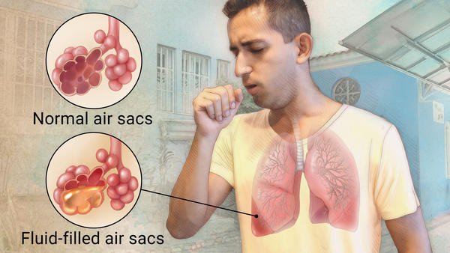
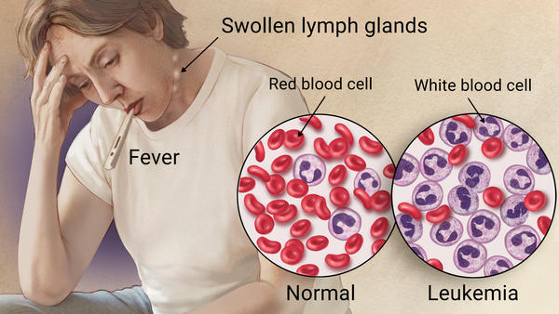
Disease
Pneumonia
May be defined as a change in structure or function that is considered abnormal within the body, or it may be any change from normal.
Usually referred to a condition in which symptoms occur and a pathologic state is present such as pneumonia or leukemia.
Both have one underlying concept: Homeostasis
Homeostasis- state of sameness or normality the body strives to maintain. (remember the body is very good at keeping homeostasis unless something is wrong)

Slide 3
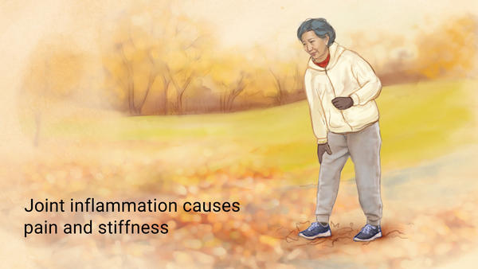
Disorder
Anorexia
(Eating disorder)
Arthritis
(bone disorder)
Derangement or abnormality of function, or can also refer to a pathologic condition of the body or mind but more commonly is used to refer to a problem such as a vitamin deficiency (nutritional disorder).
Also used to refer structural problems such as malformation of a joint (bone disorder), or a condition where the term disease does not seem to apply, such as dysphagia (swallowing disorder).
Because disease and disorder are so closely related, they are often used synonymously.

Slide 4
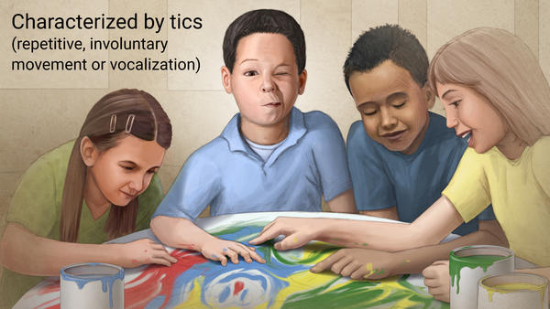
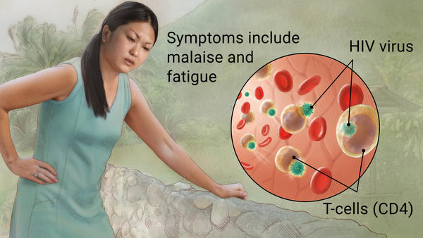
Syndrome
Tourette Syndrome
Down Syndrome
Refers to a group of symptoms, which might be caused by a specific disease but might also be caused by several interrelated problems.
A set of concurrent things (as emotions or actions) that usually form an identifiable pattern
Ex: Down Syndrome, Tourette's syndrome, and Acquired immunodeficiency syndrome.

Slide 5
Pathology
The study of disease (patho= disease, ology= study). A Pathologist is one who studies diseases.
There are many types of pathologists because there are numerous ways to study disease. For example a surgical pathologist who inspects surgical tissue or biopsies for evidence of disease.
Medical examiners can determine the cause of death and provide evidence of criminal involvement in a death.

Slide 6
Types of Pathologists
Pathologist | Role or subject
Experimental | Research
Academic | Teaching
Anatomic | Clinical examinations
Autopsy | Postmortem
Surgical | Biopsies
Clinical | Laboratory examinations
Hematology | Blood
Immunology | Antigen/Antibodies
Microbiology | Microorganisms

Slide 7
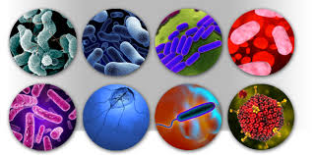
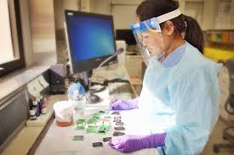
Pathologists
The prefix- patho- can be used in a variety of ways to describe disease processes or the diseases themselves. Microorganisms or agents that cause disease are called pathogens. This includes some types of bacteria, viruses, fungi, protozoans, and helminths (worms).
All pathogens have the ability to cause disease or disorder.
Ex: Fractures that are caused by a disease process that weakens the bone, such as osteoporosis, would be called pathologic fracture.

Slide 8
Pathogenesis
Patho= disease, genesis= arising, is a description of how a particular disease progresses. Many of us are familiar with the pathogenesis of the common cold.
A cold begins with an inoculation (introduction) of the cold virus, where a person shakes hand or touches someone/something with the virus allowing entry of the virus to the body.
After inoculation comes incubation time, where virus now multiplies, and the target person begins to have symptoms such as a runny nose. Pathogenesis of the cold then moves into full-blown illness, recovery, and return back to health.

Slide 9
Pathogenesis
Pathogenesis of a disease can be explained in terms of time. An acute condition is short term and usually has a sudden onset. If the disease lasts for an extended period of time, or the healing process is progressing slowly, it is considered a chronic condition.

Slide 10
Examples of acute and chronic disease/disorders
Acute | Chronic
Upper respiratory infections | Arthritis
Lacerations | Hypertension
Middle ear infections | Diabetes mellitus (High glucose – type 1)
Gastroenteritis (Stomach flu) | Low back pain
Pneumonia | Heart disease
Fractures | Asthma
(Deep cut or tear of skin)
(High blood pressure)

Slide 11
Etiology
The etiology of the disease is the study of cause.
Ex: if the cause of the disease is unknown, you would say “of unknown etiology” or “idiopathic”.
The cause or etiology of pneumonia can be a virus or a bacterium, while the etiology of athletes foot is a fungus named tinea pedis.

Slide 12
Etiology
Iatrogenic (iatro=medicine, physician, genic= arising from) means that the problem arose from a prescribed treatment. Ex: patient developing anemia from undergoing chemotherapy for cancer.
Nosocomial is a closely related term that implies that the disease was acquired from a hospital environment. Ex: A postoperative patient developing an incisional infection, that could have been avoided by good hygiene and hand washing.

Slide 13
Predisposing Factors
Also known as Risk factors, make a person more susceptible to disease. Predisposing factors are not the cause of the disease, and people with predisposing factors don’t always develop the disease.
These factors include age, sex, environment, lifestyle, and heredity. Some of these can be controllable, like lifestyle, while other cannot, such as age.

Slide 14
Age
Newborns are at risk of disease because their immune systems are not fully developed, while Older people are also at risk because their immune system is degrading or wearing out.
Girls on their early teens and women over the age of 30 are at high risk for a difficult or problem pregnancy.
The older we become, the higher the risk for disease such as cancer, heart disease, stroke, senile dementia, and Alzheimer's.

Slide 15
Sex
Some diseases are more prevalent (occurring more often) in one gender than the other.
Men are more at risk for diseases such as lung cancer, gout, and Parkinsonism.
Other disorders or diseases occur more often in women including osteoporosis, rheumatoid arthritis, and breast cancer.

Slide 16
Environment
Air and water pollution can lead to respiratory and gastrointestinal disease. Poor sanitation, excessive noise, and stress are also environmental factors.
Farmers and people living in remote, rural areas are also at risk of health issues due to unavailability to healthcare and exposure to things like dust, pesticides, and other pollutants.
Not having health care available can increase the risk for chronic illness.

Slide 17
Lifestyle
Some lifestyle factors can be controlled, while other cannot. Some controllable factors are smoking, drinking alcohol, poor nutrition, lack of exercise, and stress.
Practicing health behaviors can help prevent contamination and disease.
The CDC (center for disease control and prevention) recommends practitioners to use standard precaution when caring for an individual that has a chance of being contaminated with blood or bodily fluids that can cause hepatitis, E. coli infections, or AIDS.

Slide 18
Heredity
Genetics cannot be changed, but awareness of heredity risk factors might encourage the individual to change lifestyle behaviors to help reduce the risk of disease.
Ex: Coronary Heart disease, (plaque buildup in arteries) has a high cause of death in the U.S. This can be controlled if the individual keeps a healthy diet, doesn’t smoke, and exercises routinely.
Ex: Breast cancer/cervical cancer can be caught early if patient screens their breast routinely every year, get their yearly checkups and conducts breast self-exams.
These behaviors can decrease the overall risk of probable diseases.

Slide 19
Diagnosis
The identification or naming of the disease or condition. When an individual seeks medical attention, the physician must determine a diagnosis of the problem.
A diagnosis is made by a physician after using data collected from a medical history, physical examination, and diagnostic tests.
Medical histories include previous illness, family illness, predisposing factors, medication allergies, current illness, and current symptoms.
Symptoms might include stomach pain, headache, and nausea. (not observable)

Slide 20
Diagnosis
After medical history and symptoms, physicians proceed with a head to toe examination of the patient looking for signs of the disease.
Signs are different from symptoms, in that signs are observable and measureable. For example vomiting, elevated blood pressure, and fever.
Symptoms: Nausea, fatigue, cramps, and headache. These cannot be measured by anything, making it difficult do diagnose.
In some cases, a patient’s concern might be both a symptom and a sign. For example; a runny nose. The runny nose is the patient’s symptom and, because it’s observable to the physician, it is also a sign.

Slide 21
Diagnosis
During physical examination the physician might use other skills such as auscultation, using a stethoscope to listen to body cavities.
Palpation, feeling lightly or pressing firmly on internal organs or structures.
Percussion, tapping over various body areas to produce a vibrating sound.
These are all compared to a normal standard used to identify problems.
Most common procedures are urinalysis, complete blood count(CBC), chest X-ray(CXR), and electrocardiography(EKG/ECG)

Slide 22
Examples of common diagnostic tests and procedures
Test | Description
Complete blood count (CBC) | An examination of blood for cell counts and abnormalities (low or high white/red blood cells)
Urinalysis (UA) | An examination of urine for abnormalities (high or low sugar)
Chest X-ray (CXR) | X-ray examination of the chest cavity; produces images of the heart, lungs, airways, blood vessels and the bones of the spine and chest.
Electrocardiography (ECG/EKG) | A procedure for recording the electrical activity of the heart (checks for pumping ability of the heart)
Blood Glucose | A test of the blood to determine the glucose or sugar level of the blood
Computerized axial tomography (CT/CAT) | Special X-ray examination showing detailed images of body structures and organs.
Serum electrolytes | Examination of blood serum to determine the levels of common electrolytes (sodium, potassium, chloride, and carbon dioxide.

Slide 23
Prognosis
The predicted or expected outcome of the disease.
For example; prognosis for the common cold would be that the individual would feel better within 7 to 10 days.
Example #2; 45% of patients with severe septic shock will die within 28 days.
Septic shock is when you get A bacterial, fungal, or viral infection can cause sepsis; where you experience a significant drop in blood pressure that can lead to respiratory or heart failure, stroke, failure of other organs, and death.

Slide 24
Acute disease
The duration of the disease can be described as acute in nature.
An acute disease is one that usually lasts a short amount of time (days or weeks).
Most acute diseases are related to the respiratory system.
Example; the common cold.

Slide 25
Chronic disease
A disease that persists for a long period of time. It might begin insidiously (slowly without symptoms) and last for the entire life of the individual.
As one ages, the occurrence of chronic diseases increases.
One of the most common chronic diseases is hypertension (high blood pressure).
Can go though periods of remission ( diminished symptoms) and exacerbation (flaring or worsening symptoms)
Leukemia is an example of a disease that goes though series of remission and exacerbation.

Slide 26
Complication
The prognosis might be changed if the individuals develops a complication (the onset of a of a second disease or disorder in an individual already affected by a disease or disorder.)
For example: an individual with a fractured arm might have a prognosis of the arm healing in 6 to 8 weeks. If the individual suffers with a bone infection, the prognosis might change drastically.

Slide 27
Mortality Rate
Defines as the quality of being mortal, and destines to die.
Diseases commonly leading to the death of an individual have a high mortality rate.
The number of people who die with the disease in a certain amount of time is the mortality/death rate.
Other terms the medical community uses to refer to a deadly disease include fatal and lethal.

Slide 28
Survival Rate
A physicians program can also consider survival rate which is the percentage of people with a particular disease who live for a set period of time.
For example: the 2 year survival rate of individuals with lung cancer would be the percentage of people alive 2 years after diagnosis.

Slide 29
Treatment
A plan of care will be given by the physician to the individual with expected outcomes or prognosis. The individuals entire being should be taken into consideration.
The concept of considering the whole person rather than just the physical being is called holistic medicine.
From a holistic viewpoint, there is interaction between the spiritual, cognitive, social, physical, and emotional being.
Typically known as natural medication with no man made chemicals.

Slide 30
Treatment
Treatment interventions might include 1.) Medications, 2.) Surgery, 3.) Exercise, 4.) Nutritional modifications, 5.) Physical therapy, and 6.) Education.
Individuals and family members should be educated and involved in the treatment plan so that compliance can be decreased and the plan does not fail.

Slide 31
Treatment
After the treatment plan is implemented, the physician will follow up with the patient to determine effectiveness.
The treatment plan can be modified if the physician and patient notice that it is ineffective.
The plan usually involved a team of nurses, physical therapists, a social worker, clergy, and other healthcare professionals as needed.

Slide 32
Treatment
The best treatment option is a Preventative plan, that will help prevent diseases and illnesses.
For example, mammograms to screen for breast cancer, blood pressure screening for hypertension, routine dental care to prevent dental caries, and fecal blood test to screen for colon cancer.
Common treatment plans include Palliative treatment, which is used to prevent pain and discomfort but does not care to cure the disease. Ex: End term cancer.

Slide 33
Medical Ethics
Is the study of standards of conduct and moral judgements. This has to do with the “goodness and badness” of human action.
Ethics covers many areas of conduct and judgement in our society.
Bioethics is a branch of ethics concerned with what is right or wrong in bio (life) decisions that are also going to be combined with values and decisions in medical practice.

Slide 34
Medical Ethics
Part of the ethical challenge in this age of rapidly advancing technologies is actually determining what is right, wrong, good, or bad.
New scientific discoveries are challenging familiar or usual human behavior, reconsideration of actions, thoughts, and emotions.
Bioethical decisions are often difficult because they touch the core of humanity in dealing with issues of birth, death, sickness, health, and dignity.
An ethics committee is usually called in to make a decision based on previous works of philosophy, history law and religion to assist them in making a decision.

Slide 35
Medical ethics
Every individual at some time or another will encounter or be called on to make a decision that is bioethical in nature. For example: Support euthanasia
Use a surrogate mother or father to have a biological child.
Control sex of children through chromosome selection.
Use fetal stem cells to grow new organs and tissues.
Legalize abortion, clone humans, and allow physician assisted suicide.
Treat disease by replacing damaged or abnormal genes with normal genes.

