Slide 1
Chapter 14 Section 2: The Origin of Life
Evidence indicates that a sequence of chemical events preceded the origin of life on Earth and that life has evolved continuously since that time.

Slide 2
Essential Questions
What are the differences between spontaneous generation and biogenesis?
What might have been the sequence of events that led to cellular life?
What is the endosymbiont theory?
The Origin of Life
Copyright © McGraw-Hill Education

Slide 3
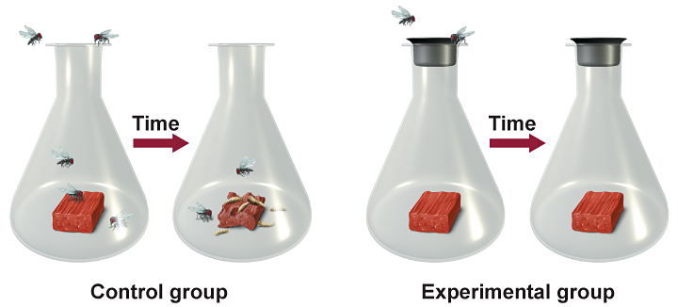
Origins: Early Ideas
Spontaneous generation, one of the earliest ideas, suggested that life arises from nonlife.
Worms, insects, and fish arose from mud.
Redi tested the idea that flies arose from rotting meat.
The Origin of Life
Copyright © McGraw-Hill Education

Slide 4
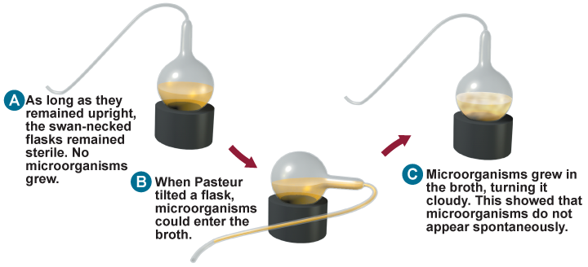
Origins: Early Ideas
The theory of biogenesis states that only living organisms can produce other living organisms.
Louis Pasteur designed an experiment to show that biogenesis was true even for microorganisms.
The Origin of Life
Copyright © McGraw-Hill Education

Slide 5
Origins: Modern Ideas
Simple organic molecule formation
Most biologists agree that life originated through a series of chemical events in Earth’s early history.
The primordial soup hypothesis suggested that if the Earth’s atmosphere had a mix of certain gases, organic molecules could have been synthesized.
UV light from the Sun could serve as the energy source for these organic molecules, which would eventually be the precursors to life.
The Origin of Life
Copyright © McGraw-Hill Education

Slide 6
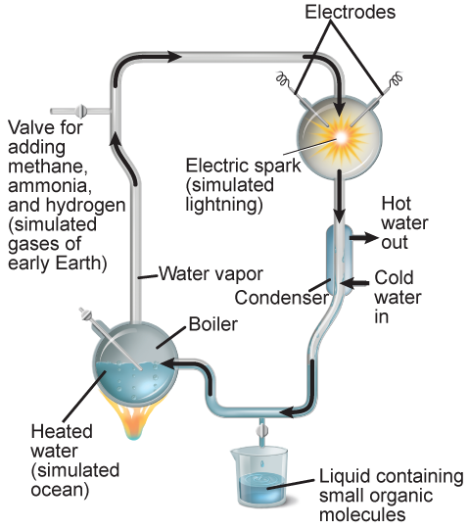
Origins: Modern Ideas
Simple organic molecule formation
Miller and Urey were the first to show that inorganic compounds could produce simple organic molecules, including amino acids.
Later, scientists found that precursor to nucleotide bases could be formed from even simpler molecules in simulated early Earth environments.
The Origin of Life
Copyright © McGraw-Hill Education

Slide 7
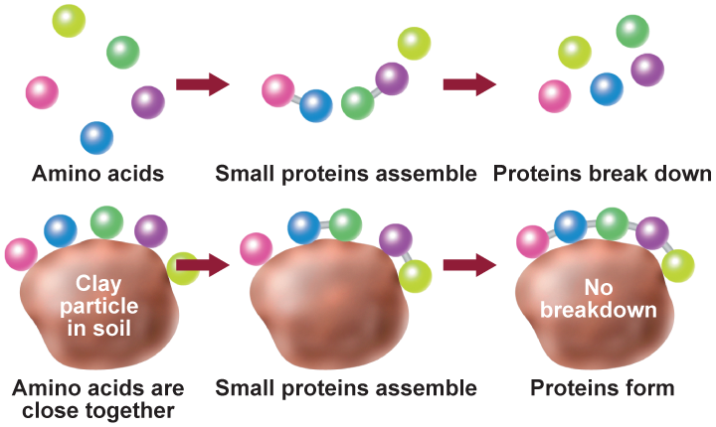
Origins: Modern Ideas
Making proteins
Life requires proteins, not just amino acids.
One possible mechanism for the formation of proteins would be if amino acids were bound to a clay particle, a common sediment in early oceans.
The Origin of Life
Copyright © McGraw-Hill Education

Slide 8
Origins: Modern Ideas
Genetic code
Many biologists consider RNA to have been life’s first coding system.
RNA can act like enzymes called ribozymes and may have carried out early life processes.
Other researchers have proposed that clay crystals could have provided an initial template for RNA replication.
The Origin of Life
Copyright © McGraw-Hill Education

Slide 9
Origins: Modern Ideas
Molecules to cells
Formation of membranes was an important step in the evolution of life.
Researchers have investigated ways of enclosing molecules in membranes, but the connection between various chemical events and the overall path to cells is unresolved.
The Origin of Life
Copyright © McGraw-Hill Education

Slide 10
Cellular Evolution
The first cells
Scientists hypothesize that the first cells were prokaryotes.
Smaller, simpler than eukaryotic cells
Most similar to modern day archaea
Modern archaea are found in extreme environments that are similar to early Earth.
The Origin of Life
Copyright © McGraw-Hill Education

Slide 11
Cellular Evolution
Photosynthesizing prokaryotes
Early earth lacked free oxygen until about 1.8 billion years ago.
Photosynthesizing prokaryotes called cyanobacteria evolved not long after the initial archea-like life forms
Cyanobacteria eventually produced enough oxygen to support the formation of the ozone layer.
The Origin of Life
Copyright © McGraw-Hill Education

Slide 12
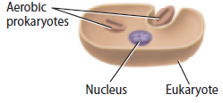
Cellular Evolution
The endosymbiont theory
Lynn Margulis proposed the endosymbiont theory, which proposed that ancestral eukaryotic cells absorbed prokaryotic cells, which evolved into organelles.
Prokaryotes entered eukaryotic cells as undigested food or parasites.
Their relationship became mutually beneficial.
The theory explains the double membranes around mitochondria and chloroplasts.
The Origin of Life
Copyright © McGraw-Hill Education

