Slide 1

Chapter 14
Section 1: Fossil Evidence of Change
Fossils provide evidence of the change in organisms over time.

Slide 2
Essential Questions
What are the similarities and differences between Earth’s early environment and Earth’s current environment?
What is a typical sequence of events in fossilization?
How are the different techniques for dating fossils used?
What are the major events on the geologic time scale?
Fossil Evidence of Change
Copyright © McGraw-Hill Education

Slide 3
Earth’s Early History
Land environments
Earth formed about 4.6 billion years ago.
Gravity pulled the densest elements to the center of the planet.
After about 500 million years, a solid crust formed on the surface.
Fossil Evidence of Change
Copyright © McGraw-Hill Education

Slide 4
Earth’s Early History
Atmosphere
The gases that likely made up the atmosphere are those that were expelled by volcanoes, such as water vapor (H₂O), carbon dioxide (CO₂), sulfur dioxide (SO₂), carbon monoxide (CO), nitrogen (N₂), and hydrogen (H₂).
Minerals in the oldest known rocks suggest that the early atmosphere had little to no free oxygen.
Fossil Evidence of Change
Copyright © McGraw-Hill Education

Slide 5
Clues in Rocks
The fossil record
A fossil is any preserved evidence of an organism.
99% of the species that have ever lived are now extinct, but only a small percentage remain as fossils.
Most organisms decompose before they have a chance to become fossilized.
Fossil Evidence of Change
Copyright © McGraw-Hill Education

Slide 6
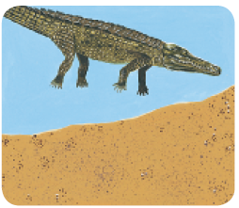
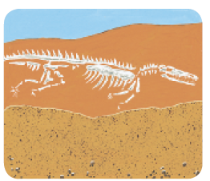
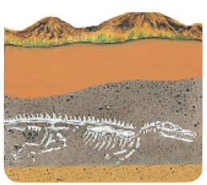
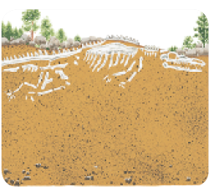
Clues in Rocks
Fossil formation
Nearly all fossils are formed in sedimentary rock
The sediments build up until they cover the organism’s remains.
Minerals replace the organic matter or fill the empty pore spaces of the organism, or the organism decomposes and leaves behind an impression of its body.
Fossil Evidence of Change
Copyright © McGraw-Hill Education

Slide 7
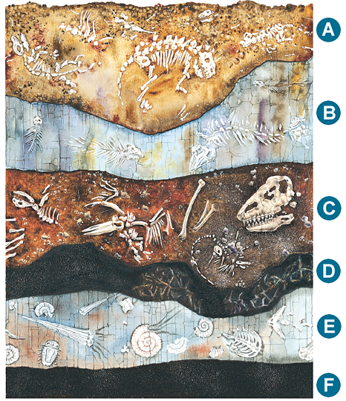
Clues in Rocks
Dating fossils
Scientists who study fossils are called paleontologists.
Relative dating is a method used to determine the age of rocks by comparing them with those in other layers.
Relative dating is based on the law of superposition, which states that younger layers of roc are deposited on top of older layers.
Fossil Evidence of Change
Copyright © McGraw-Hill Education

Slide 8
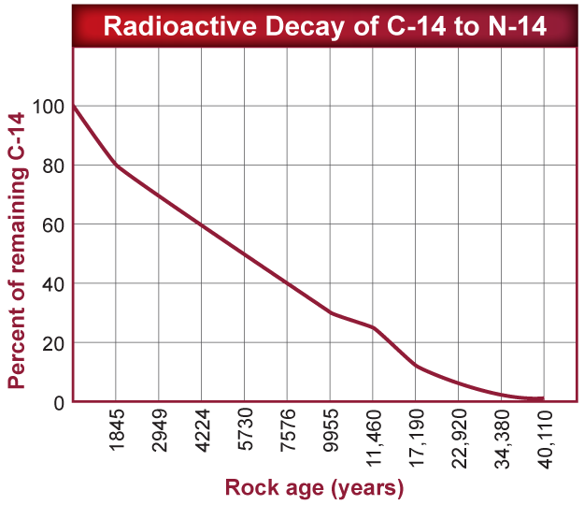
Clues in Rocks
Dating fossils
Radiometric dating uses the decay of radioactive isotopes to measure the age of a rock
Technique depends on knowing the half life – the time it takes for half of the original isotope to decay – of the isotope in question.
Fossil Evidence of Change
Copyright © McGraw-Hill Education

Slide 9
The Geologic Time Scale
The geologic time scale is a model that expresses the major geological and biological events in Earth’s history.
Geologic time is divided into two segments, the Precambrian and the Phanerozoic eon
  Epochs are the smallest units of geologic time(>1m years)
  Periods are composed of two or more epochs (10m years)
  Eras consist of two or more periods (100m years)
  An eon is the longest unit of time in the geologic time scale, can include billions of years
Fossil Evidence of Change
Copyright © McGraw-Hill Education

Slide 10
The Geologic Time Scale
Precambrian
First 4 billion years (90 percent) of Earth’s history
Life first appears during the Precambrian
  Autotrophic prokaryotes enriched the atmosphere with oxygen.
  Eukaryotes emerged; first animals appeared.
  Food chains were generally short and simple.
Fossil Evidence of Change
Copyright © McGraw-Hill Education

Slide 11
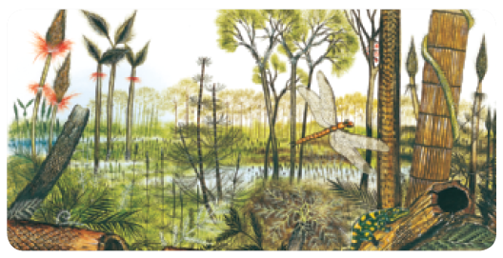
The Geologic Time Scale
The Paleozoic Era
The ancestors of most major animal groups diversified in what scientists call the Cambrian explosion.
First life on land emerges during this era
A mass extinction ended the Paleozoic Era, with 90% of marine organisms going extinct.
Fossil Evidence of Change
Copyright © McGraw-Hill Education

Slide 12
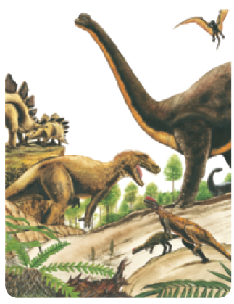
The Geologic Time Scale
The Mesozoic Era
Dinosaurs, birds, and mammals evolved during the Mesozoic Era
The K-T boundary is a layer of material in between the rocks in the Cretaceous and Paleogene periods with unusually high levels of iridium
Iridium is rare on Earth, but common on meteorites, suggesting a massive meteorite struck the Earth about 65 million years ago.
This meteorite impact changed the climate on Earth, wiping out the dinosaurs, many marine invertebrates, and many plant species.
Fossil Evidence of Change
Copyright © McGraw-Hill Education

Slide 13
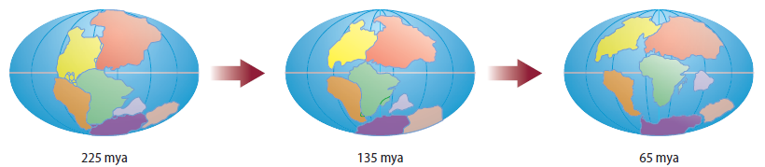
The Geologic Time Scale
The Mesozoic Era
Geologic changes took place during the Mesozoic Era that shaped the course of evolution.
Plate tectonics describes the movement of several large plates that make up the surface of the Earth.
These plates, some of which contain continents, move atop a partially molten layer of rock underneath them.
Fossil Evidence of Change
Copyright © McGraw-Hill Education

Slide 14
The Geologic Time Scale
The Cenozoic Era
Mammals became the dominant land animals.
After the mass extinction at the end of the Mesozoic era, mammals of all kinds began to diversify.
Humans appeared very recently, in the current Neogene Period.
Fossil Evidence of Change
Copyright © McGraw-Hill Education

