Slide 1
Section 3: Chromosomes and Human Heredity
Chromosomes can be studied using karyotypes.

Slide 2
Essential Questions
How are karyotypes used to study genetic disorders?
What is the role of telomeres?
How is nondisjunction related to Down syndrome and other abnormal chromosome numbers?
What are the benefits and risks of diagnostic fetal testing?
Chromosomes and Human Heredity
Copyright © McGraw-Hill Education

Slide 3
Karyotype Studies
Scientists study not only genes but entire chromosomes.
Images of chromosomes stained during metaphase allow scientists to study sister chromatids and homologous chromosomes.
Karyotype – micrograph in which the pairs of homologous chromosomes are arranged in decreasing size.
Chromosomes and Human Heredity
Copyright © McGraw-Hill Education

Slide 4
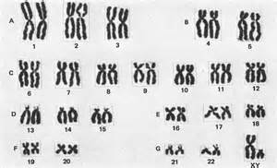
Karyotype

Slide 5
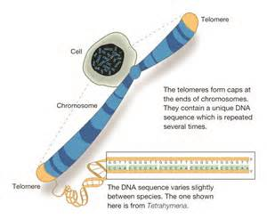
Telomeres
Telomeres are protective caps on the end of chromosomes.
Telomeres consist of DNA and proteins.
They serve as a protective function for the structure of the chromosome.
Chromosomes and Human Heredity
Copyright © McGraw-Hill Education

Slide 6
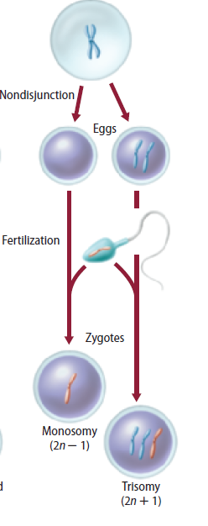
Nondisjunction
Cell division where sister chromatids fail to separate properly is called nondisjunction.
Chromosomes and Human Heredity
Copyright © McGraw-Hill Education

Slide 7
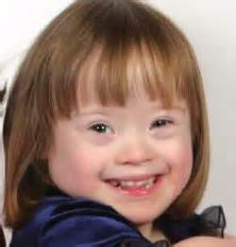
Nondisjunction
Down syndrome
Result of an extra chromosome 21
Characteristics include distinctive facial features, short stature, heart defects, and mental disability.
Chromosomes and Human Heredity
Copyright © McGraw-Hill Education

Slide 8
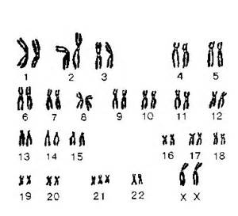
Down syndrome Karyotype

Slide 9
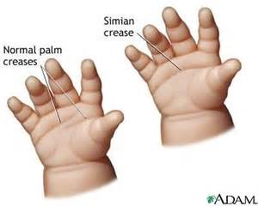
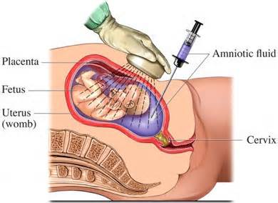
Fetal testing
Fetal tests can provide information on potential genetic disorders and chromosomal status of developing babies.
Chromosomes and Human Heredity
Copyright © McGraw-Hill Education

