Slide 1

Chapter 10 - Section 1: Meiosis
Meiosis produces haploid gametes.

Slide 2
Chromosomes and Chromosome Number
Characteristics such as hair color, eye color, etc., are called traits.
The instructions for each trait are located on chromosomes, in the nucleus of cells.
DNA is organized in segments called genes that control the production of a protein.
Each chromosome contains hundreds of genes.
Meiosis
Copyright © McGraw-Hill Education

Slide 3
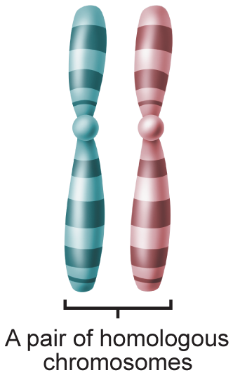
Chromosomes and Chromosome Number
Homologous chromosomes
Human cells have 46 chromosomes, or 23 pairs (one contributed by each parent).
The chromosomes that make up the pairs are called homologous chromosomes.
Homologous chromosomes are the same length, same centromere position, and carry genes for the same traits.
Dad
Mom
Meiosis
Copyright © McGraw-Hill Education

Slide 4
Chromosomes and Chromosome Number
Haploid and diploid cells
To maintain the same number of chromosomes from generation to generation, organisms produce gametes – sex cells with half the number of chromosomes.
The symbol n can be used to represent the number of chromosomes in a gamete.
  A cell with n chromosomes is called a haploid cell.
  A cell that contains 2n chromosomes is called a diploid cell.
Meiosis
Copyright © McGraw-Hill Education

Slide 5
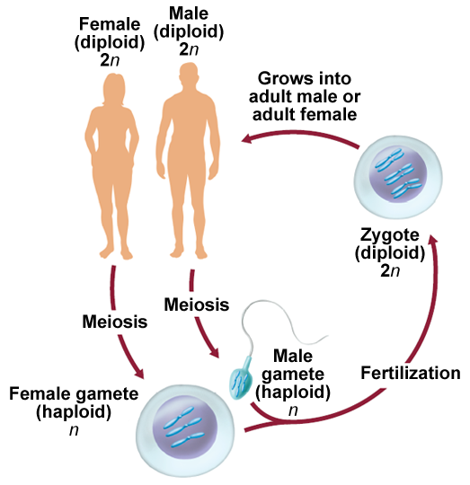
Meiosis I
Meiosis is a type of cell division that reduces the number of chromosomes in a cell and produces gametes.
Involves two consecutive cell divisions, meiosis I and meiosis II.
Meiosis
Copyright © McGraw-Hill Education

Slide 6
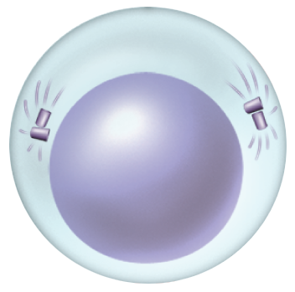

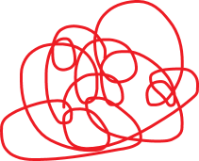
Meiosis I
Interphase
  Chromosomes replicate.
  Chromatin condenses.
Meiosis
Copyright © McGraw-Hill Education

Slide 7
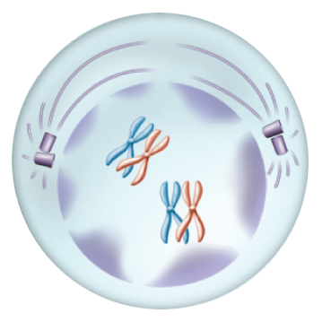
Meiosis I
Prophase I
  Pairing of homologous chromosomes occurs.
  Each chromosome consists of two sister chromatids.
Meiosis
Copyright © McGraw-Hill Education

Slide 8
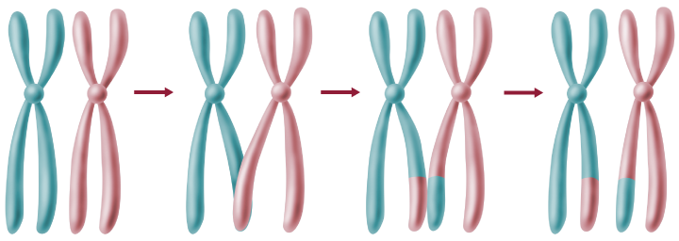
Meiosis I
Prophase I
  As homologous chromosomes condense, they are bound together in a process called Synapsis, which allows for crossing over.
  Crossing over – chromosomal segments are exchanged between a pair of homologous chromosomes.
  Crossing over produces exchange of genetic information.
Meiosis
Copyright © McGraw-Hill Education

Slide 9
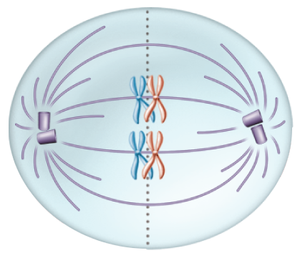
Meiosis I
Metaphase I
  Chromosome centromeres attach to spindle fibers.
  Homologous chromosomes line up as a pair at the equator.
Meiosis
Copyright © McGraw-Hill Education

Slide 10
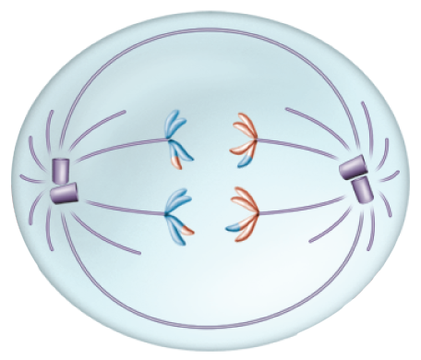
Meiosis I
Anaphase I
  Homologous chromosomes separate and move to opposite poles of the cell.
  The chromosome number is reduced from 2n to n when the homologous chromosomes separate.
Meiosis
Copyright © McGraw-Hill Education

Slide 11
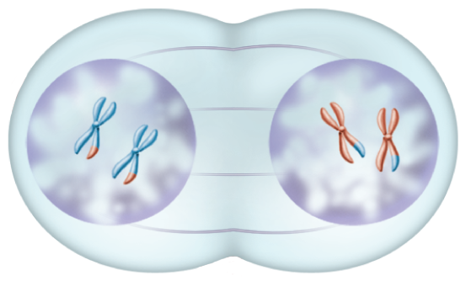
Meiosis I
Telophase I
  Chromosomes reach the cells opposite poles.
  Cytokinesis occurs.
Meiosis
Copyright © McGraw-Hill Education

Slide 12
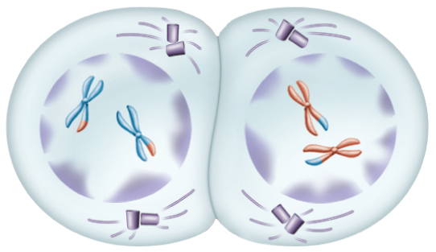
Meiosis II
Prophase II
  A second set of phases begins as the spindle apparatus forms and the chromosomes condense.
Meiosis
Copyright © McGraw-Hill Education

Slide 13
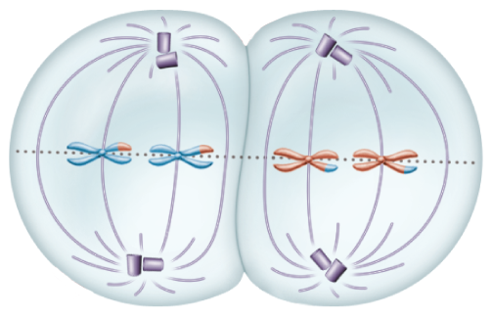
Meiosis II
Metaphase II
  Chromosomes are positioned at the equator.
  Meiosis II involves a haploid number of chromosomes.
Meiosis
Copyright © McGraw-Hill Education

Slide 14
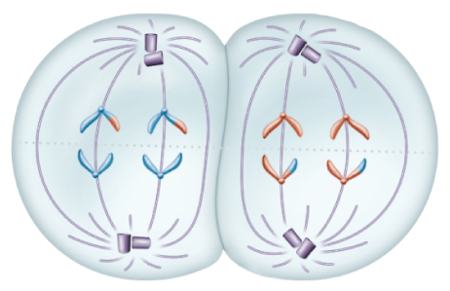
Meiosis II
Anaphase II
  Sister chromatids are pulled apart at the centromere by spindle fibers and move toward the opposite poles of the cell.
Meiosis
Copyright © McGraw-Hill Education

Slide 15
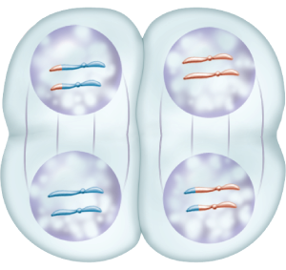
Meiosis II
Telophase II
  The chromosomes reach the poles, and the nuclear membrane and nuclei reform.
Meiosis
Copyright © McGraw-Hill Education

Slide 16
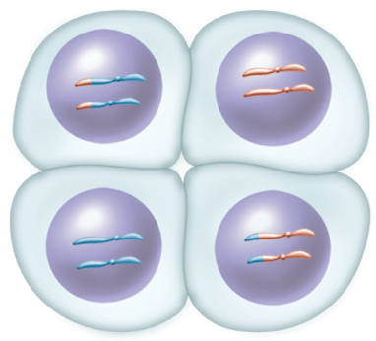
Meiosis II
Cytokinesis results in four haploid cells, each with n number of chromosomes.
Cytokinesis
Meiosis
Copyright © McGraw-Hill Education

Slide 17
The Importance of Meiosis
Mitosis consists of one cell division that produces identical cells
Meiosis consists of two cell divisions that produce haploid daughter cells that are not genetically identical.
Meiosis results in genetic variation.
Meiosis
Copyright © McGraw-Hill Education

Slide 18
Sexual Reproduction v. Asexual Reproduction
Asexual reproduction
  The organism inherits all of its chromosomes from a single parent.
  The new individual is genetically identical to its parent.
Sexual reproduction
  Rate of beneficial mutations is faster.
  Beneficial genes multiply faster over times than they do for asexual organisms.
Meiosis
Copyright © McGraw-Hill Education

