Slide 1
Section 3: Cell Cycle Regulation
The normal cell cycle is regulated by cyclin proteins.

Slide 2
Essential Questions
What is the role of cyclin proteins in controlling the cell cycle?
How does cancer relate to the cell cycle?
What is the role of apoptosis?
What are the two types of stem cells and what are their potential uses?
Cell Cycle Regulation
Copyright © McGraw-Hill Education

Slide 3
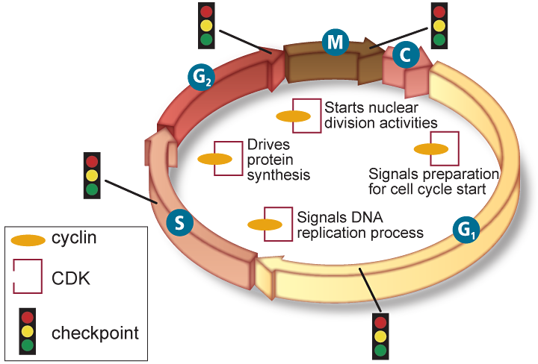
Normal Cell Cycle
The role of cyclins
The timing and rate of cell division are important, and controlled by proteins and enzymes
The cell cycle in eukaryotic cells is driven by a combination of two substances.
Cyclins are proteins that bind to enzymes called cyclin-dependent kinases (CDKs).
Different cyclin/CDK combinations control different activities during different stages of the cell cycle.
Cell Cycle Regulation
Copyright © McGraw-Hill Education

Slide 4
Normal Cell Cycle
Quality control checkpoints
The cell cycle has built-in checkpoints that monitor the cycle and can stop it if something goes wrong.
There are checkpoints after each stage of interphase to protect against duplicating DNA damage.
Cell Cycle Regulation
Copyright © McGraw-Hill Education

Slide 5
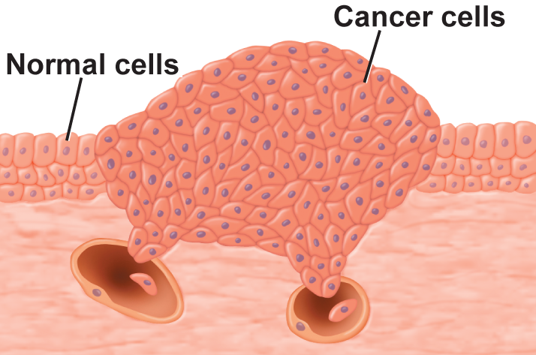
Abnormal Cell Cycle: Cancer
Cancer is the uncontrolled growth and division of cells.
Cancer results when cells stop responding to the controls of the cell cycle.
Cancer cells can kill an organism by crowding out normal cells, resulting in the loss of tissue function.
Cell Cycle Regulation
Copyright © McGraw-Hill Education

Slide 6
Abnormal Cell Cycle: Cancer
Causes of cancer
Mutations or changes in segments of DNA cause the cell growth and division of cancer cells.
Various environmental factors can affect the occurrence of cancer cells.
Substances that are know to cause cancer are called carcinogens.
Cell Cycle Regulation
Copyright © McGraw-Hill Education

Slide 7
Apoptosis
Apoptosis is the process of programmed cell death.
Cells going through apoptosis shrink and shrivel.
Apoptosis occurs during development, in cells that are damaged, and in cells that may lead to cancerous growths.
Cell Cycle Regulation
Copyright © McGraw-Hill Education

Slide 8
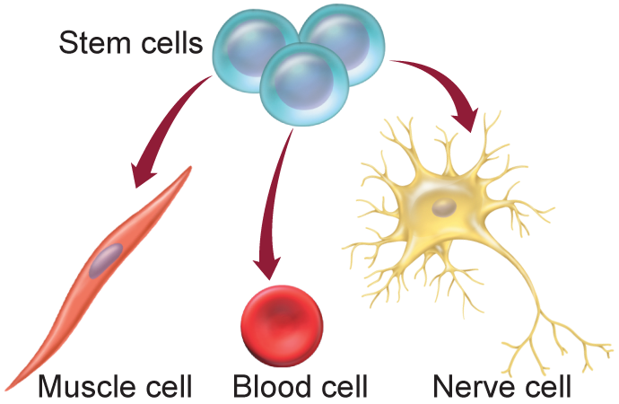
Stem Cells
Multicellular organisms have specialized cells.
The precursor cells that can be directed to become specialized cells are stem cells.
Cell Cycle Regulation
Copyright © McGraw-Hill Education

Slide 9
Stem Cells
Embryonic stem cells
After fertilization, the initial mass of cells (100-150 cells) remain undifferentiated – these comprise embryonic stem cells.
As development continues, cells receive signals that initiate their differentiation into specialized cells.
Cell Cycle Regulation
Copyright © McGraw-Hill Education

Slide 10
Stem Cells
Adult stem cells
Found in various tissues in the body
Might be used to maintain and repair tissue.
More developed/specialized than embryonic stem cells, but might be able to differentiate into different kinds of cells.
Cell Cycle Regulation
Copyright © McGraw-Hill Education

