Slide 1
*Diagnostic Test*
There are hundreds of possible Antigens(allergens) that cause allergic reactions. Some are more common such as house dust, pet hair, chocolate, ragweed, cigarette smoke, pollen, seafood, nickel, paints, dyes, and chemical cleaners.
The most important diagnostics test is the skin test. It may be performed by an intradermal injection of a small amount of the suspected antigen under the skin.
Skin patch tests also can be used that has antigens on the patch as well as a scratch test that is spread inside the scratch to identify the allergy.

Slide 2
Diagnostics Test
Allergy to an antigen is positive for an inflammatory response occurs at the injection site. Desensitization treatment requires injection of an increasing amount allergen over a long period of time with the goal of desensitizing the body to the allergen.
Hypersensitivity reactions to transfused blood cells are usually identified by a blood count indicating low levels of red cells, white cells, and platelets.
Antibodies can form against all these blood elements, leading to anemia, leukopenia, and thrombocytopenia (inability to clot blood).

Slide 3
Diagnostic Test.
A Coombs test will indicate the formation of antibodies on the red blood cells, determining blood type and diagnosis of certain hemolytic (hemo=blood, lytic=destroying) anemias.
This test can also indicate the presence of maternal antibodies against fetal blood type.

Slide 4
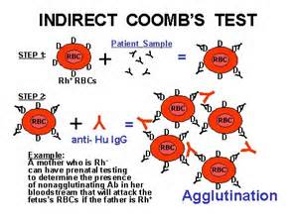
Coombs test

Slide 5
Diagnostic test
Autoimmune disorders can be diagnosed using blood tests that measure for specific diseases.
Example: individuals with systemic lupus have a positive antinuclear antibody(ANA) test.
Rheumatoid factor (RF) in the blood is often an indication of rheumatoid arthritis.

Slide 6
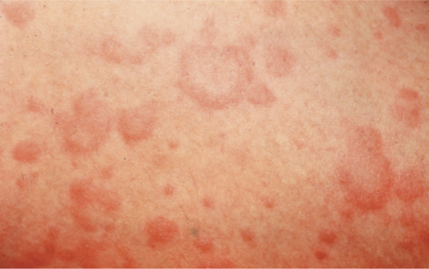
Hypersensitivity Disorders : Allergies (in general)
Description: One of the most prevalent types of hypersensitivity problems. Hay fever, asthma, urticaria (a reaction characterized by intense wheals and itching), and contact dermatitis are common allergic reaction. Severe asthma is an example of a life threatening condition that can occur from an allergy.
Picture of wheals

Slide 7
Etiology (the Cause):
Allergy is an acquired hypersensitivity. Individual needs to be first exposed or sensitized into the allergen. Subsequent or repeated exposure leads to a reaction identified as an allergy or an allergic reaction by the immune system.
An immediate response to an allergy are examples like hay fever, asthma, or food allergy.
Delayed response allergies are slower to react and are usually less harmful. For example contact dermatitis, caused by exposure to poison ivy.

Slide 8
Symptoms:
Because most allergies are airborne, they cause respiratory symptoms such as a runny nose, coughing, sneezing, wheezing, and nasal congestion.
Other allergies can cause redness, heat, swelling and itching of the involved tissue.

Slide 9
Treatments & Prevention
Treatments: Avoidance of the allergen, allergy desensitization injections, antihistamine and steroid medications.
Preventions: total avoidance of the allergen or in the case of autoimmune disease, minimizing the hyper immune symptoms.

Slide 10
Hay Fever (Allergic Rhinitis)
Description: A reaction and possible inflammation in the mucous membrane of the nose and upper respiratory tract to an allergen
Etiology: allergen is usually airborne and can be seasonal, like tree pollen, grasses, agricultural crops, and ragweed pollen can cause an increase in symptoms during different seasons of the year.
No seasonal hay fever can occur due to house dust, pet dander, or food allergies.

Slide 11
Hay Fever
Symptoms: Sneezing, watery eyes, runny nose and itching.
Diagnosis: Skin testing the most common method of allergy testing for Hay Fever.
Treatment: Removal of the allergen or separate the allergen for the patient. Patient can choose to move permanently or move away from the pollen count and the climate causing the Hay fever.
An air conditioned environment is beneficial because it filters much of the allergen. Antihistamines and other drugs can be given orally, and nose spray/drops in order to control symptoms. Allergy desensitization might be of benefit to control allergy reactions.

Slide 12
Asthma
Description: Chronic allergic condition also known as Bronchial asthma. It affect 5-10% of children making it the leading cause of chronic illness for children. Asthma affects young men more frequently before puberty, and girls more frequent after puberty.
It is believed that the changes is hormone level before and after puberty cause the effects to change airway responses.

Slide 13
Asthma
Etiology: When exposed to an allergen, the hypersensitive individual has episodes of wheezing due to bronchospasm or muscular constriction of the bronchi of the respiratory tract.
Asthma can be cause by allergens of the environment. Other causes of asthma are non allergic and include events that produce stress. Like infections such as the common cold, changes in temperature and humidity, exercise and emotional stress.

Slide 14
Asthma
Symptoms: Symptoms of attack include extreme shortness of breath, difficulty breathing, wheezing, and anxiety. Attacks vary in severity from mild to almost suffocating. Coughing during the attack begins with a mild dry cough, but progresses to production of large amounts of mucous as the attack continues.
Skin might be pale and moist in mild attacks, with cyanosis(low oxygen saturation) of the nail beds and lips in more severe attacks.
During an attack asthmatics often assume a sitting position, leaning forward with hands resting on the knees. This position helps breathing using respiratory muscles.
A severe attack does not respond to treatment with bronchodilators, and/or lasts for several days, called status asthmaticus and is a life threatening medical emergency.

Slide 15
Asthma
Diagnosis: made after a complete history and physical exam along with lung function testing. A trial medication might be ordered. If the medication works, the diagnosis is probably asthma.
Treatment: Avoidance of causative allergens, desensitization, education, and medication to treat the symptoms. Deep breathing exercises, maintenance of proper posture, and relaxation techniques are beneficial.
A regimen of medications to relax and open the bronchi (bronchodilators) and to thin the excessive mucous (mucolytic) is important.
There is no cure for asthma, but can be controlled by a combination of therapies including strict complicated medication regimen, relaxation techniques, exercise and avoidance of allergens.

Slide 16
Urticaria (Ooor-ti-caria)
Description: Commonly known as hives or nettle rash, urticaria is a reaction of the skin
Etiology: This condition is caused by contact with an external irritant such as insect bites, pollen drugs, food or plants.
Symptoms: characterized by slightly elevated lesions that are redder or paler than the surrounding skin and associated with severe itching. The elevated areas are called Wheels or hives. Scratching or rubbing the hypersensitive area can lead to formation of larger or additional wheels.

Slide 17
Urticaria
Diagnosis: a Physical Examination will help diagnose this skin reaction. A history of recent exposure to plants, insect bites, pets, new foods, or medications that might assist in identifying the allergen.
Treatment: Includes antihistamines and avoidance of the allergen.

Slide 18
Anaphylaxis
Description: This is a severe allergic response to an allergen, often leading to anaphylactic shock.
Etiology: Anaphylaxis also known as anaphylactic reaction is caused by absorption of the antigen into the blood directly or through mucous membranes. Food allergy is believed to be the leading cause of anaphylaxis outside the hospital. Other causes of anaphylaxis include medications, insect stings, and latex. Mast cells release Histamine and a protein called Tryptase to the area it was exposed to.

Slide 19
Anaphylaxis
Symptoms: A local anaphylactic reaction might be mild and produce generalized itching, swelling, and urticaria The reaction should be closely monetarized because it might rapidly progress to systemic anaphylaxis.
Systemic anaphylaxis is a true medical emergency involving the release of histamines throughout body tissues causing itching of the throat, tongue, and scalp. Edema (swelling of face & airway) lead to difficulty breathing. Blood pressure drops (shock) and temperature. Shock may also cause unconsciousness, and if symptoms are not reversed with medical attention, death from respiratory and cardiac arrest can occur within 15 to 20 minutes.

Slide 20
Anaphylaxis
Diagnosis: Symptoms generally initiate within minutes and last less than 24 hours. Diagnosis is made rapidly based on presenting symptoms.
Treatment: During attack, performance of tracheostomy (trache=trachea, ostomy=opening) or endotracheal (endo=within, trachea=windpipe) intubation with mechanical ventilation. Immediate administration of epinephrine (adrenaline) is necessary. Epinephrine is a vasoconstrictor and a smooth muscle relaxant that raises blood pressure, dilates the bronchi, and decreases laryngeal spasms.

Slide 21
Anaphylaxis
Treatment Cont. : Antihistamines and corticosteroids are powerful anti-inflammatory hormones that limit histamine production, thus showing the allergic reaction.
Follow up treatment requires identification of the allergen to avoid a reaction. Individuals should wear an allergy identification necklace or bracelet. Individuals with severe reactions should always carry an allergy kit containing Benadryl (antihistamine), syringes, and vials of epinephrine, or an EPI Pen (epinephrine auto injector). Family should understand and practice steps and treatments of a reaction.

Slide 22
Food allergies
Description: Gastrointestinal food allergies are often difficult to diagnose because it involves elimination of certain foods, and then adding them to your diet one at a time.
Etiology: Chocolate and shellfish are common food allergies. Sometimes the allergy is not specific to food, but to additives or preservatives in the food. A milk allergy is typically not a true allergy, but an intolerance to the lactose in the milk. Taking a lactose enzyme (lactase) can help prevent the intolerance.

Slide 23
Food allergies
Symptoms: Skin rash, abdominal cramping, diarrhea, and cramping.
Diagnosis: Get a through history of the patient and patient’s documented food diary. Testing, including, skin tests and blood tests. Food challenges can also be helpful.
Treatment: For mild allergic reactions, treatment with antihistamines might be sufficient. For severe reactions, first priority is to maintain airway open and possibly activate the emergency medical system.

Slide 24
Contact Dermatitis
Description: Acute or chronic allergic reaction affecting the skin.
Etiology: Usually some type of cosmetic, laundry product, plant, jewelry, paint, drug, plastic, or a variety of other agents. Determining the causative agent is difficult to determine, and once determined, complete avoidance might not be possible.
Symptoms: Allergic lesions in range from small, red, localized lesions to vascular lesions that cover the entire body. Ex: poison ivy

Slide 25
Poison ivy oily (REZ;IN)
Some plants contain oily resin like substance that causes itchy rash in men and women. Urushiol is one such resin found in the leaves and branches of poison ivy that cause poison ivy rash. This type of resin can stick on to the clothing and shoes of humans when they are walking through the plants. The same plant can produce a worse type of infection in the lungs when it is burnt and the smoke is inhaled. Treatment can be given for poison ivy rash by medications like a corticosteroid.

Slide 26
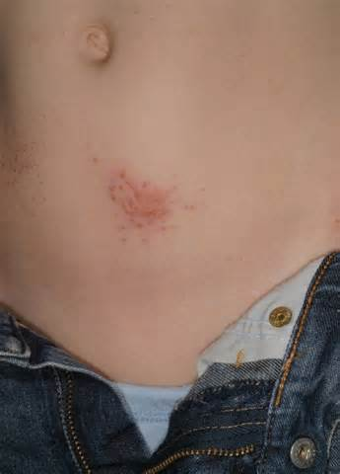
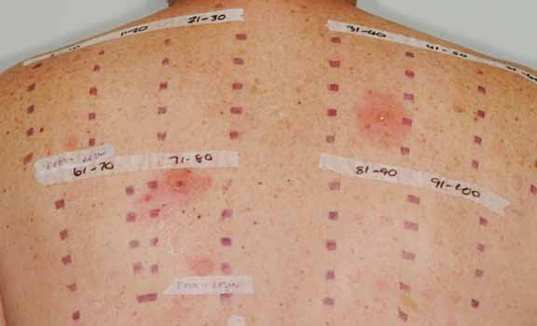
Contact dermatitis
Diagnosis: skin patch testing will help determine the diagnosis of the allergen.
Treatment: Treatment is only available when allergen is diagnosed, with a Corticosteroid, and Antihistamine for the swelling. Avoidance of the allergen is the most effective treatment.

