Slide 1
Scleroderma
Description: Scleroderma (Sclero= hardening, Derma=skin) is a chronic autoimmune disorder characterized by the hardening of the skin, shrinking of connective tissues that include the skin. This disease might exhibit periods of remission and exacerbation.
This disease typically has a slow progression and allows the individual a reasonably long life. If the disorder progresses rapidly, it can affect vital organs and early death can occur, usually related to kidney failure.

Slide 2
Scleroderma
Etiology: This autoimmune reaction begins with the skin and connective tissues, attracting lymph cells that are stimulated to produce collagen, leading to the disorder.
Milder forms of the disease commonly affect women 30-50 years of age and include those limited to the skin, face and extremities.
The more severe form is called systemic or diffuse, usually affects men and older persons, also affecting internal organs including the heart, lungs, and kidneys. The tissues become hardened, thickened, and often limit in function.

Slide 3
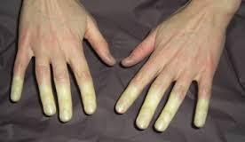
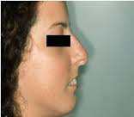
Scleroderma
Symptoms: People with scleroderma will have thick, leather like, shiny, taut (stretched) skin and joint contractures.
First symptom is typically Raynaud's phenomenon, an episodic vasoconstriction affecting the hands.
Mouth area becomes wrinkled with a tight, purse lipped appearance, leading to difficulty eating.

Slide 4
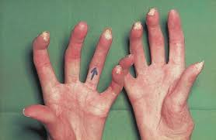
Scleroderma
Diagnosis: Can be difficult because is mimics other disorders such as bursitis (inflammation of the fluid filled sacs of the joint) and arthritis. Physical symptoms indicative of scleroderma include:
Tight skin around the hands skin and mouth.
Change in the capillaries at the base of the
fingernails, & Calcium deposits under the skin.
These physical symptoms, coupled with clinical examinations, blood testing for presence of anticentromere antibodies(ACA), antinuclear antibodies (ANAs), ant topoisomerase I antibody(ATA), are usually detectable, and tissue biopsy showing high levels of collagen and calcium deposits, often yields a positive diagnosis.

Slide 5
Scleroderma
Treatment: Is symptomatic with anti-inflammatory medications, immunosuppressives, and antibiotics might be beneficial.
Muscle stretching and strengthening exercises might also be beneficial to maintain muscle strength and joint mobility.
Prevention: No one really knows what causes scleroderma , so at the time, there are no preventative methods identified.

Slide 6
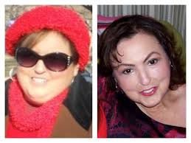
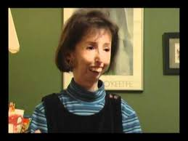
Scleroderma
Mild Scleroderma
Severe Scleroderma

Slide 7
https://www.youtube.com/watch?v=Gl66qO8uxSM – Documentary
https://www.youtube.com/watch?v=GKN3zMG63pk - Scleroderma the Teresa Nadeau Story Part 1
https://www.youtube.com/watch?v=h6ti1eVo-9s - An Overview of Scleroderma Part 1: Breaking it down
https://www.youtube.com/watch?v=6KLeGkeREkM - An Overview of Scleroderma Part 2: Treatment and management

