Slide 1
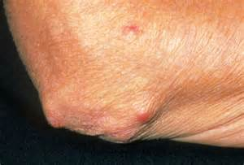
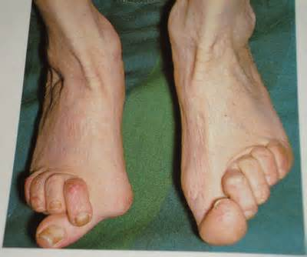
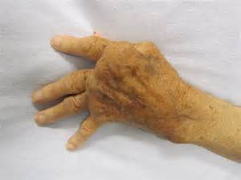
Rheumatoid Arthritis
Description: Autoimmune disease that causes chronic inflammation of connective tissue. Joint tissue is permanently affected, but any connective tissue of the body might be involved.
Etiology: Associated with the production of abnormal antibodies that attacks or attaches to the bodies own cells and tissues. Presence of the antibody called Rheumatoid factor (RF) in the affected individuals blood is indicative of the disease.

Slide 2
Rheumatoid Arthritis
Symptoms: Commonly, metacarpal-phalangeal joints of the hands are initially affected with rheumatoid arthritis. This leads to a classic sign of rheumatoid arthritis called ulnar deviation of the fingers. As the disease progresses, involvement of other synovial (moveable) joints can occur. Joints affected can include those of the fingers, wrists, elbows, feet, ankles, and knees.
Symptoms can vary in severity from mild to severe and might go through periods of remission exacerbation. Rheumatoid arthritis begins with inflammation of synovial lining of the joint, leading to pain stiffness and joint deformity. Eventually the cartilage of the joint is destroyed and replaced with a granulation tissue called pannus. Progression of the disease, the entire joint surface is destroyed and replaced with fibrous tissue, making it less movable. Function/loss of joint function is called Ankylosis.

Slide 3
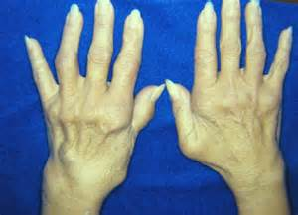
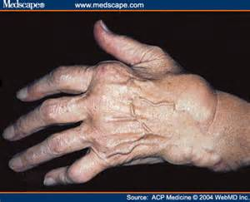
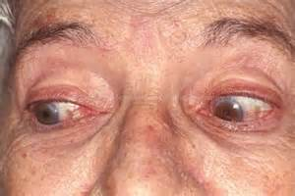
Rheumatoid Arthritis(RA)
Symptoms Cont.: In addition to joint changes, the individual might also have lesions (tissue abnormality) in the collagen of the lungs, blood vessel, heart, and eyes, leading to Pleuritis (pleura=lining of the lungs, itis= inflammation), anemia, valvulitis (valvul=valve, itis = inflammation), and glaucoma (optic nerve damage). Rheumatoid nodules characteristically appear in the subcutaneous tissue(hypodermis) around the fingers, elbows and toes. Individuals with RA will often appear frail and chronically ill. Anemia and infections are common secondary problems.

Slide 4
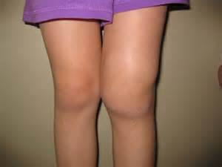
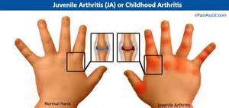
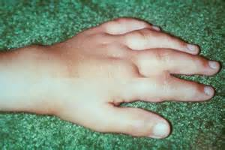
Rheumatoid arthritis
Symptoms Cont.: This chronic disease affects both sexes and all ages, but onset is most common in women between age 20-40. Women are affected three times more than men because of their ability to have children, smaller body size, and smaller muscles. Rheumatoid arthritis can affect children from infants to 16 year old children, can be very severe, and is called juvenile rheumatoid arthritis or Still’s Disease.

Slide 5
Rheumatoid arthritis
Diagnosis: Based on physical examination, characteristic symptoms, and blood tests including positive rheumatoid factor, anti- CCP antibodies (anti-cyclic citrullinated peptide antibody), and elevated erythrocyte sedimentation rate (ESR) Inflammation test.
Treatment: Rheumatoid arthritis cannot be cured. Treatment includes use of anti-inflammatory medications and analgesics. Disease modifying anti- rheumatic drugs (DMARD’s) and biological drugs act on the immune system and are showing favorable progress in slowing the progression of rheumatoid arthritis. DMRD’s include Imutrex®, Planquenil®, and Zulfinide®. Biologic medications are the newest and include Humera®, Enbrel®, and Actemra®.

Slide 6
Rheumatoid Arthritis
Treatment Cont. : Other medications used in the treatment of rheumatoid arthritis include, Minocin®, Neoral®, and Imuran®. Corticosteroids can be prescribed short term during periods of exacerbation. Exercise and rest routine is essential to maintain joint function. Surgical joint replacement might also be beneficial.
Prevention: There is no known way to prevent Rheumatoid Arthritis.
https://www.youtube.com/watch?v=Rq7-Lkmd8tA
https://www.youtube.com/watch?v=_kOuma9Ad-E
https://www.youtube.com/watch?v=Yc-9dfem3lM

