Slide 1
Myasthenia Gravis
Description: Characterized by severe muscle fatigue.
Etiology: This disease affects the transmission of nerve signals to muscle at the neuromuscular junction, but there is no muscle or nerve tissue disease. Nerve impulses are carried to the muscle by the neurotransmitter acetylcholine. Impulses are sent by the nerve but are not properly received by the muscle. This error in transmission is due to antibodies attacking the muscle receptors, which blocks the transmission of acetylcholine. The weak transmission leads to weak muscle contractions and fatigue.
This is the least common autoimmune disorder, with an estimated 20 cases per 100,000 people. Myasthenia can be categorized as an autoimmune, musculoskeletal, or neurologic disease because it has characteristics of problems in each of the systems.

Slide 2
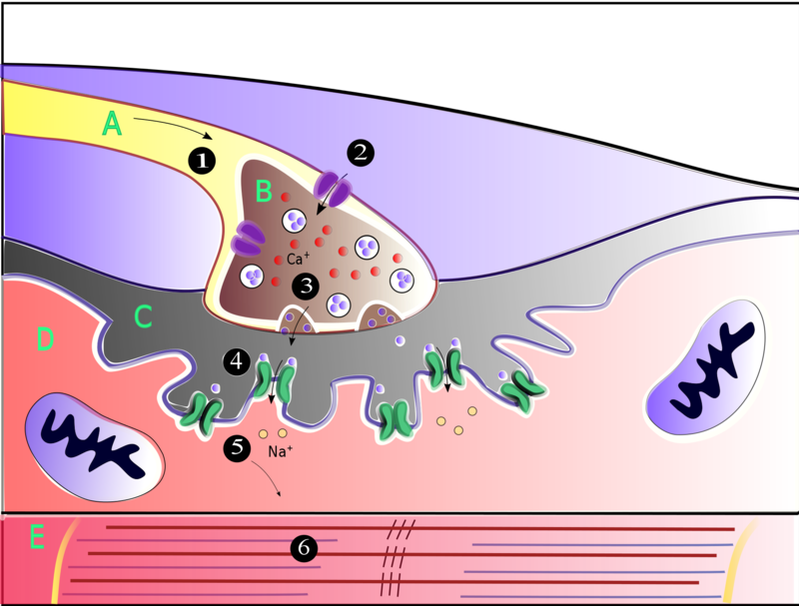
Muscles contract when they receive signals from motor neurons. The neuromuscular junction is the site of the signal exchange. The steps of this process in vertebrates occur as follows: (1) The action potential reaches the axon terminal. (2) Calcium ions flow into the axon terminal. (3) Acetylcholine is released into the synaptic cleft. (4) Acetylcholine binds to postsynaptic receptors. (5) This binding causes ion channels to open and allows sodium ions to flow into the muscle cell. (6) The flow of sodium ions across the membrane into the muscle cell generates an action potential which induces muscle contraction. Labels: A: Motor neuron axon B: Axon terminal C: Synaptic cleft D: Muscle cell E: Part of a Myofibril
Motor neuron Axon
Axon terminal
Synaptic gap/cleft
Potassium ions
Myofibril

Slide 3
Myasthenia Gravis
Motor neuron
Axon terminal

Slide 4
Myasthenia Gravis
Symptoms: Onset of disease is usually slow, and diagnosis might be difficult because it can affect any muscle in his body. Commonly, facial muscles are the ones initially affected, leading to diplopia (double vision), ptosis (drooping eyelids), dysphagia (difficulty swallowing), dysphonia (difficulty talking), and difficulty with facial expression, which can leave the individual with an expressionless facial appearance. Fatigue of all voluntary muscles and include difficulty rising from a sitting position, lifting the arms, standing, and walking.
Degree of weakness varies with the time of day and activities. Generally these individuals feel stronger in the morning due to a buildup of acetylcholine and become weaker as the day progresses because acetylcholine storage diminishes.

Slide 5
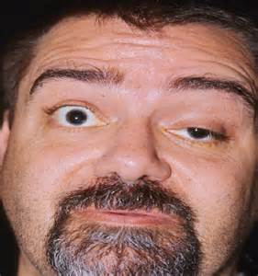
Myasthenia Gravis
Ptosis

Slide 6
Myasthenia Gravis
Diagnosis: Myasthenia is difficult to diagnose because symptoms can be hard to distinguish from other neurologic disorders. A thorough physical exam might reveal fatigue of the muscles: blood testing for antibodies against the acetylcholine receptors (Anti-AChR) also suggest myasthenia. Other tests include electromyography (EMG) to test muscle fatigue and respiratory spirometry to asses respiratory function.
Treatment: Cholinergic medications that do not allow the normal breakdown of the neurotransmitter acetylcholine will allow a buildup of the neurotransmitter, improving neuromuscular transmission. Plasma change is needed to remove the circulating antibodies, providing some improvement of the condition.

Slide 7
Myasthenia Gravis
Treatment cont.: Advances in treatment have reduced mortality rate to 3-4%. Death usually occurs due to muscle weakness, leading to respiratory failure.
Prevention: It cannot be prevented, but avoiding stress, extremes in temperature, fever, illness, and overexertion can help prevent exacerbations.
https://www.youtube.com/watch?v=53DsG_EkV4g
https://www.youtube.com/watch?v=j80reMSwQs4&t=71s

