Slide 1
Immune system disease and Disorders
Chapter 5

Slide 2
Immune System Anatomy and Physiology
Immune system includes primary organs such as the thymus gland, and the bone marrow. And secondary organs such as the lymph nodes, spleen, liver, and tonsils.
Lymphocytes are the major cells of the immune system, arise and develop in the primary organs.
Secondary organs are responsible for filtering foreign substances and providing the space for antigen reactions.

Slide 3
Immune System Anatomy and Physiology
The immune system includes four types of leukocytes: Polymorphonuclear lymphocytes, monocytes, macrophages , and lymphocytes.
Polymorphonuclear lymphocytes (PMN’s) aka granulocytes, are active in inflammatory process. Some activate when infection threatens body, others prevent damage to tissues and cells from allergic reactions.
Monocytes and macrophages become phagocytic in presence of pathogens and foreign substances.

Slide 4
Immune System Anatomy and Physiology
Lymphocytes are in charge of the Immune response being formed in the bone marrow. Remaining and maturing cells become B lymphocytes while others migrate and mature in the thymus and become T lymphocytes.
When B&T lymphocytes mature, they enter the blood and circulate and colonize lymphatic organs, predominantly the spleen and lymph nodes.
T lymphocytes (T cells) destroy microorganisms that invade the body and are responsible for the cell mediated response.

Slide 5
Immune System Anatomy and Physiology
B lymphocytes are responsible for humoral immunity, which is associated with circulating antibodies by enlarging and dividing to make mature plasma cells.
The plasma cells secrete antibodies into the blood and lymph to protect the body against infections and toxins produced by microorganisms.

Slide 6
Immune System Anatomy and Physiology
There are two types of immune responses in the body: Specific and non-specific.
Specific immunity is associated with antigens and antibody reaction.
Antibodies respond to the exposure to antigens. Antibodies may neutralize, kill, or cause clumping of the foreign microorganism.
A group of proteins are produced in the liver and combined with serum in the liver to enhance the work for the antibodies to destroy the invader.

Slide 7
Organs of the immune system

Slide 8
Immune System Anatomy and Physiology
The nonspecific immune response includes, inflammation, phagocytosis, physical barriers (skin and mucous membranes, etc..) and chemical barriers (acids and other secretions)
Nonspecific immunity is part of the first and second line of defense against foreign invaders.

Slide 9
Immune System Anatomy and Physiology
The best way to classify immunity is by dividing it into passive and active, then further divide it into natural and artificial.
Example of passive: Natural resistance is the inherited immunity the individual may possess due to race, species, or ethnic background. Some races, species, or particular groups of populations are naturally resistant to certain diseases. Such as some are susceptible to certain diseases.

Slide 10
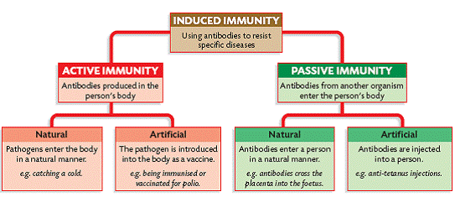
Immune System Anatomy and Physiology

Slide 11
Common signs and symptoms
A patients concern can be considered as both a symptom and a sign. Some references consider this an objective or observable symptom. For example, a patient complaining of a runny nose. It’s the patients symptom, but for the doctor it is an observable sign.
Common signs and symptoms related to the various immune system disease are varied, depending on the organ or organ system affected.
For example: Allergies, symptoms include the inflammatory response (redness, heat, swelling, and itching), and respiratory symptoms (runny nose, cough, sneezing, and nasal congestion).

Slide 12
Common signs and symptoms
A classical problem with immune deficiency disorders is the development of unusual and severe infections such as pneumonia, meningitis, or septicemia.
The development of infections by microorganisms that are usually not pathogenic (opportunistic infections), might indicate of an immunodeficiency disorder (lack of immunity).
Common sign and symptoms related to various autoimmune(immune against self) and isoimmune (immunity against other humans) vary depending on organ and organ system, as well as the pathogen.

Slide 13
*Diagnostic Test*
There are hundreds of possible Antigens(allergens) that cause allergic reactions. Some are more common such as house dust, pet hair, chocolate, ragweed, cigarette smoke, pollen, seafood, nickel, paints, dyes, and chemical cleaners.
The most important diagnostics test is the skin test. It may be performed by an intradermal injection of a small amount of the suspected antigen under the skin.
Skin patch tests also can be used that has antigens on the patch as well as a scratch test that is spread inside the scratch to identify the allergy.

Slide 14
Diagnostics Test
Allergy to an antigen is positive for an inflammatory response occurs at the injection site. Desensitization treatment requires injection of an increasing amount allergen over a long period of time with the goal of desensitizing the body to the allergen.
Hypersensitivity reactions to transfused blood cells are usually identified by a blood count indicating low levels of red cells, white cells, and platelets.
Antibodies can form against all these blood elements, leading to anemia, leukopenia, and thrombocytopenia (inability to clot blood).

Slide 15
Diagnostic Test.
A Coombs test will indicate the formation of antibodies on the red blood cells, determining blood type and diagnosis of certain hemolytic (hemo=blood, lytic=destroying) anemias.
This test can also indicate the presence of maternal antibodies against fetal blood type.

Slide 16
Fetal Blood typing

Slide 17
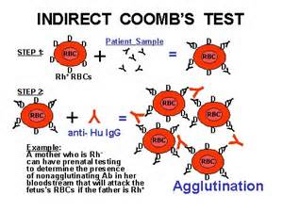
Coombs test

Slide 18
Diagnostic test
Autoimmune disorders can be diagnosed using blood tests that measure for specific diseases.
Example: individuals with systemic lupus have a positive antinuclear antibody(ANA) test.
Rheumatoid factor (RF) in the blood is often an indication of rheumatoid arthritis.

