Slide 1
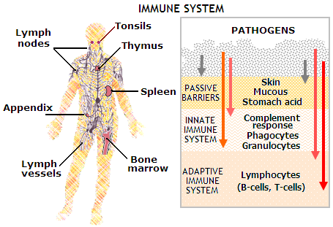
Impaired immunity
1st line of defense of the body’s normal structure and function, include intact skin, mucous membranes, tears, and secretion.
2 additional ways are: inflammatory response in which leukocytes kill foreign invaders, and specific antibody-antigen in which the body responds to antigens by producing antibodies.
Antibodies: also called immune bodies, are proteins the body produces to react to antigen and render it harmless.
Antigen: substances that can cause the body some type of harm, thus setting up a specific reaction.

Slide 2
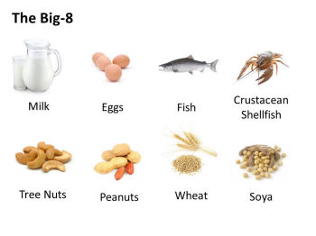
Allergy
Immune response is too hypersensitive to environmental substances.
The allergen in an allergy can be anything like house dust, grass, pets, perfumes, or insect bites.
Allergens only cause a reaction to the persons that are sensitive to the allergen.

Slide 3
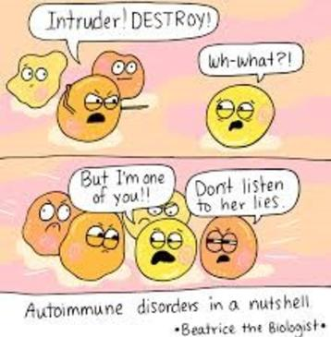
Autoimmunity
When the immune response attacks itself. (auto=self)
The body’s lymphocytes (white blood cells producing antibody’s) cannot identify the body’s own self antigens, which are harmless.
In response, lymphocytes form antibodies then attack the body’s own cells.
Ex: Rheumatoid arthritis and rheumatic fever.

Slide 4
Immunodeficiency
Inability to defend the body due to a decrease or absence of leukocytes, primarily lymphocytes.
Immunodeficiency in people are usually asymptomatic (without symptoms) except for recurrent infections that lead to death.
Acquired Immunodeficiency syndrome (AIDS) is an example.
Immunodeficiency can also be caused by medications like chemotherapy and radiation.

Slide 5
Immunodeficiency
Organ recipients are intentionally immunosuppressed or immunodeficient to save their transplant organ.
Without immunosuppressant medications, the body’s immune system would recognize the organ as foreign and attack it, leading to organ death. (Organ rejection)

Slide 6
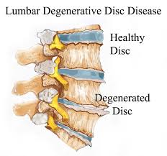
Aging
Diseases related to aging are often called degenerative diseases.
Tissue degeneration is a change in functional activity to a lower or lesser level.
Aging mechanisms are complex and thought to include factors as heredity, lifestyle, stress, diet, and environment.

Slide 7
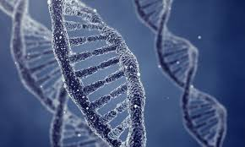
Aging
Heredity factors can include increased life span related to the inherited ability to resist disease.
Hereditary factors cannot be controlled, longevity can be increased and disease decreased by controlling lifestyle behaviors that increase risk of chronic disease.
Body repairs and replaces itself throughout its lifetime, but with aging, this process slows.

Slide 8
Aging
Age as early as 40, causes changes to skin, endocrine function, vision and muscle strength.
Bone loss is also common causing osteoporosis, decreased melanin pigment production, leading to the graying of the hair.
Decreased immunity, leading to increase in infections, and possible development of cancer.
Loss of brain and nerve cells that might lead to senile dementia, as well as intestinal motility, causing constipation.

Slide 9
Cellular injury
Cellular injury and death can lead to hypoxia(not enough oxygen), anoxia (no oxygen) and vise versa, by drug, bacterial toxins, or viruses.
Ability of cell to survive depend on factors as, time cell suffers, and type of cell injury.
Short term injury causes cell to have a greater chance of survival.
Heart, brain, and nerve cells are easily injured and die, while connective and epithelial cells, recuperate and replace themselves by mitosis.

Slide 10
Cellular Adaptation
There are 5 types of adaptations: Atrophy, hypertrophy, dysplasia, metaplasia, and Hyperplasia.
Atrophy (a=without, trophy=growth) causes decrease in cell size leading to decrease In tissue and organ. Due to aging process or disease.
Ex: decrease of muscle and bone in elderly, and breast and reproductive organs atrophy.
No use of muscle causes cell decrease in size.

Slide 11
Atrophy of a cell

Slide 12
Hypertrophy
Hyper=excessive, trophy=growth, leading to growth in tissue and organ size.
Ex: muscle growth from exercising. Muscles need to adapt to the amount of exercise and must grow.
Increase workload in skeletal muscle cause cellular hypertrophy and increase in muscle size.

Slide 13
Hypertrophied cell

Slide 14
Hyperplasia
Hyper=increase, plasia=growth increase in cell number due to hormonal stimulation. (any stimulation causing growth.

Slide 15
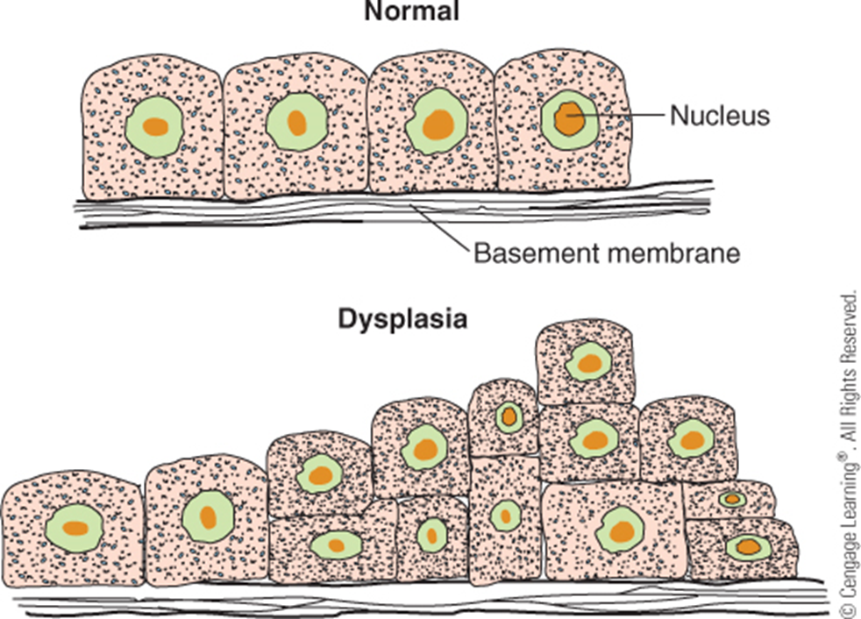
Dysplasia
Dys=bad or difficult, plasia=growth.
Usually follows hyperplasia by alteration of size, shape, and organization of cells. If irritation or stimulus causing growth stops, cells can change back to normal, but usually progresses to neoplasia.

Slide 16
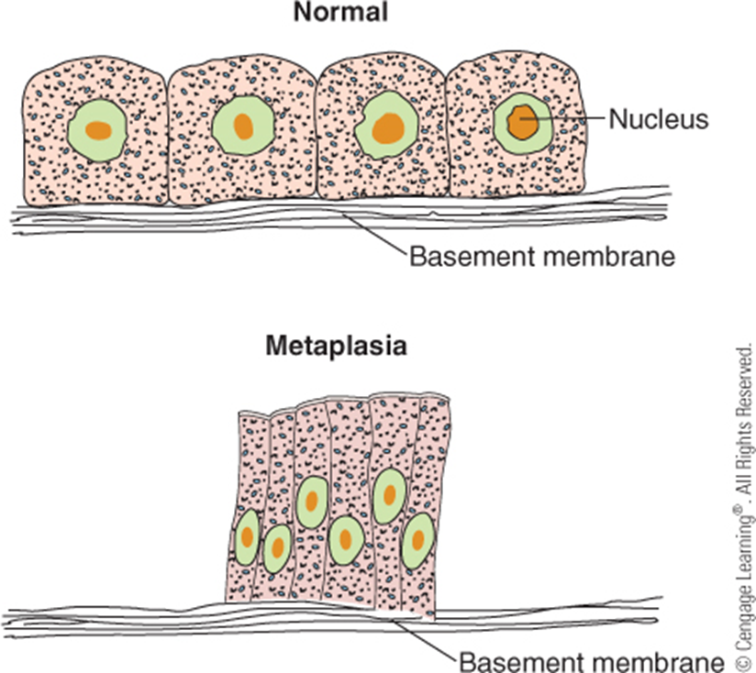
Metaplasia
Meta=changed, plasia=growth.
Cellular adaptation where cell changes to different type of cell.
Ex: columnar epithelial cell in respiratory tree changing to stratified squamous epithelial cells, when exposed to cigarette smoke.

Slide 17
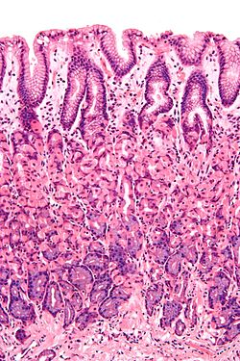
Metaplasia
Columnar
Epithelial cells
Stratified squamous epithelial cells.
Found in the stomach, large intestine and large intestine. These cells produce mucus to protect themselves from high pH and enzymes in digestive tract.
Forms outermost layer of the skin, like the mouth and esophagus. Areas of constant abrasion.

Slide 18
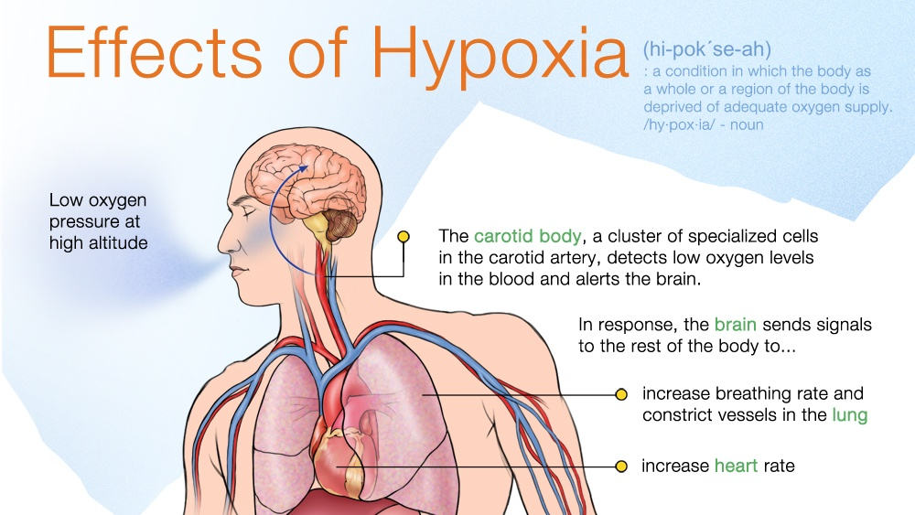
Cell and Tissue death
Cell death can be caused by trauma, hypoxia, anoxia, drugs, bacterial toxins, or viruses.
Hypoxia caused by decrease of blood is called ischemia (isch=hold back, emia=blood) if no oxygen gets to blood, it causes cell death (necrosis)
Dead cells or tissues are described as necrotic. Ischemic necrosis is cell death due to no oxygen in cells also called an infarct.
Most common infarct affect heart tissue, leading to myocardial infarction, or heart attack.

Slide 19
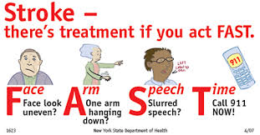
Organism death
Diseases that would not be lethal in our younger years, such as respiratory infections, can cause death in an older individual.
According to Center for Disease Control and Prevention (CDC), most common cause of death is heart disease, followed by cancer and strokes.
Strokes are the leading cause of serious long-term disability in the U.S.

Slide 20
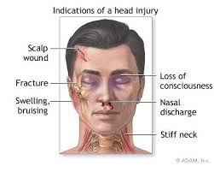
Organism death
Disability is called Morbidity (state of being diseased).
Severe injury's like brain injury can cause person to live a limited quality of life.
Prior to death, major organs like heart, brain, and lungs stop functioning. Loss of brain function in a person is considered brain dead.

Slide 21
Organism death
The criteria for determining brain death include:
Lack of response to stimuli
Loss of all reflexes
Absence of respiration or breathing effort.
Lack of brain activity as shown by electroencephalogram (EEG)
Defining death is controversial in the medical profession.

