Slide 1
Section 2: Complex Patterns of Inheritance
Complex inheritance of traits does not follow inheritance patterns described by Mendel.

Slide 2
Incomplete Dominance
In some organisms, heterozygous individuals will display the dominant phenotype.
With incomplete dominance, the heterozygous phenotype is an intermediate phenotype between the two homozygous phenotypes.
Complex Patterns of Inheritance
Copyright © McGraw-Hill Education

Slide 3
Codominance
In codominance, both the dominant and recessive allele are expressed in heterozygous individuals.
Complex Patterns of Inheritance
Copyright © McGraw-Hill Education

Slide 4
Codominance
Sickle-cell disease
Changes in hemoglobin cause red blood cells to become sickle shaped.
People who are heterozygous for the trait have both normal and sickle-shaped cells.
Sickle-cell disease and malaria
Those who are heterozygous for the sickle cell trait also have a higher resistance to malaria.
The death rate due to malaria is lower where sickle-cell trait is higher, meaning more people live to pass it on to their offspring.
Complex Patterns of Inheritance
Copyright © McGraw-Hill Education

Slide 5
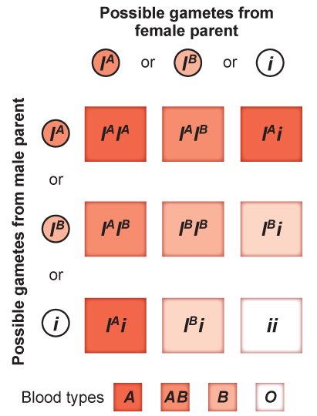
Multiple Alleles
Blood groups in humans
Some forms of inheritance are determined by more than two alleles, referred to as multiple alleles.
The ABO blood group has three forms of alleles, sometimes called AB markers.
Complex Patterns of Inheritance
Copyright © McGraw-Hill Education

Slide 6
Epistasis
Epistasis is an interaction where of one allele hiding the effects of another allele.
Seen in the coat color of Labrador retrievers
Dominant allele E determines whether the coat will have dark pigment.
Allele B determines how dark the coat will be.
When a dog has recessive ee alleles, the coat will be yellow, because the e allele masks the effects of the B allele.
Complex Patterns of Inheritance
Copyright © McGraw-Hill Education

Slide 7
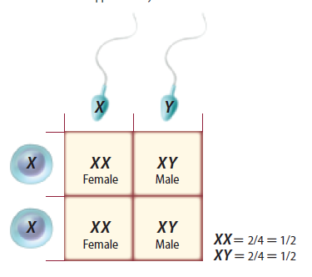
Sex Determination
One pair of chromosomes, sex chromosomes, determine an individual’s gender.
XX: female
XY: male
The other 22 pairs of chromosomes are called autosomes.
Complex Patterns of Inheritance
Copyright © McGraw-Hill Education

Slide 8
Dosage Compensation
The X chromosome carries a variety of genes that are necessary for the development of both females and males.
The Y chromosome mainly has genes that relate to the development of male characteristics.
In female, one X chromosome is inactivated in each cell.
Called dosage compensation or x-inactivation
Which X stops working in each cell is random.
Complex Patterns of Inheritance
Copyright © McGraw-Hill Education

Slide 9
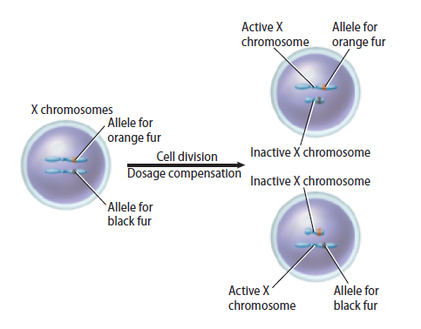
Dosage Compensation
Chromosome inactivation
Complex Patterns of Inheritance
Copyright © McGraw-Hill Education

Slide 10
Sex-Linked Traits
Traits controlled by genes located on the X chromosome are sex-linked traits.
Because males have only one copy of the X chromosome, they are more affected by recessive X-linked traits
Complex Patterns of Inheritance
Copyright © McGraw-Hill Education

Slide 11
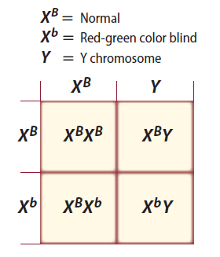
Sex-Linked Traits
Red-green color blindness
Recessive, X-linked trait
Mothers are carriers.
Complex Patterns of Inheritance
Copyright © McGraw-Hill Education

Slide 12
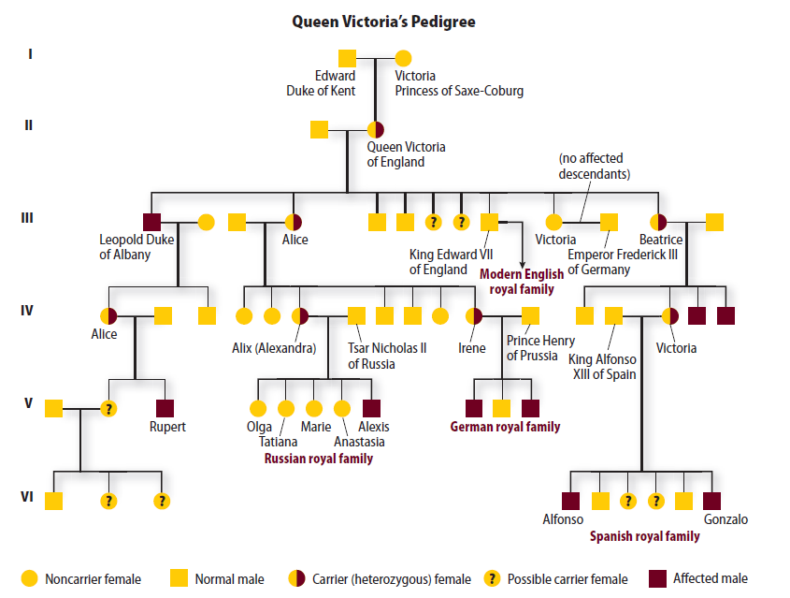
Sex-Linked Traits
Hemophilia
Recessive, X-linked trait that causes delayed clotting of blood
Complex Patterns of Inheritance
Copyright © McGraw-Hill Education

Slide 13
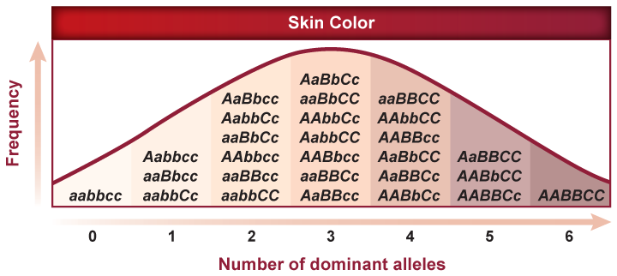
Polygenic Traits
Polygenic traits arise from the interaction of multiple pairs of genes.
Include such traits as skin color, height, and eye color
Complex Patterns of Inheritance
Copyright © McGraw-Hill Education

Slide 14
Environmental Influences
Sunlight and water
Without enough sunlight, most plants will not produce flowers.
Insufficient water causes plants to drop their leaves.
Temperature
Most organisms experience phenotypic changes with extreme heat.
Complex Patterns of Inheritance
Copyright © McGraw-Hill Education

