Slide 1

Section 1: Basic Patterns of Human Inheritance
The inheritance of a trait over several generations can be shown in a pedigree.

Slide 2
Essential Questions
How can genetic patterns be analyzed to determine dominant or recessive inheritance patterns?
What are examples of dominant and recessive disorders?
How can human pedigrees be constructed from genetic information?
Basic Patterns of Human Inheritance
Copyright © McGraw-Hill Education

Slide 3
Recessive Genetic Disorders
A recessive trait is expressed when the individual is homozygous recessive for the trait. (bb)
Those with at least one dominant allele (heterozygous) will not express the recessive disorder. (Bb)
An individuals who is heterozygous for a recessive disorder is called a carrier.
Ex: Brown Hair is dominant: Upper case letter: B
Blonde hair is recessive: Lower case letter: b
Basic Patterns of Human Inheritance
Copyright © McGraw-Hill Education

Slide 4
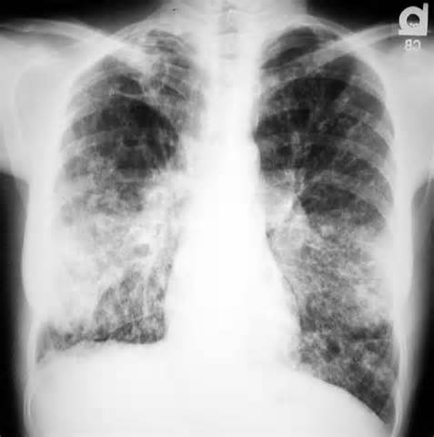
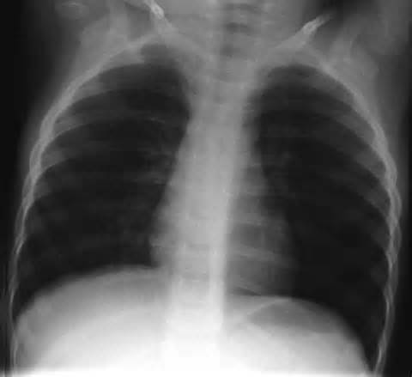
Recessive Genetic Disorders
Cystic fibrosis
A disorder that affects the mucus-producing glands, digestive enzymes, and sweat glands.
Chloride ions are not absorbed into the cells of a person with cystic fibrosis but are excreted in the sweat.
Cystic fibrosis causes mucus excretion that clogs ducts in the pancreas, interrupts digestion, blocks respiratory pathways in the lungs.
Basic Patterns of Human Inheritance
Copyright © McGraw-Hill Education

Slide 5
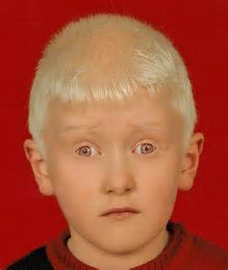
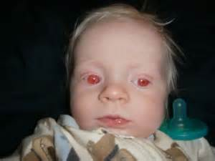
Recessive Genetic Disorders
Albinism
Albinism is caused by altered genes, resulting in the absence of the skin pigment melanin in hair and eyes.
Individuals with albinism have very pale skin, white hair, and pink irises.
Basic Patterns of Human Inheritance
Copyright © McGraw-Hill Education

Slide 6
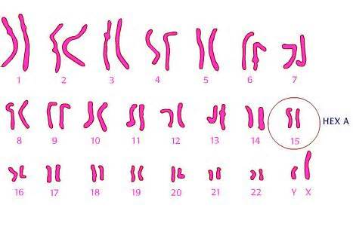

Recessive Genetic Disorders
Tay-Sachs disease
Caused by the absence of the enzymes responsible for breaking down fatty acids called gangliosides
Gangliosides accumulate in the brain, inflating brain nerve cells and causing mental deterioration.
Basic Patterns of Human Inheritance
Copyright © McGraw-Hill Education

Slide 7
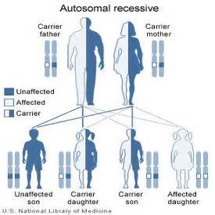
Recessive Genetic Disorders
Galactosemia
Recessive genetic disorder characterized by the inability of the body to digest galactose.
Inability to digest milk products
Basic Patterns of Human Inheritance
Copyright © McGraw-Hill Education

Slide 8
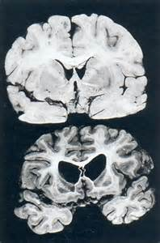
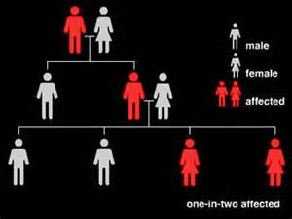
Dominant Genetic Disorders
Huntington’s disease
Affects the nervous system, causing gradual loss of brain function
Occurs in 1 out of every 10,000 people in the US
Achondroplasia
Basic Patterns of Human Inheritance
Copyright © McGraw-Hill Education

Slide 9
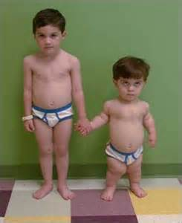
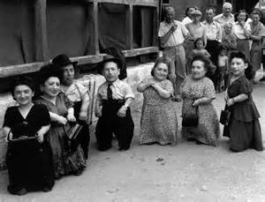
Achondroplasia
Causes small body size and limbs that are comparatively short
Caused by an abnormal gene that affects bone growth
Better known as little people disease.

Slide 10
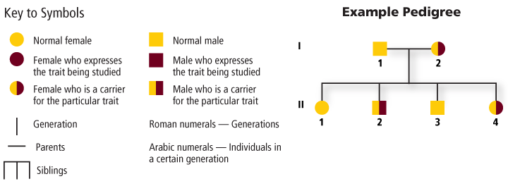
Pedigrees
A pedigree is a diagram that traces the inheritance of a particular trait through several generations.
Basic Patterns of Human Inheritance
Copyright © McGraw-Hill Education

Slide 11
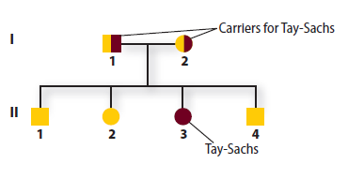
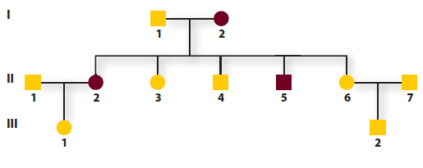
Analyzing Pedigrees
Pedigrees can be used to examine both recessive and dominant genetic disorders.
Information about an individual’s genotype can be inferred from the phenotype of his/her parents and offspring.
Recessive disorder
Dominant disorder
Basic Patterns of Human Inheritance
Copyright © McGraw-Hill Education

Slide 12
Analyzing Pedigrees
Inferring Genotypes
Knowing physical traits can determine what genes an individual is most likely to have.
Predicting Disorders
Record keeping helps scientists use pedigree analysis to study inheritance patterns, determine phenotypes, and ascertain genotypes.
Basic Patterns of Human Inheritance
Copyright © McGraw-Hill Education

