Slide 1
Autoimmune disorders
Hypersensitivities win which the body fails to recognize its own/self antigens. An individuals body cells have specific antigen on the cells surfaces.
Failure of the body to recognize the self antigen, leads to the body attacking and destroying its own tissues.
Cause for autoimmune disease is currently unknown and studied.
Some autoimmune disorders include Rheumatoid arthritis, Rheumatic fever, Myasthenia Gravis, Type 1 Diabetes, Lupus erythematosus, and scleroderma.

Slide 2
Rheumatic Fever
Description: Rheumatic Fever is an inflammatory disease, that can affect the heart, joints and skin.
Etiology: Occurs following a group of streptococcal infection, usually strep throat. In some individuals, the proteins in their hearts and other connective tissues are similar to the protein in strep bacteria. Exposure to strep bacteria causes the immune system to make antibodies to fight the bacteria.
These antibodies also attack the tissues of the heart and joints because they cannot distinguish the difference in the proteins. Rheumatic fever is characterized by myocarditis. (myo=muscle, cardi=heart, itis= inflammation)

Slide 3
Rheumatic fever
Symptoms: Rheumatic fever usually occurs 1 to 4 weeks after a streptococcal infection. Children and adolescents are most commonly affected. Onset of the disease can be sudden or gradual and includes symptoms of fever , malaise, and joint pain.
The first occurrence of rheumatic fever might be mild and resolve without any permanent damage. Further episodes are usually more severe and might lead to permanent scarring and deformity of the heart valves. Deformity of the mitral and aortic valve can eventually lead to heart failure.

Slide 4
Rheumatic fever
Diagnosis: There is no definitive test for diagnosing rheumatic fever. Blood testing for anti-streptolysin O/and or anti-DNAse B antibody along with electrocardiogram to determine heart muscle damage, that is part of the diagnostic workup, as well as a positive culture for Streptococcus bacteria being a indicative of the diagnosis.
Treatment: Culturing strep infections and prolonged treatment (at least 10 days) with antibiotics is most effective. Prophylactic antibiotics can be given to susceptible individuals. Surgical replacement of the heart valves might be necessary for individuals with severe valve deformity.

Slide 5
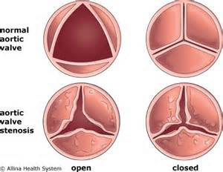
Rheumatic fever
Prevention: Prompt and accurate diagnosis and treatment of group A streptococcal infections are the best preventative measures against rheumatic fever.

Slide 6
Rheumatic Fever
https://www.youtube.com/watch?v=NSJwthP7c9s
https://www.youtube.com/watch?v=PNMP-GLWsoU
Very rare, only occurs in severe cases.
(Erythema Marginatum)
More common symptoms include Sydenham's Chorea (rapid irregular jerking).
(Arthritis)

Slide 7
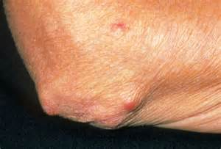
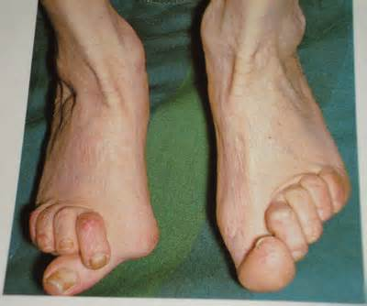
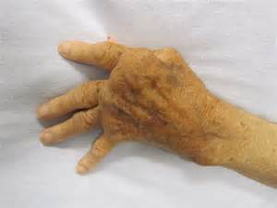
Rheumatoid Arthritis
Description: Autoimmune disease that causes chronic inflammation of connective tissue. Joint tissue is permanently affected, but any connective tissue of the body might be involved.
Etiology: Associated with the production of abnormal antibodies that attacks or attaches to the bodies own cells and tissues. Presence of the antibody called Rheumatoid factor (RF) in the affected individuals blood is indicative of the disease.

Slide 8
Rheumatoid Arthritis
Symptoms: Commonly, metacarpal-phalangeal joints of the hands are initially affected with rheumatoid arthritis. This leads to a classic sign of rheumatoid arthritis called ulnar deviation of the fingers. As the disease progresses, involvement of other synovial (moveable) joints can occur. Joints affected can include those of the fingers, wrists, elbows, feet, ankles, and knees.
Symptoms can vary in severity from mild to severe and might go through periods of remission exacerbation. Rheumatoid arthritis begins with inflammation of synovial lining of the joint, leading to pain stiffness and joint deformity. Eventually the cartilage of the joint is destroyed and replaced with a granulation tissue called pannus. Progression of the disease, the entire joint surface is destroyed and replaced with fibrous tissue, making it less movable. Function/loss of joint function is called Ankylosis.

Slide 9
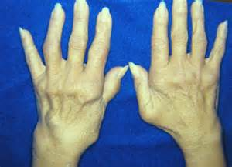
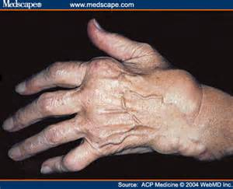
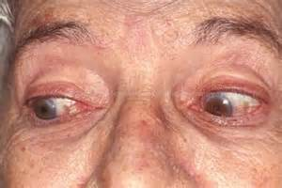
Rheumatoid Arthritis(RA)
Symptoms Cont.: In addition to joint changes, the individual might also have lesions (tissue abnormality) in the collagen of the lungs, blood vessel, heart, and eyes, leading to Pleuritis (pleura=lining of the lungs, itis= inflammation), anemia, valvulitis (valvul=valve, itis = inflammation), and glaucoma (optic nerve damage). Rheumatoid nodules characteristically appear in the subcutaneous tissue(hypodermis) around the fingers, elbows and toes. Individuals with RA will often appear frail and chronically ill. Anemia and infections are common secondary problems.

Slide 10
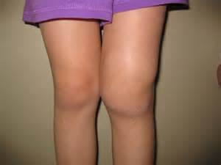
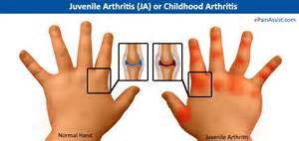
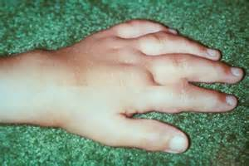
Rheumatoid arthritis
Symptoms Cont.: This chronic disease affects both sexes and all ages, but onset is most common in women between age 20-40. Women are affected three times more than men because of their ability to have children, smaller body size, and smaller muscles. Rheumatoid arthritis can affect children from infants to 16 year old children, can be very severe, and is called juvenile rheumatoid arthritis or Still’s Disease.

Slide 11
Rheumatoid arthritis
Diagnosis: Based on physical examination, characteristic symptoms, and blood tests including positive rheumatoid factor, anti- CCP antibodies (anti-cyclic citrullinated peptide antibody), and elevated erythrocyte sedimentation rate (ESR) Inflammation test.
Treatment: Rheumatoid arthritis cannot be cured. Treatment includes use of anti-inflammatory medications and analgesics. Disease modifying anti- rheumatic drugs (DMARD’s) and biological drugs act on the immune system and are showing favorable progress in slowing the progression of rheumatoid arthritis. DMRD’s include Imutrex®, Planquenil®, and Zulfinide®. Biologic medications are the newest and include Humera®, Enbrel®, and Actemra®.

Slide 12
Rheumatoid Arthritis
Treatment Cont. : Other medications used in the treatment of rheumatoid arthritis include, Minocin®, Neoral®, and Imuran®. Corticosteroids can be prescribed short term during periods of exacerbation. Exercise and rest routine is essential to maintain joint function. Surgical joint replacement might also be beneficial.
Prevention: There is no known way to prevent Rheumatoid Arthritis.
Videos to look over: https://www.youtube.com/watch?v=BxquxWrGSiw , https://www.youtube.com/watch?v=Yc-9dfem3lM, https://www.youtube.com/watch?v=_kOuma9Ad-E

Slide 13
Myasthenia Gravis
Description: Characterized by severe muscle fatigue.
Etiology: This disease affects the transmission of nerve signals to muscle at the neuromuscular junction, but there is no muscle or verve tissue disease. Nerve impulses are carried to the muscle by the neurotransmitter acetylcholine. Impulses are sent by the nerve but are not properly received by the muscle. This error in transmission is due to antibodies attacking the muscle receptors, which blocks the transmission of acetylcholine. The weak transmission leads to weak muscle contractions and fatigue.
This is the least common autoimmune disorder, with an estimated 20 cases per 100,000 people. Myasthenia can be categorized as an autoimmune, musculoskeletal, or neurologic disease because it has characteristics of problems in each of the systems.

Slide 14
Myasthenia Gravis
Symptoms: Onset of disease is usually slow, and diagnosis might be difficult because it can affect any muscle in his body. Commonly, facial muscles are the ones initially affected, leading to diplopia (double vision), ptosis (drooping eyelids), dysphagia (difficulty swallowing), dysphonia (difficulty talking), and difficulty with facial expression, which can leave the individual with an expressionless facial appearance. Fatigue of all voluntary muscles and include difficulty rising from a sitting position, lifting the arms, standing, and walking.
Degree of weakness varies with the time of day and activities. Generally these individuals feel stronger in the morning due to a buildup of acetylcholine and become weaker as the day progresses because acetylcholine storage diminishes.

Slide 15
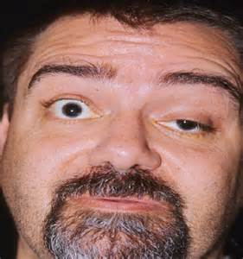
Myasthenia Gravis
Ptosis

Slide 16
Myasthenia Gravis
Diagnosis: Myasthenia is difficult to diagnose because symptoms can be hard to distinguish from other neurologic disorders. A thorough physical exam might reveal fatigue of the muscles: blood testing for antibodies against the acetylcholine receptors also suggest myasthenia. Other tests include electromyography (EMG) to test muscle fatigue and respiratory spirometry to asses respiratory function.
Treatment: Cholinergic medications that do not allow the normal breakdown of the neurotransmitter acetylcholine will allow a buildup of the neurotransmitter, improving neuromuscular transmission. Plasma change is needed to remove the circulating antibodies, providing some improvement of the condition.

Slide 17
Myasthenia Gravis
Treatment cont.: Includes cholinergic medications that do not allow the normal breakdown of the neurotransmitter acetylcholine, improving neuromuscular transmission. Advances in treatment have reduced mortality rate to 3-4%. Death usually occurs due to muscle weakness, leading to respiratory failure.
Prevention: It cannot be prevented, but avoiding stress, extremes in temperature, fever, illness, and overexertion can help prevent exacerbations.
https://www.youtube.com/watch?v=53DsG_EkV4g

Slide 18
Lupus Erythematosus
Description: There are two types of lupus erythematosus : cutaneous or (discoid) lupus erythematosus and systemic (diffuse).
Cutaneous or discoid lupus erythematosus (DLE) is limited to the skin or cutaneous involvement. DLE can be thought as a type of systemic lupus because cause, testing, and treatment are similar for cutaneous involvement. This is the less serious form of lupus.
Systemic lupus erythematosus (SLE) affects multiple systems. It affects 1 in 2,400 people, primarily affecting women more than men because of the effects of estrogen to the body. Onset is usually between ages 30 and 40 but can appear at any age.

Slide 19
Lupus Erythematosus
Etiology: SLE is an autoimmune disorder in which B lymphocytes produce autoantibodies that attack body cells. Individuals with SLE have a high number of antinuclear antibodies(ANA’s)
These antibodies attack the body’s own cell nuclei, destroying the RNA and DNA of the cell.
Detection of the ANA by microscopic immunofluorescence supports the diagnosis of SLE.

Slide 20
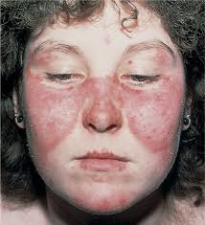
Lupus Erythematosus
Symptoms: SLE often affects the skin and a number of other organs or symptoms. A common sign is the presence of a red facial butterfly shaped rash across the bridge if the nose and cheeks.
Symptomatic individuals often complain of fever, joint pain, weight loss, and facial rash. Involvement of joint, kidneys, and muscles can lead to complaints of arthritis, glomerulonephritis (inflammation of the filtering unit of the kidney) and atrophy.
Heart valve deformities and abnormal blood composition might also be a symptom.

Slide 21
Lupus Erythematosus
Diagnosis: Can be difficult, but test include testing electrolytes, renal function, liver enzymes, complete blood count, and ANA are helpful. Most DEFINITIVE test is a positive result on an ANA test.
Treatment: Because the disease goes through periods of remission and exacerbation. Complete remission is rare, therefore treatment is symptomatic. Nonsteroidal anti-inflammatory, antipyretic (fever reducer), and analgesic medications, can be used to treat symptoms.
Life threatening exacerbations are often treated with corticosteroids. Prognosis depends on which organ is affected and severity of the infection.
Treatment: SLE cannot be prevented or cured.

Slide 22
Scleroderma
Description: Scleroderma (Sclero= hardening, Derma=skin) is a chronic autoimmune disorder characterized by the hardening of the skin, shrinking of connective tissues that include the skin. This disease might exhibit periods of remission and exacerbation.
This disease typically has a slow progression and allows the individual a reasonably long life. If the disorder progresses rapidly, it can affect vital organs and early death can occur, usually related to kidney failure.

Slide 23
Scleroderma
Etiology: This autoimmune reaction begins with the skin and connective tissues, attracting lymph cells that are stimulated to produce collagen, leading to the disorder.
Milder forms of the disease commonly affect women 30-50 years of age and include those limited to the skin, face and extremities.
The more severe form is called systemic or diffuse, usually affects men and older persons, also affecting internal organs including the heart, lungs, and kidneys. The tissues become hardened, thickened, and often limit in function.

Slide 24
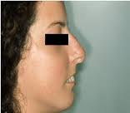
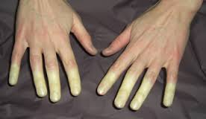
Scleroderma
Symptoms: People with scleroderma will have thick, leather like, shiny, taut (stretched) skin and joint contractures.
First symptom is typically Raynaud's phenomenon, an episodic vasoconstriction affecting the hands.
Mouth area becomes wrinkled with a tight, purse lipped appearance, leading to difficulty eating.

Slide 25
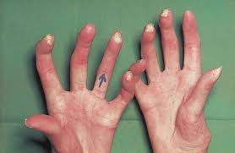
Scleroderma
Diagnosis: Can be difficult because is mimics other disorders such as bursitis (inflammation of the fluid filled sacs of the joint) and arthritis. Physical symptoms indicative of scleroderma include:
Tight skin around the hands skin and mouth.
Change in the capillaries at the base of the fingernails.
Calcium deposits under the skin.
These physical symptoms, coupled with clinical examinations, blood testing for presence of anti-centromere antibodies, and tissue biopsy showing increased collagen levels often yields a positive diagnosis,

Slide 26
Scleroderma
Treatment: Is symptomatic with anti-inflammatory medications, immunosuppressants, and antibiotics might be beneficial.
Muscle stretching and strengthening exercises might also be beneficial to maintain muscle strength and joint mobility.
Prevention: No one really knows what causes scleroderma , so at the time, there are no preventative methods identified.

Slide 27
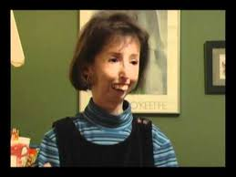
Scleroderma
Mild Scleroderma
Severe Scleroderma

