Slide 1
Section 1: How Organisms Obtain Energy
All living organisms use energy to carry out all biological processes.
K What I Know | W What I Want to Find Out | L What I Learned

Slide 2
Essential Questions
What are the two laws of thermodynamics?
What is the difference between an anabolic pathway and a catabolic pathway?
How does ATP work in a cell?
How Organisms Obtain Energy
Copyright © McGraw-Hill Education

Slide 3
Transformation of Energy
Cellular processes require energy – the ability to do work.
Thermodynamics is the study of the flow and transformation of energy in the universe.
How Organisms Obtain Energy
Copyright © McGraw-Hill Education

Slide 4
Transformation of Energy
Laws of thermodynamics
First law—the law of conservation of energy: energy can be converted from one form to another, but it cannot be created nor destroyed.
Second law: energy cannot be converted without the loss of usable energy, that is, entropy—disorder or unusable energy--increases.
How Organisms Obtain Energy
Copyright © McGraw-Hill Education

Slide 5
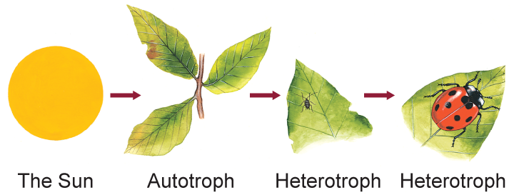
Transformation of Energy
Autotrophs and Heterotrophs
Directly or indirectly, nearly all the energy for life comes from the Sun.
Autotrophs make their own food, either with energy from the sun or from inorganic substances.
Heterotrophs ingest other organisms to obtain energy.
How Organisms Obtain Energy
Copyright © McGraw-Hill Education

Slide 6
Metabolism
All of the chemical reactions in a cell are referred to as the cell’s metabolism.
A series of chemical reactions in which the product of one is the substrate for the next is called a metabolic pathway.
Catabolic pathways release energy by breaking down larger molecules.
Anabolic pathways use energy to build larger molecules.
How Organisms Obtain Energy
Copyright © McGraw-Hill Education

Slide 7
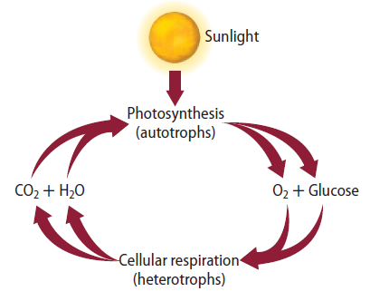
Metabolism
Photosynthesis – anabolic pathway in which light energy from the Sun is converted to chemical energy for use by the cell
Cellular respiration – catabolic pathway in which organic molecules are broken down to release energy for use by the cell
How Organisms Obtain Energy
Copyright © McGraw-Hill Education

Slide 8
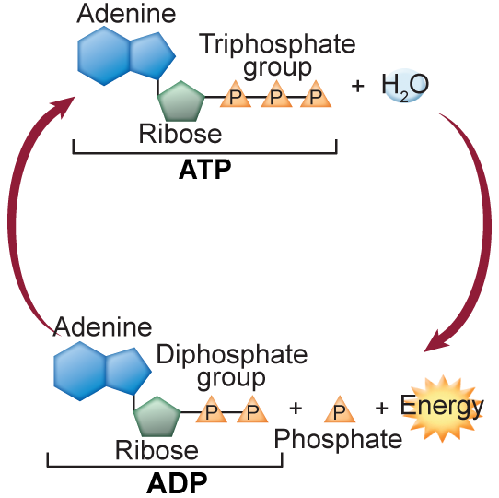
ATP: The Unit of Cellular Energy
In living things, chemical energy is stored in biological molecules.
Adenosine triphosphate (ATP) is the most important biological molecule that provides chemical energy.
How Organisms Obtain Energy
Copyright © McGraw-Hill Education

Slide 9
ATP: The Unit of Cellular Energy
ATP structure
Most abundant energy-carrier in cells
Nucleotide made of an adenine base, a ribose sugar, and three phosphate groups
How Organisms Obtain Energy
Copyright © McGraw-Hill Education

Slide 10
ATP: The Unit of Cellular Energy
ATP function
Releases energy when the bond between the second and third phosphate groups is broken.
Transforms into a molecule called adenosine diphosphate (ADP) and a free phosphate group.
How Organisms Obtain Energy
Copyright © McGraw-Hill Education

Slide 11
Review
Essential Questions
What are the two laws of thermodynamics?
What is the difference between an anabolic pathway and a catabolic pathway?
How does ATP work in a cell?
Vocabulary
energy
thermodynamics
metabolism
photosynthesis
cellular respiration
adenosine triphosphate (ATP)
How Organisms Obtain Energy
Copyright © McGraw-Hill Education

