Slide 1
Chapter 9
Cellular Reproduction
Section 1: Cellular Growth

Slide 2
Essential Questions
Why are cells relatively small?
What are the primary stages of the cell cycle?
What are the stages of interphase?
Cellular Growth
Copyright © McGraw-Hill Education

Slide 3
Vocabulary
cell cycle
interphase
mitosis
cytokinesis
chromosome
chromatin
Cellular Growth
Copyright © McGraw-Hill Education

Slide 4
The Cell Cycle
Once a cell reaches its size limit it must either stop growing or divide.
Cells reproduce by a cycle of growing and dividing called the cell cycle.
Each time a cell goes through one complete cycle, it becomes two cells.
Three main stages of the cell cycle:
Interphase: stage during which the cells grows, carries out cellular functions, and replicates its DNA.
Mitosis: the cell’s nucleus and nuclear material divide; has four sub stages.
Cytokinesis: cell’s cytoplasm divides, creating two new cells.
Cellular Growth
Copyright © McGraw-Hill Education

Slide 5
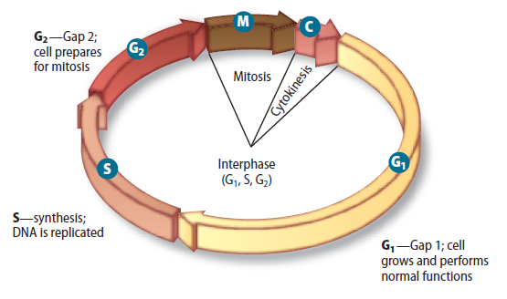
The stages of interphase
Interphase has three sub stages: G₁, S, and G₂ .
During G1, the cell is growing and carrying out normal cellular functions.
Cellular Growth
Copyright © McGraw-Hill Education

Slide 6
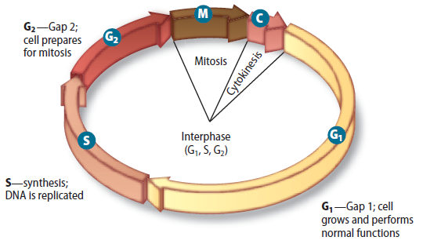
The stages of interphase
During S, the cell copies its DNA in preparation for cell division.
Chromosomes are the structures that contain the genetic material.
Chromatin is the relaxed form of DNA in the cell’s nucleus.
Cellular Growth
Copyright © McGraw-Hill Education

Slide 7
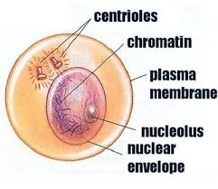
The stages of interphase
The G2 stage follows the S stage and is the period when the cell prepares for the division of its nucleus.
Cellular Growth
Copyright © McGraw-Hill Education

Slide 8
Mitosis and cytokinesis
During mitosis, a cell’s nuclear material divides and separates into opposite sides of the cell.
During cytokinesis, the cell divides into two daughter cells.
How the Cell Cycle Works
Cellular Growth
Copyright © McGraw-Hill Education

Slide 9
Prokaryotic cell division
Eukaryotic cells divide via the cell cycle.
Prokaryotic cells divide via binary fission.
Cellular Growth
Copyright © McGraw-Hill Education

Slide 10
Chapter 9
Cellular Reproduction
Section 2: Mitosis and Cytokinesis

Slide 11
Essential Questions
What are the events of each stage of mitosis?
What is the process of cytokinesis?
Mitosis and Cytokinesis
Copyright © McGraw-Hill Education

Slide 12
Vocabulary
prophase
sister chromatid
centromere
spindle apparatus
metaphase
anaphase
telophase
Mitosis and Cytokinesis
Copyright © McGraw-Hill Education

Slide 13
Mitosis
During mitosis cell’s replicated genetic material separates and the cell prepares to split into two cells.
The key activity of mitosis is the accurate separation of the cell’s replicated DNA.
Mitosis:
Increases the number of cells in a multicellular organism as it grows
Replaces damaged cells
Mitosis and Cytokinesis
Copyright © McGraw-Hill Education

Slide 14
The Stages of Mitosis
Prophase
Prophase is the first and longest stage of mitosis.
Cell’s chromatin tightens/condenses into chromosomes.
Sister chromatids are structures that contain identical copies of DNA.
The sister chromatids are attached at the centromere.
Mitosis and Cytokinesis
Copyright © McGraw-Hill Education

Slide 15
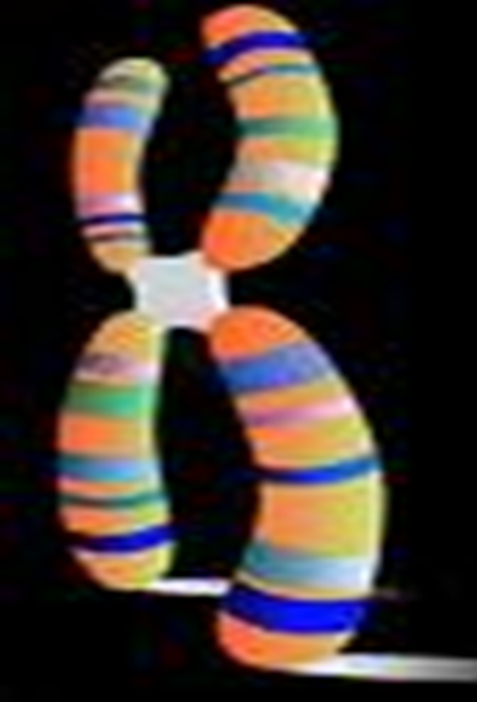

Slide 16
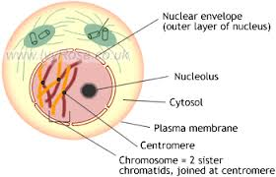
The Stages of Mitosis
Prophase
As prophase continues, spindle fibers, centrioles, and aster fibers form a spindle apparatus or Spindle Fibers.
The spindle apparatus attaches to each of the sister chromatids before cell division.
Mitosis and Cytokinesis
Copyright © McGraw-Hill Education

Slide 18
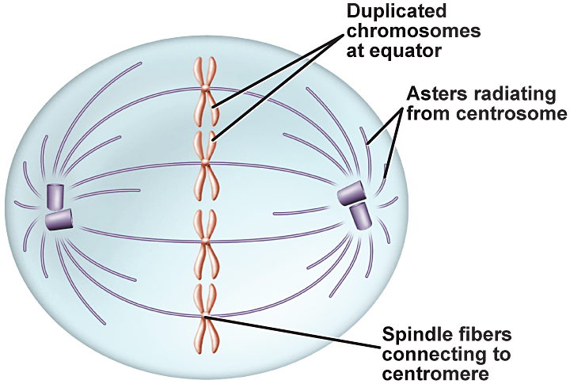
The Stages of Mitosis
Metaphase
The second stage of mitosis is metaphase – the shortest phase.
Sister chromatids are pulled along the spindle apparatus toward the center of the cell.
They line up in the middle of the cell.
Mitosis and Cytokinesis
Copyright © McGraw-Hill Education

Slide 20
The Stages of Mitosis
Anaphase
During anaphase, the chromatids pull apart.
The microtubules of the spindle apparatus begin to shorten.
The sister chromatids separate.
The chromosomes move toward the poles of the cell.
Mitosis and Cytokinesis
Copyright © McGraw-Hill Education

Slide 22
The Stages of Mitosis
Telophase
Telophase is when the chromosomes arrive at the poles and begin to decondense.
Two new nuclear membranes begin to form and the nucleoli reappear.
The spindle apparatus disassembles.
Mitosis and Cytokinesis
Copyright © McGraw-Hill Education

Slide 24
Cytokinesis
After the two daughter nuclei have formed, cells undergo cytokinesis.
In animal cells, microfilaments constrict/pinch off to form two cells.
In plant cells, instead of pinching in half, a new structure called the cell plate forms between the two daughter nuclei.
Mitosis and Cytokinesis
Copyright © McGraw-Hill Education

Slide 25
Mitosis and Cytokinesis

Slide 26
Chapter 9
Cellular Reproduction
Section 3: Cell Cycle Regulation

Slide 27
Essential Questions
What is the role of cyclin proteins in controlling the cell cycle?
How does cancer relate to the cell cycle?
What is the role of apoptosis?
What are the two types of stem cells and what are their potential uses?
Cell Cycle Regulation
Copyright © McGraw-Hill Education

Slide 28
Vocabulary
cyclin
cyclin-dependent kinase
cancer
carcinogen
apoptosis
stem cell
Cell Cycle Regulation
Copyright © McGraw-Hill Education

Slide 29
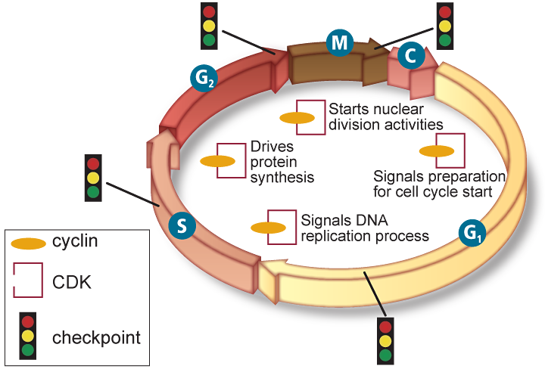
Normal Cell Cycle
The role of cyclins
The timing and rate of cell division are important, and controlled by proteins and enzymes
The cell cycle in eukaryotic cells is driven by a combination of two substances.
Cyclins are proteins that bind to enzymes called cyclin-dependent kinases (CDKs).
Different cyclin/CDK combinations control different activities during different stages of the cell cycle.
Cell Cycle Regulation
Copyright © McGraw-Hill Education

Slide 30
Normal Cell Cycle
Quality control checkpoints
The cell cycle has built-in checkpoints that monitor the cycle and can stop it if something goes wrong.
There are checkpoints after each stage of interphase to protect against duplicating DNA damage.
Cell Cycle Regulation
Copyright © McGraw-Hill Education

Slide 31
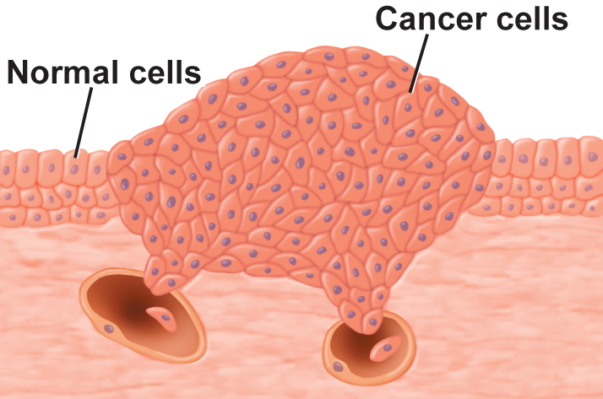
Abnormal Cell Cycle: Cancer
Cancer is the uncontrolled growth and division of cells.
Cancer results when cells stop responding to the controls of the cell cycle.
Cancer cells can kill an organism by crowding out normal cells, resulting in the loss of tissue function.
Cell Cycle Regulation
Copyright © McGraw-Hill Education

Slide 32
Abnormal Cell Cycle: Cancer
Causes of cancer
Mutations or changes in segments of DNA cause the cell growth and division of cancer cells.
Various environmental factors can affect the occurrence of cancer cells.
Substances that are know to cause cancer are called carcinogens.
Cell Cycle Regulation
Copyright © McGraw-Hill Education

Slide 33
Apoptosis
Apoptosis is the process of programmed cell death.
Cells going through apoptosis shrink and shrivel.
Apoptosis occurs during development, in cells that are damaged, and in cells that may lead to cancerous growths.
Cell Cycle Regulation
Copyright © McGraw-Hill Education

Slide 34
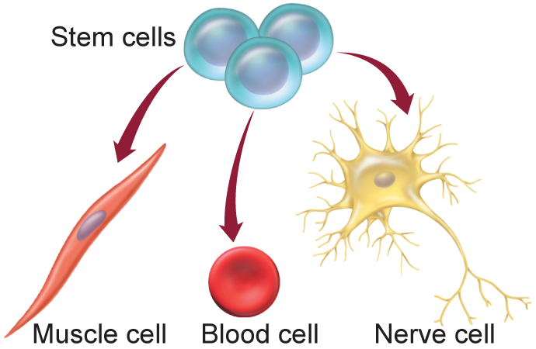
Stem Cells
Multicellular organisms have specialized cells.
The precursor cells that can be directed to become specialized cells are stem cells.
Cell Cycle Regulation
Copyright © McGraw-Hill Education

Slide 35
Stem Cells
Embryonic stem cells
After fertilization, the initial mass of cells (100-150 cells) remain undifferentiated – these comprise embryonic stem cells.
As development continues, cells receive signals that initiate their differentiation into specialized cells.
Cell Cycle Regulation
Copyright © McGraw-Hill Education

Slide 36
Stem Cells
Adult stem cells
Found in various tissues in the body
Might be used to maintain and repair tissue.
More developed/specialized than embryonic stem cells, but might be able to differentiate into different kinds of cells.
Cell Cycle Regulation
Copyright © McGraw-Hill Education

