Slide 1
Cellular Transport
7-4

Slide 2
Essential Questions
What are the processes of diffusion, facilitated diffusion, and active transport?
What is the effect of a hypotonic, hypertonic, or isotonic solution on a cell?
How do large particles enter and exit cells?

Slide 3
Vocabulary
diffusion
dynamic equilibrium
facilitated diffusion
osmosis
isotonic solution
hypotonic solution
hypertonic solution
active transport
endocytosis
exocytosis

Slide 4
Passive Transport
Movement of particles across the cell membrane without using energy
Three Modes of Passive Transport
Diffusion
Facilitated Diffusion
Osmosis

Slide 5
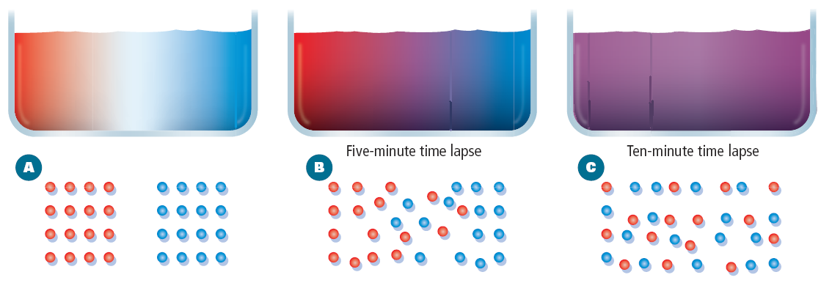
Diffusion
Movement of particles from an area of high concentration to an area of lower concentration.
Dynamic Equilibrium
Reached when diffusion of material into the cell equals diffusion of material out of the cell
Molecules continue to move, but the overall concentration remains the same.

Slide 6
Diffusion in a Cell

Slide 7
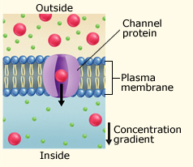
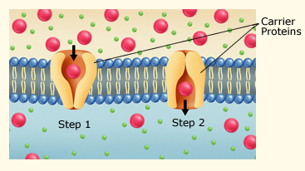
Facilitated Diffusion
Movement of materials across the plasma membrane using proteins
Channel Proteins Carrier Proteins

Slide 8
Osmosis
Diffusion of water across a selectively permeable membrane
Three Types of Solutions
Isotonic
Hypotonic
Hypertonic

Slide 9
Hypertonic - High [solute], outside cell
and low [solute] inside cell.
As a result water leaves the cell causing it to shrink

Slide 10
Hypotonic Low [Solute] outside cell
and High [Solute], inside cell.
This results in water entering the cell causing the cell to burst.

Slide 11
Isotonic : Concentration of solutes are equal on both sides of the membrane.
Osmosis

Slide 13
Active Transport
Movement of particles across the cell membrane using energy
Active Transport Using Carrier Proteins

Slide 15
Types of Active Transport Pumps
Na+/K+ ATPase pump
Moves three Na+ ions out of the cell and two K+ ions into the cell
How the Sodium Potassium Pump Works

Slide 16
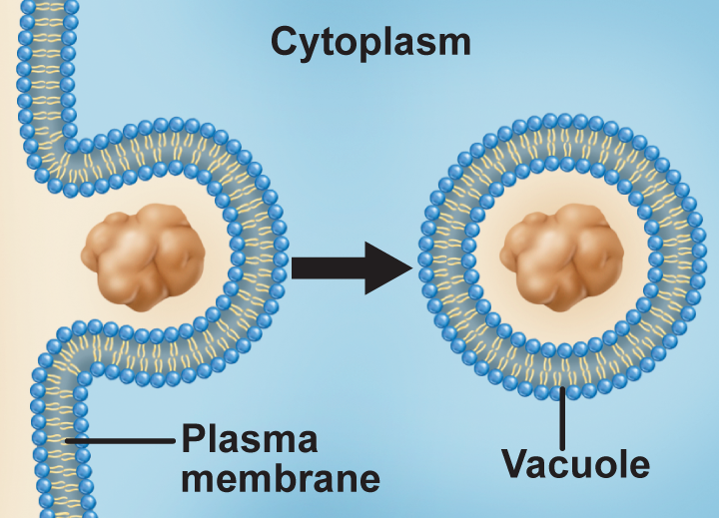
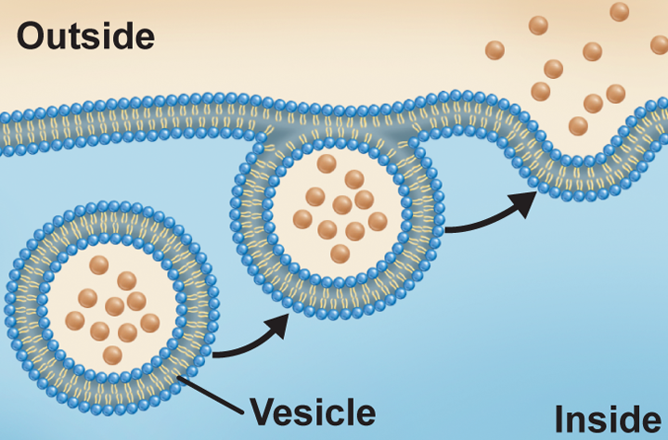
Endocytosis
Process by which the cell surrounds and takes particles into the cell
Exocytosis
Secretion of material out of the plasma membrane
Cellular Transport
Copyright © McGraw-Hill Education

Slide 17
Phagocytosis- “cell eating” extensions of cytoplasm surround a particle and package it within a vacuole.
Endocytosis and Exocytosis

