Slide 1
Chemical Reactions
6-2

Slide 2
Essential Questions
What are the parts of a chemical reaction?
How can energy changes be related to chemical reactions?
What is the importance of enzymes in living organisms?

Slide 3
Reactants and Products
A chemical reaction is the process by which atoms or groups of atoms in substances are reorganized into different substances.
Chemical bonds are broken or formed during a chemical reaction.
Clues that a chemical reaction has taken place:
production of heat or light
formation of a new gas, liquid, or solid
Substances can also undergo physical changes, which change the appearance but not the composition.

Slide 4
Vocabulary
chemical reaction
reactant
product
activation energy
catalyst
enzyme
substrate
active site

Slide 5
Chemical Equations
In written chemical equations, chemical formulas describe the substances in the reaction and arrows indicate the process of change.
Reactants are the starting substances, on the left side of the arrow.
Products are the substances formed during the reaction, on the right side of the arrow.
The arrow can be read as “yields” or “react to form” or “makes”

Slide 6
Balanced equations
In chemical reactions, matter cannot be created or destroyed.
All chemical equations must show this balance of mass.
The number of atoms of each elements on the reactant side must equal the number of atoms of the same element on the product side.
C₆H₁₂O₆ + 6O₂ → 6CO₂ + 6H₂O

Slide 7
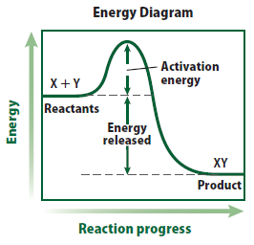
Energy of Reactions
Activation energy
The minimum amount of energy needed for reactants to form products is called activation energy.
Some reactions happen rarely due to the high activation energy required.

Slide 8
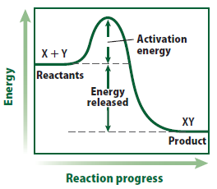
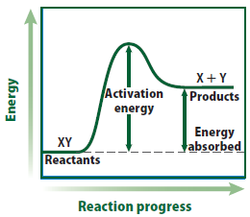
Type of reactions
Energy change in chemical reactions
Reactions that release energy in the form of heat are exothermic.
Reactions that absorb energy in the form of heat are endothermic.

Slide 9
Enzymes
All living things are driven by chemical reactions.
Additional substances are needed to reduce activation energy and reaction time in living organisms.
A catalyst is a substance that lowers the activation energy needed to start a chemical reaction.
Catalysts do not change the amount of product produced, nor are they used up during the reaction.

Slide 10
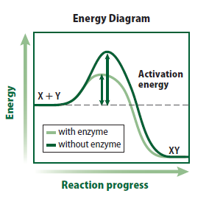
Enzymes AKA - Proteins
Special proteins called enzymes are the biological catalysts that speed up the rate of chemical reactions in biological processes.
Most enzymes are specific to one reaction, begin the word with what they catalyze and end with “ase”.
Ex: Enzyme – Lactase, Catalyzes the breakdown of Lactose
Lipase enzyme, Catalyzes the breakdown of lipids.

Slide 11
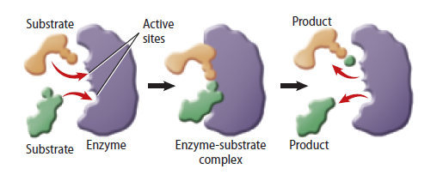
The reactants that bind to an enzyme are called substrates.
The specific location where a substrate binds on an enzyme is called the active site. Think of the enzyme as a lock and the substrate as a key. They must match, or they will NOT work!!
Factors such as pH (Acids “Acidic” and Bases “Alkaline”), temperature, and other substances affect enzyme activity.

Slide 12
How Enzymes Work
Bozeman Science Enzymes

