Slide 1
Chapter 1: The Nature of Science
Essential Questions
What are the characteristics of scientific inquiry?
What are the differences between science and pseudoscience?
What are the scientific methods scientists used in scientific inquiry?
The Nature of Science
Copyright © McGraw-Hill Education

Slide 2
What is science?
Science is the use of evidence to construct testable explanations and predictions of natural phenomena, as well as, the knowledge generated through this process.
A testable explanation of a situation or phenomena is called a hypothesis.
Science only answers questions that are testable by a process called scientific inquiry – the planned and deliberate investigation of the natural world.
.
The Nature of Science
Copyright © McGraw-Hill Education

Slide 3
Scientific Methods
Scientific inquiry begins with observation, a direct method of gathering information in an orderly way.
The process of combining what you know with what you have learned to draw logical conclusions is called inferring; the conclusions themselves are called inferences.
The methods scientists use to gather data and answer questions are referred to as scientific methods.
The Nature of Science
Copyright © McGraw-Hill Education

Slide 4
Forming a Hypothesis
Observations and inferences are used to form testable hypotheses
When a hypothesis is supported by data from multiple investigations, the hypothesis is usually considered valid and is accepted by the scientific community.
If the hypothesis is not supported by scientific investigations, the hypothesis is revised, and additional investigations are conducted .
Even when hypotheses are not supported more is learned, and scientific progress is made.
The Nature of Science
Copyright © McGraw-Hill Education

Slide 5
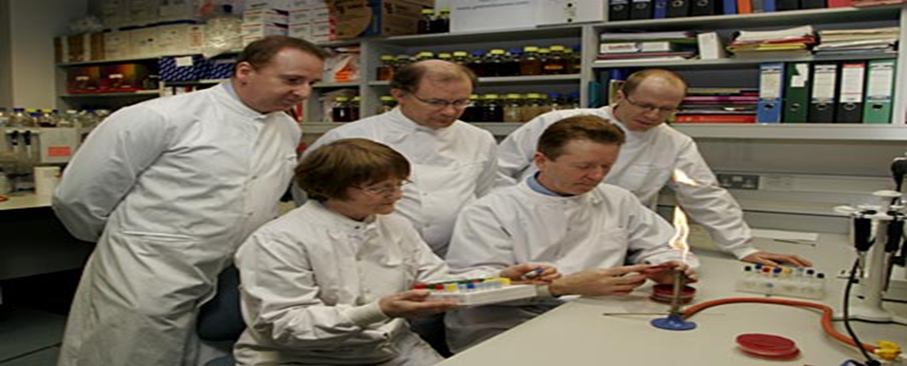
Data Collection
Controlled experiments
When a scientist conducts an experiment, they investigate a phenomenon in a controlled setting to test a hypothesis.
The control group in an experiment is the group used for comparison.
An experimental group is a group exposed to the factor being tested.
The Nature of Science
Copyright © McGraw-Hill Education

Slide 6
Data Collection
Experimental design
During a controlled experiment, only one factor can change at a time.
Independent variable—the tested factor that might affect the outcome of the experiment
Dependent variable—results from or depends on changes to the independent variable.
Constant (Control)—a factor that remains fixed during an experimental while the independent and dependent variables change.
The Nature of Science
Copyright © McGraw-Hill Education

Slide 7
Scientific Theories, Laws, and Hypotheses
Scientific theory
Scientific theory vs. hypothesis
A scientific theory is an explanation of a natural phenomenon supported by many observations and experiments over time.
Tested by multiple independent researchers
Scientific law
A scientific law describes relationships under certain conditions in nature.
A law does not explain why the relationship occurs
A hypothesis is not necessarily well established or generally accepted
A hypothesis can be incorporated into a theory after extensive testing
The Nature of Science
Copyright © McGraw-Hill Education

Slide 8
Essential Questions
What is biology?
What are possible benefits of studying biology?
What are the characteristics of living things?
Introduction to Biology
Copyright © McGraw-Hill Education

Slide 9
The Science of Life
“Biology” comes from the Greek bio, meaning life, and from logos, meaning study
Study the origins and history of life and once-living things
Study the structures of living things
Study how living things interact with one another
Study how living things function
Introduction to Biology
Copyright © McGraw-Hill Education

Slide 10
The Characteristics of Life
Made of one or more cells
Displays organization
Grows and develops
Reproduces
Responds to stimuli
Requires energy
Maintains homeostasis
Adaptations evolve over time
An organism is anything that has or once had all these characteristics
Introduction to Biology
Copyright © McGraw-Hill Education

Slide 11
The Characteristics of Life
Made of one or more cells
Cells are the basic unit of structure and function in all living things.
Living things can be unicellular (one cell) or multicellular (many cells).
Displays organization
Living things display organization, which means they are arranged in an orderly way.
Single cells: contains organized functional structures
Multicellular:
Specialized cells organized into tissues
Tissues are organized into organs
Organ systems work together to support an organism
Introduction to Biology
Copyright © McGraw-Hill Education

Slide 12
The Characteristics of Life
Grows and develops
Most organisms begin as a single cell.
The addition of mass to an organism, often in the form of new cells and structures, is called growth.
The process of natural changes over the lifetime of an organism is called development.
Reproduces
Reproduction = the production of offspring
Organisms that can breed with one another and produce fertile offspring are know as a species.
Reproduction is not essential for the survival of an individual, but it is essential for the continuation of the species.
Introduction to Biology
Copyright © McGraw-Hill Education

Slide 13
The Characteristics of Life
Responds to stimuli
Anything that is part of the internal or external environments and causes a reaction by the organism is called a stimulus.
The reaction to a stimulus is a response.
Requires energy
Living things get their energy from food.
Most plants and some unicellular organisms use light energy from the Sun to make their own food.
Organisms that cannot make their own food get energy by consuming other organisms.
Introduction to Biology
Copyright © McGraw-Hill Education

Slide 14
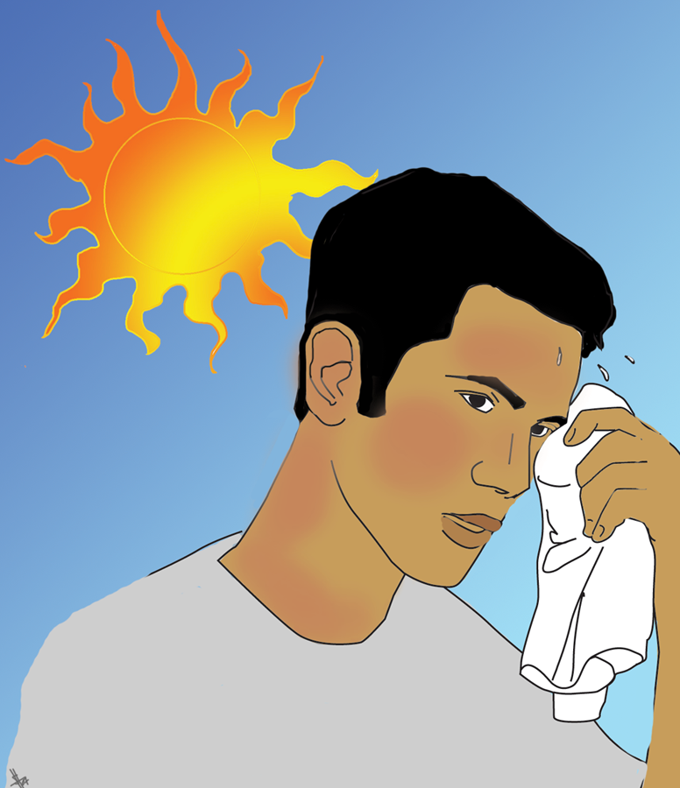
The Characteristics of Life
Maintains homeostasis
Regulation of an organism’s internal conditions to maintain life is called homeostasis.
If anything happens within or to an organism that affects its normal state, processes to restore the normal state begin.
Introduction to Biology
Copyright © McGraw-Hill Education

Slide 15
The Characteristics of Life
Adaptations evolve over time
An adaptation is any inherited characteristic that results from changes to a species over time.
Adaptations enable species to survive and pass on their genes to the next generation.
Adaptations are usually developed in response to an environmental factor.
Introduction to Biology
Copyright © McGraw-Hill Education

